Slide 1
26/10/2021
Special Report N°17/2021:
EU readmission cooperation
with third countries:
relevant actions yielded limited results

Slide 2




Why did we do this audit
What did we look at
What did we find
What do we recommend

Slide 3
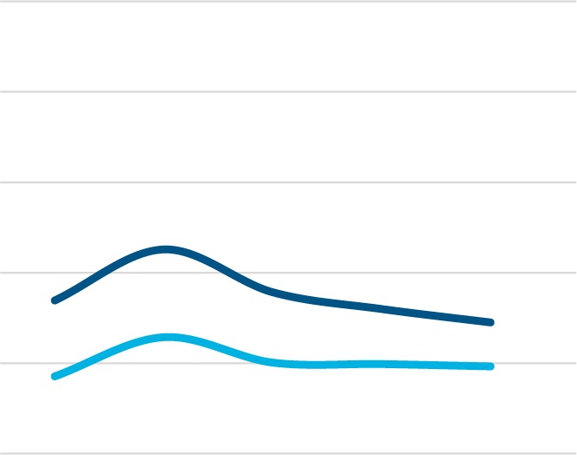
Why did we do this audit
Effective and well-managed return policy is an essential part of a comprehensive migration policy
Several reasons for low return rates among irregular migrants (see our report 24/2019 on Asylum, relocation and return):
  Internal - weaknesses in asylum and return legislation, and in Member States’ systems, procedures and capacities
  External - difficulty of cooperating with migrants’ countries of origin
Low returns of irregular migrants
100 %
80 %
60 %
Effective return rate (EU 27)
40 %
29 %
Returns to all third countries
20 %
19 %
Returns to third countries outside Europe
0 %
2015
2016
2017
2018
2019

Slide 4
What did we look at
Has EU effectively enhanced cooperation on readmission with third countries?
Has the EU made progress in concluding relevant readmission agreements or similar arrangements with third countries?
Has EU action facilitated effective implementation of third countries’ readmission obligations?
Audit
questions

Slide 5
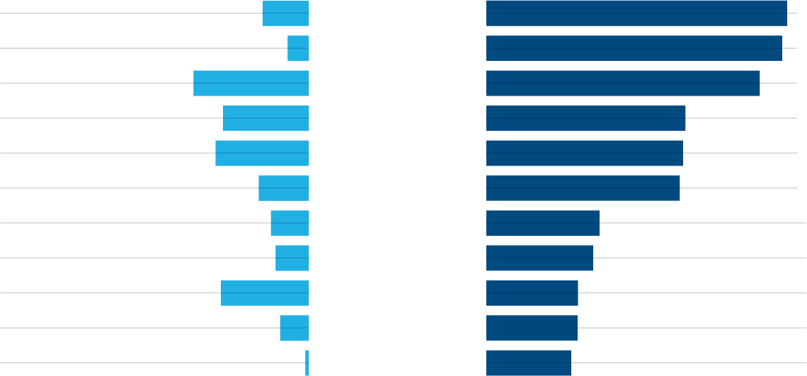
What did we look at
Period: 2015 (Action Plan on Return), until mid-2020
Coverage:
  10 third countries, based on the average number of non-returned irregular migrants (Syria excluded)
  38 % of return orders and 46 % of all unreturned irregular migrants from the EU during 2014-2018
Audit
scope
Yearly average returns of irregular migrants (2014-2018)
Returned third-country nationals to a third country following an order to leave (yearly average)
Countries ordered
in descending number of unreturned migrants
Unreturned irregular migrants (yearly average)
3 924
Afghanistan
25 620
1 793
Syria
25 199
9 810
Morocco
23 287
7 294
Pakistan
16 943
7 924
Iraq
16 759
4 245
Algeria
16 466
3 216
Nigeria
9 633
2 814
Tunisia
9 094
7 480
India
7 803
2 426
Bangladesh
7 771
291
Guinea
7 220

Slide 6
What was outside the scope of this audit
The alleged human rights breaches in the asylum and return procedures reported by NGOs / the media
The co-operation between Frontex and the Commission
The Belarus Readmission Agreement
Outside
scope

Slide 7
What did we find
Results of negotiations with third countries are suboptimal due to insufficient use of synergies with Member States and across EU policies
EU actions to facilitate readmission were relevant, but results were uneven and the impact could not be assessed
EU actions relevant, but yielded limited results

Slide 8
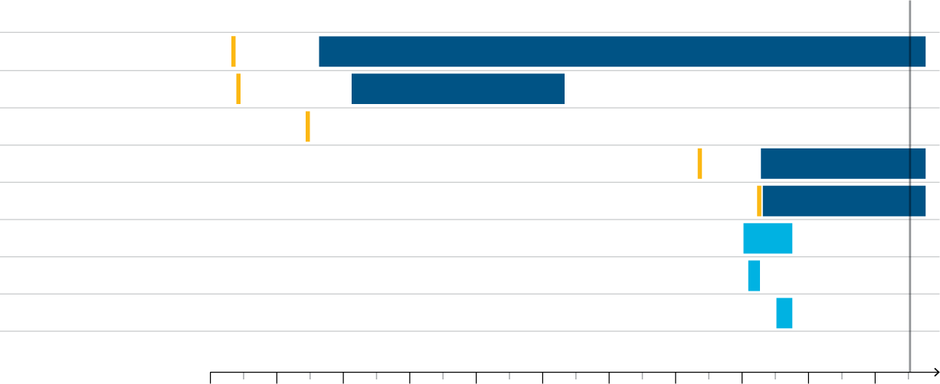
1
Results of negotiations with third countries are suboptimal due to insufficient use of synergies with Member States and across EU policies
Observations
The Commission and the EEAS did engage in readmission dialogue with the third countries with the most unreturned irregular migrants
Limited progress in concluding readmission agreements
More successful in negotiating legally non-binding readmission arrangements
Negotiations:
Mandate to negotiate
Readmission agreement
TODAY
Non-binding readmission arrangement
Morocco
Pakistan
Algeria
Tunisia
Nigeria
Bangladesh
Afghanistan
Guinea
2000
2002
2004
2006
2008
2010
2012
2014
2016
2018
2020

Slide 9
1
Results of negotiations with third countries are suboptimal due to insufficient use of synergies with Member States and across EU policies
Observations
Synergies with MS
Incentives
Coordination
No prior agreement with MS on potential incentives and tools to support negotiations
When MS associated in facilitating negotiations, beneficial in achieving results
EU political involvement needs to be stepped up
Commission able to use various policies ad-hoc
Structural incentives:
  Visa policy: most progress
  Development assistance: limited progress
  Trade: no progress yet
  Legal migration: synergies with MS needed
Negative incentives – mixed MS positions
Commission’s Partnership Framework Task Force
Coreper:
  Informal visa leverage mechanism (2017)
  Comprehensive leverage mechanism (2020)

Slide 10

2
EU actions to facilitate readmission were relevant, but results were uneven and the impact could not be assessed
Observations
Addressed by means such as:
Readmission process
CHALLENGES
Identification (confirming nationality/identity) based on:
documents (valid or expired)
biometric data
interviews by consulates
identification missions
Restrictions in types of accepted documents
Long delays (insufficient administrative capacity or lack of willingness to cooperate)
Nationality confirmed only in limited number of cases (primarily for voluntary returns)
readmission agreements and arrangements
EU MS networks to pool national resources
increased Frontex support
Acquisition of travel documents issued by:
Consulates
Authorities in third country
EU Member States (European travel document)
Long delays in issuing documents, resulting
in increased risk of absconding
Travel documents issued with short validity,
or even only for specific day of return
Refusal of European travel document for returns
Acceptance of transfer of returnee (transfer, admission)
Visa requirements for escorting officers (even if not leaving plane/airport) and obstructive procedures for issuing visas
Quantitative limits (number of flights per month, or returnees per flight)
Restrictions on accepted means of transport (limiting use of ferries, boats, charter flights, or airline companies)

Slide 11
2
EU actions to facilitate readmission were relevant, but results were uneven and the impact could not be assessed
Observations
Readmission agreements and arrangements
EU MS networks:
Eurint
EURLO
ERRIN
Frontex support
Cover most of the common obstacles (except EUTD, visas, quantitative limits)
But not necessarily observed in practice
JRC/JWG meetings with limited effectiveness
Successful in pooling national resources
Generally appreciated by participating countries for their results
Transfer to Frontex, but resources constraints
Increased support for MS pre-return activities and return operations
VC identification system effective, but most identified applied for protection
Identification missions - MS difficulties a major source of inefficiency
Support for returns by scheduled flights and with voluntary departures and returns growing quickly

Slide 12
2
EU actions to facilitate readmission were relevant, but results were uneven and the impact could not be assessed
Observations
Capacity Building Projects
(6 projects)
Reintegration Projects
(14 projects)
Data on returns and readmissions
Relevant for improving readmission cooperation
Development of electronic RCMS has potential to enhance cooperation on a structural level
Relevant to the needs of returnees and third countries
Likely to mostly deliver their planned outputs
“Sustainable reintegration” also depends on external factors and available resources
Shortcomings regarding data completeness and comparability
Regular assessment under revised VISA code - potential to improve EU data collection and sharing, and to facilitate evidence-based policy decisions

Slide 13
What do we recommend?
More flexible approach when negotiating readmission agreements
  Adapt contents of EURAs to specific features of readmission cooperation
  Agree procedure to pursue alternative arrangements when appropriate
1
Synergies with Member States to facilitate readmission negotiations
  Agree with MS on policies to potentially use as incentives beforehand
  Include key MS in the process of facilitating negotiations
2
Strengthen incentives for third countries to cooperate on readmissions
  Evaluate, at the inception phase, the potential of all newly proposed agreements, instruments and policies being used as incentives
3
Enhance data collection on readmissions and reintegration sustainability
  Introduce disaggregation on the swiftness of readmission procedures
  Collect data on the sustainability of returned migrants’ reintegration
4

Slide 14
Thank you for your attention!
Find out more about the other products and activities of the ECA:
eca.europa.eu
ECA-InstitutionalRelations@eca.europa.eu
@EUauditors
EUROPEAN COURT OF AUDITORS
12, rue Alcide De Gasperi
1615 Luxembourg
LUXEMBOURG

