Slide 1
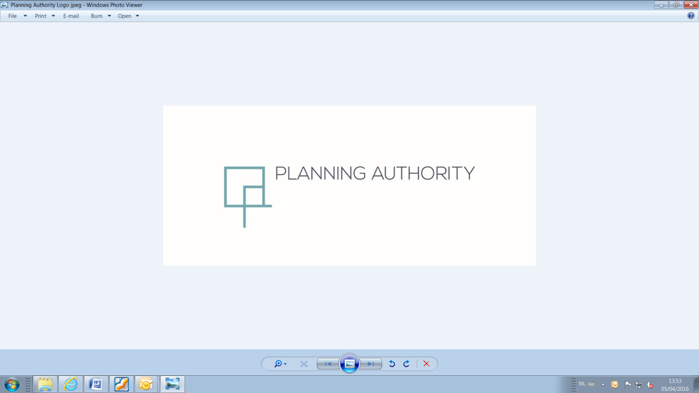
Partial Review to CMLP (2006)
Tal-Handaq North, Qormi
Area of Containment
Presentation to the Standing Committee on Environment and Development Planning
9th March 2021

Slide 2
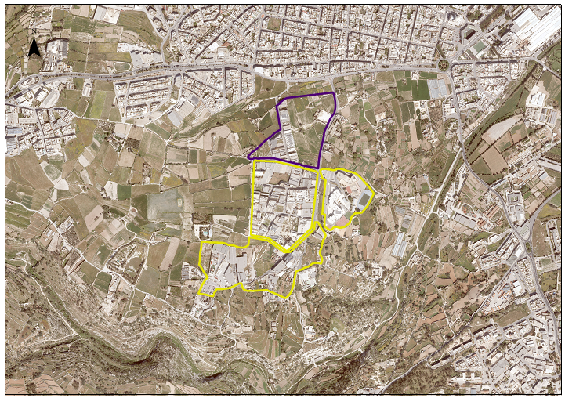
Qormi
Triq Guze Duca
Triq Guze Duca
Handaq North AoC
Handaq EHub
St Ignatius College
Handaq South AoC
Wied il-Kbir Protected Area

Slide 3
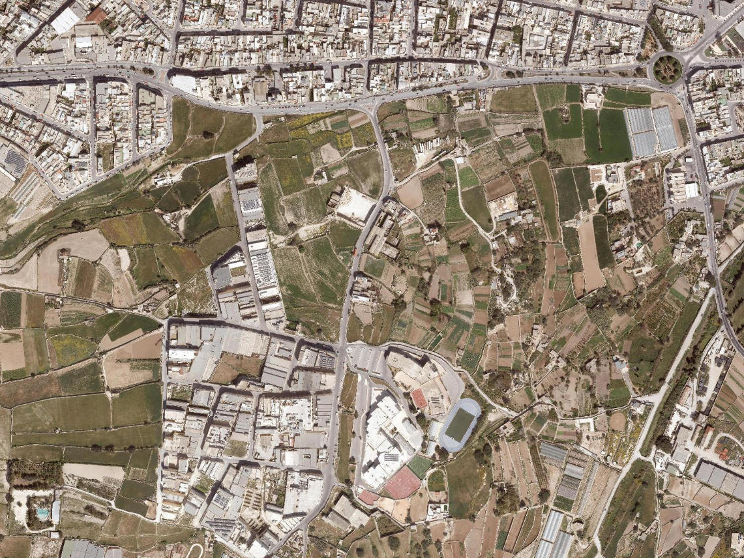
Handaq North
AoC

Slide 4
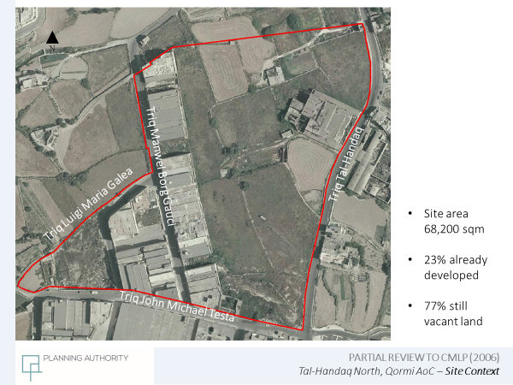

Slide 5
Plan Formulation Process
Publication of objectives for the Partial Local Plan Review in June 2016
Publication of the draft policy in September 2017
Publication of the revised draft policy in February 2021

Slide 6
Objectives of the Review
a) To establish the land use zoning, building height limitation, road alignments and other relevant planning parameters for the Area of Containment;
b) Initiate and follow the requirements of Policy CG05 (Area of Containment) of the Central Malta Local Plan;
c) To improve the general quality of the Area of Containment.

Slide 7
Draft Policy PRHA01 of 2017

Slide 8
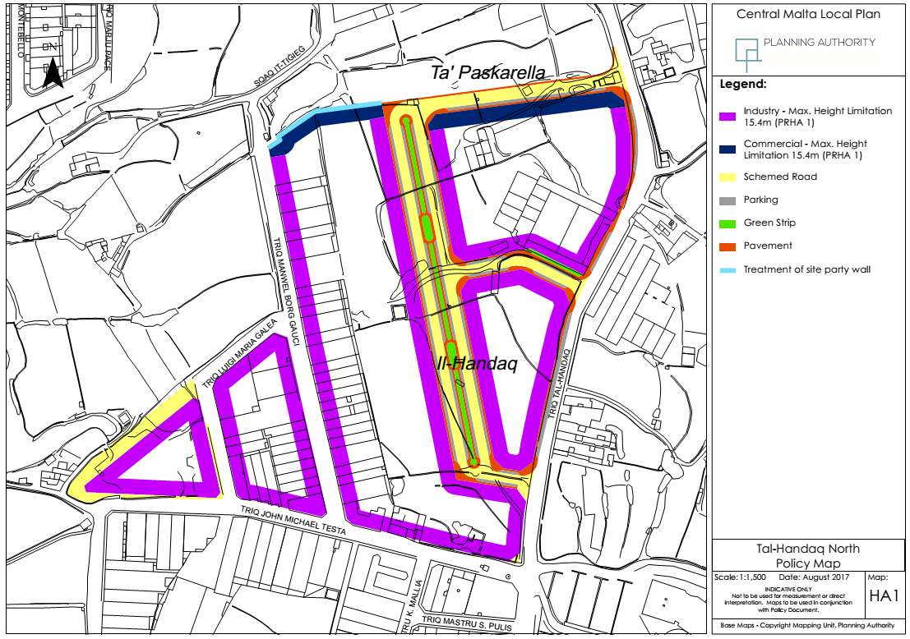

Slide 9
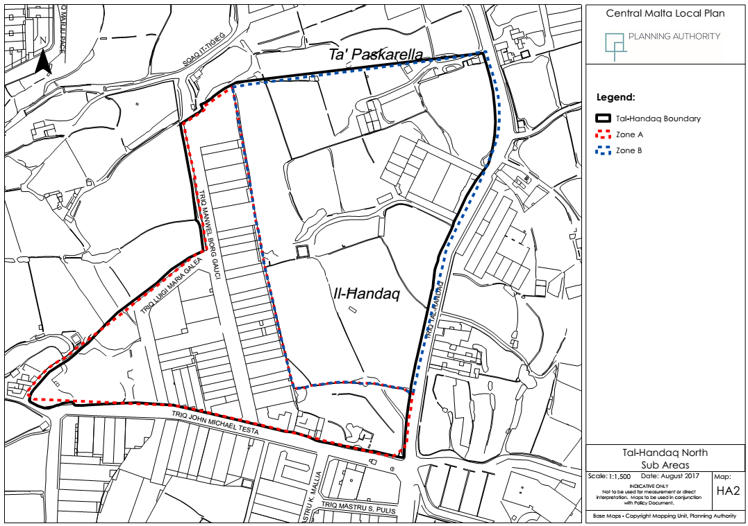
HAL-MULA, ZEBBUG AREA

Slide 10
POLICY PRHA 01 Handaq North Area of Containment
The Area of Containment at Handaq North, Qormi as indicated on the Map HA 1 is divided into 2 sub-areas Zones A and B (as per Map HA 2)
Land Use Framework:
Class 4A Offices and 4B Retail (on northernmost facade facing Triq Guze Duca only)
Class 5A Light Industry and 5B General Industry
Class 6A Warehousing, Storage and Distribution
Ancillary and supporting land uses subject to (i) and (iv) above remaining the predominant land use within the site
Industrial development to comply with all relevant regulations e.g.
operational permits, fire and safety etc.

Slide 11
Building Heights:
The height of development shall not exceed the maximum allowable height of 15.4 metres above the road level as per DC2015
Design:
New or redevelopment shall lead to an improvement in terms of visual appearance of the AoC and its surroundings through higher quality design and
Development should not result in the creation of blank party walls. On the northernmost facade indicated in light blue facing the Qormi by-pass, Triq Guze Duca, the side elevation of the development facing this road is to be treated and adequately designed.

Slide 12
The three building blocks indicated in Map HA1 and as shown within Zone B on Map HA2 shall be comprehensively planned within the development application process to ensure the adequate and timely provision of infrastructure and amenities including the central planned landscaped open space as a planning gain
The planning gain requirement is to follow an identification of costs for this road and landscaped belt by TM with cost funding apportioned to their respective site area

Slide 13
Transport and Parking:
The Urban Improvement Fund (UIF) is not applicable to the AoC and standard DC parking requirements apply
Along Triq tal-Handaq, vehicular loading/unloading/servicing will only be permitted if such operations can take place within the premises, for safety and efficient operations reasons.
Official Alignments:
Development planning applications are subject to the official road and building alignments as shown on Map HA 1

Slide 14
Public Consultation
2017 Public consultation resulted in 8 submissions
  2 from the general public;
  4 from landowners;
  1 from Qormi Local Council
  1 from ERA

Slide 15
Issues of Public Concern
Vacant land ODZ should not be developed
Request to add further land to the AoC
Objection to one of the proposed roads on private land
Road alignment to be amended to provide frontage to private property
Zone A should include showrooms, retail and offices
Building heights should be increased
Alternative layout proposed by owners
Vehicular roads should be 44 feet
Contrary to green strip as it will end up a dumpsite

Slide 16
Issues of Public Concern
Range of uses should be wider
Control of edge-of-scheme development
Adoption of an environmental management system
Comprehensive planning of the infrastructure
Storm water management plan
Waste management
Landscaping details

Slide 17
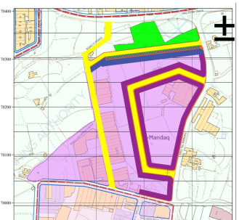
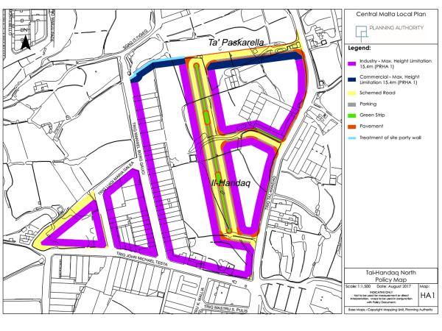
Public submission

Slide 18
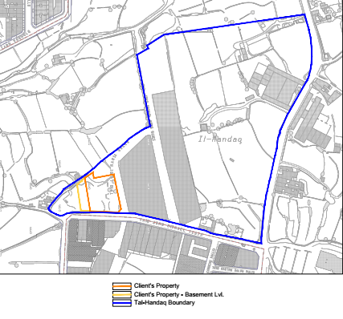
Public Submission

Slide 19
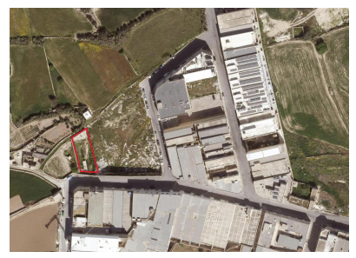
Public Submission

Slide 20

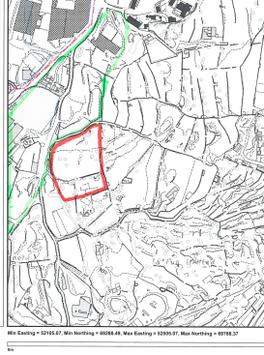


Slide 21
Comments by the Standing Committee
The Committee made the following recommendations:
Li l-Awtorita’ tal-Ippjanar tikunsidra li mill-planning gain isir titjib ta’ Sqaq it-Tigieg;
Li kemm jista’ jkun possibbli fit-triq il-principali tan-nofs il-parking jigi organizzat b’tali mod li jintrebah l-akbar ammont ta’ on street parking possibbli biex ikum hemm l-ahjar uzu tat-triq il-gdida li se tinholoq;
3. Li l-Awtorita’ tal-Ippjanar tikkunsidra li l-parti taz-zona kummercjali li s’issa ghadha mhijiex mibnija b’xi mod jigi evitat li jinholoq blank party wall li jkun possibbilment anke vizibbli min Triq l-Imdina. Biex jigi evitat dan il-blank party wall ghandu jinholoq passagg pedonali li l-Awtorita’ jidhrilha li jkun bizzejjed biex fuqu jinfethu l-aperturi;

Slide 22
Comments by the Standing Committee
The Committee made the following recommendations:
Li jigi diskuss ma’ Transport Malta l-ahjar cirkolazzjoni anke vis-a’-vis l-iskola li hemm fl-inhawi; u
5. Li l-Awtorita’ tal-Ippjanar tikkunsidra li b’mod tassattiv tara li eventwalment ikun hemm waste management tajjeb fis-sit

Slide 23
Partial Review to CMLP (2006)
Tal-Handaq North, Qormi AoC
TRANSPORT IMPACT ASSESSMENT
Terms of Reference issued by the Authority in May 2019

Slide 24
To study the transport impacts of FOUR (4) OPTIONS with the scope of identifying the preferred option from a transport point of view. Assumption - 2023 (opening year) and 2028 (5 years in operation).
OPTIONS
Different Configuration
SCENARIO 2
2 floors + 0.75 receded floor within the 15.4m height limitation
SCENARIO 1
3 floors + 0.75 receded floor within the 15.4m height limitation
X 4 OPTIONS
= 8 DIFFERENT SCENARIOS
PARTIAL REVIEW TO CMLP (2006)
Tal-Handaq North, Qormi AoC – Transport Impact Assessment

Slide 25

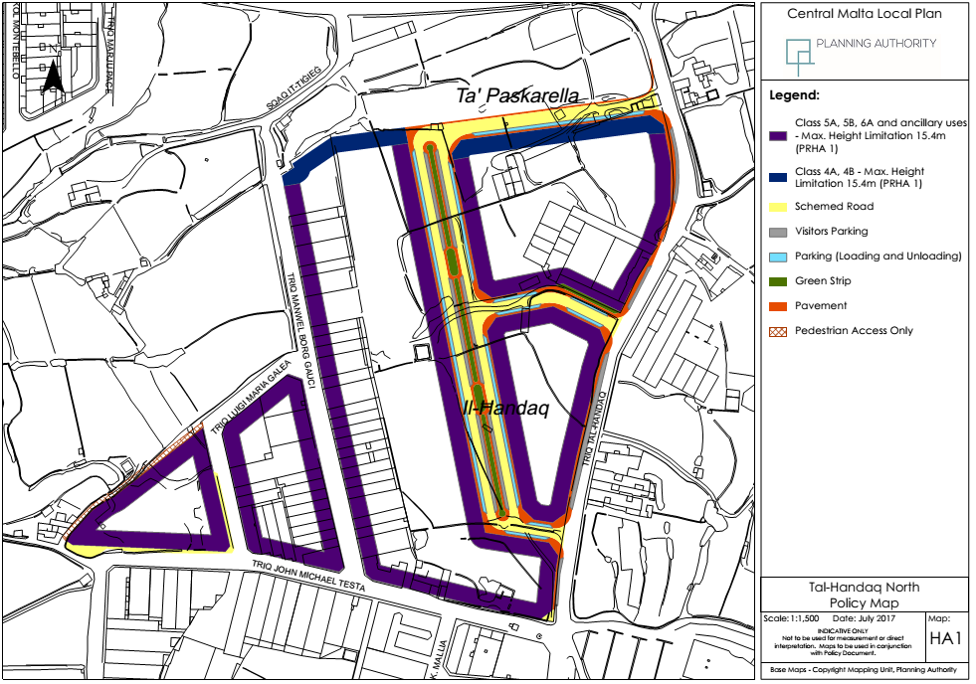
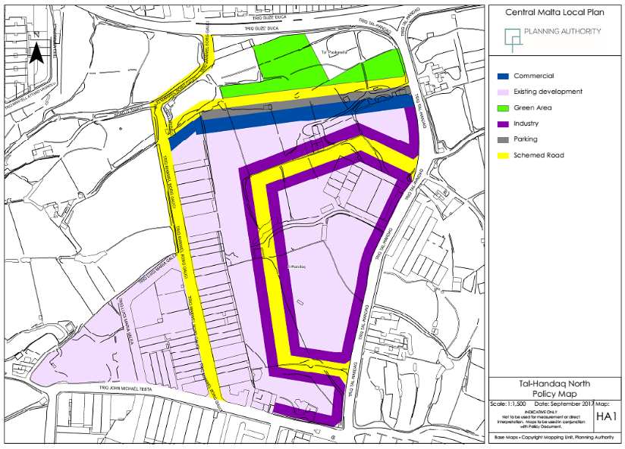
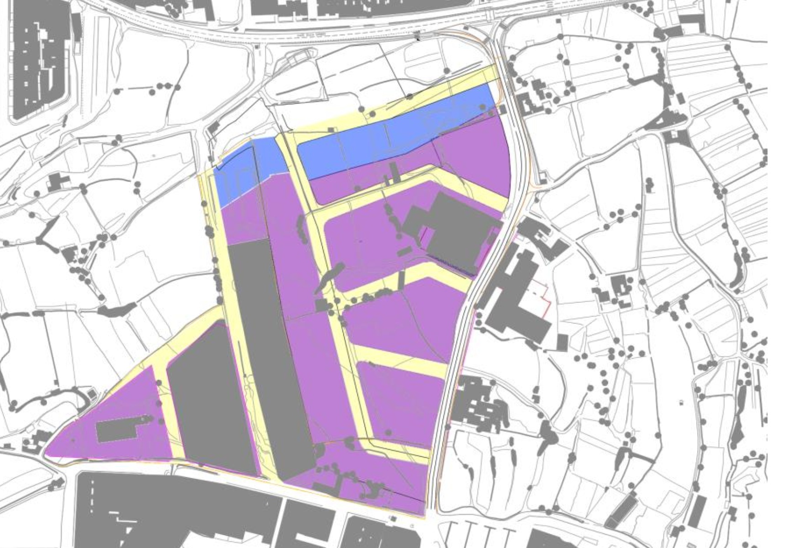
OPTION 1 SCENARIO 1 = 192,751sqm
OPTION 1 SCENARIO 2 = 147,789sqm
OPTION 2 SCENARIO 1 = 197,807sqm
OPTION 2 SCENARIO 2 = 151,566sqm
OPTION 3 SCENARIO 1 = 219,500sqm
OPTION 3 SCENARIO 2 = 168,376sqm
OPTION 4 SCENARIO 1 = 208,070sqm
OPTION 4 SCENARIO 2 = 159,277sqm

Slide 26
Main conclusion from TIA
JUNCTION IMPROVEMENTS ARE NECESSARY
IRRESPECTIVE OF THE PROPOSED
DEVELOPMENT SUBJECT OF THIS PARTIAL
REVIEW.

Slide 27
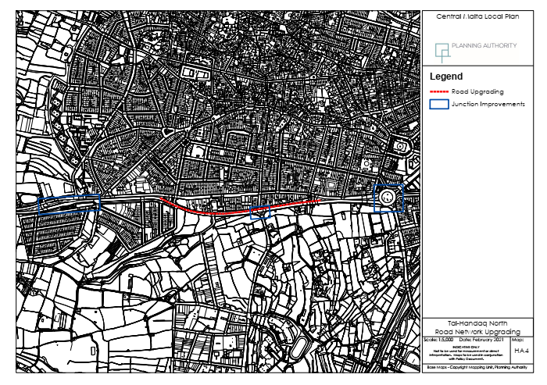
Proposed Road Junction Improvements

Slide 28
PERFORMANCE OF PROPOSALS
OPTION 1 – SCENARIO 2(FEASIBLE)
OPTION 4 – SCENARIO 2(BARELY FEASIBLE)
OPTION 3 – SCENARIO 2 IS NOT FEASIBLE.

Slide 29
Revision to draft policy of 2017
Development densities set at 2.75 levels
All vehicular routes to be 13.7m
Inclusion of pedestrian links
Centrally located green strip to be replaced by 5% amenity spaces in Zone B
Inclusion of independent offices in Zone B capped at 10,000sqm
Comprehensive planning areas based on land ownership
Provision of GI to be mandatory
The UIF payment scheme shall apply
Green transport Plans required with comprehensive areas

Slide 30
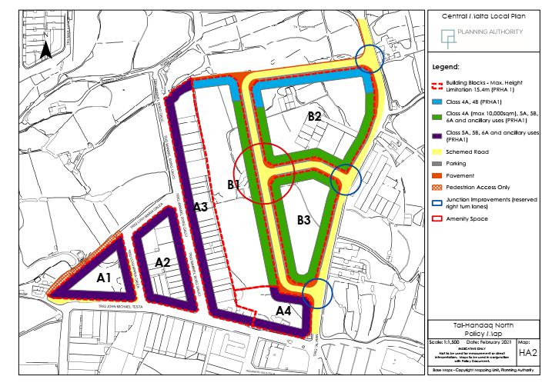

Slide 31
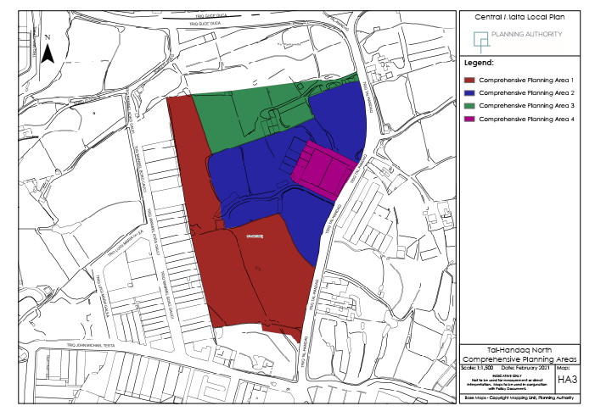

Slide 32
Way Forward
Revised policy open for consultation till 1/4/2021
email address: handaq_north@pa.org.mt

