Slide 1

Partial Local Plan Review
Zabbar ZA_A08
Draft Policy –
Presentation to Standing Committee on the Environment and Development Planning
26th January 2021
Notes:
1

Slide 2
Proposed Changes to Map ZA_A08 in SMLP
Re-zoning of a site from Open Space to Residential Area
Zoning of alternative site as Open Space and Parking Area

Slide 3
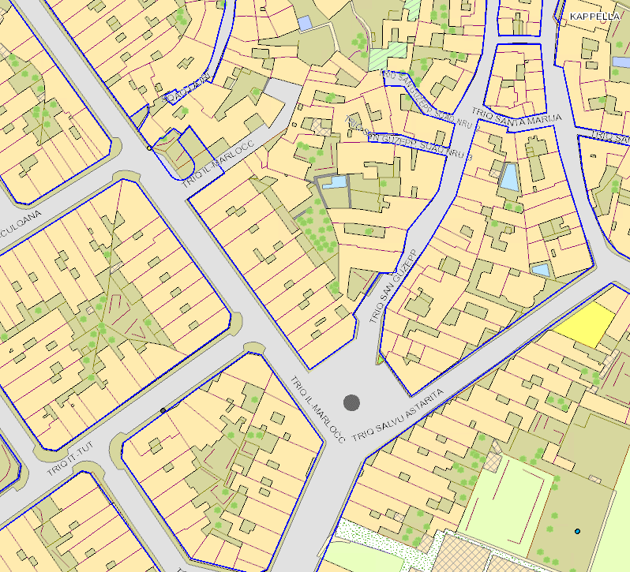
Current Indicative Alignment
SITE 1
SITE 2

Slide 4
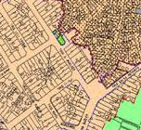
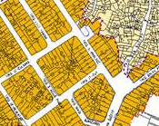
Policy Map
Building Heights Map

Slide 5
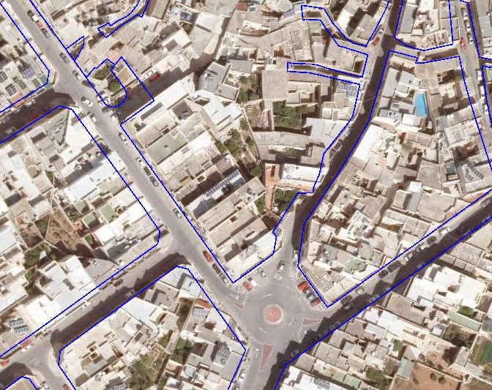
Aerial view of site(s)
SITE 1
SITE 2

Slide 6
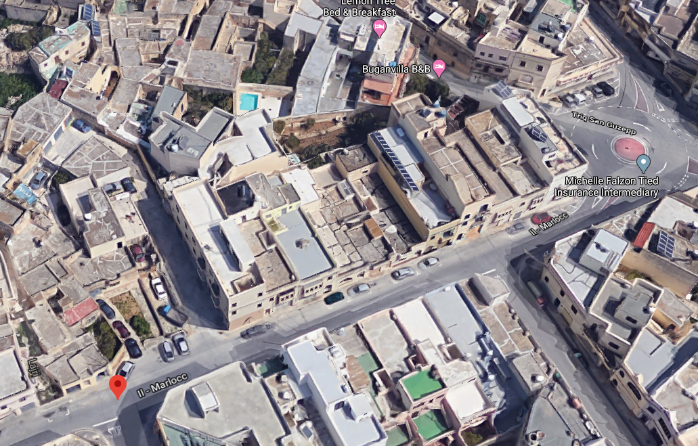

Slide 7
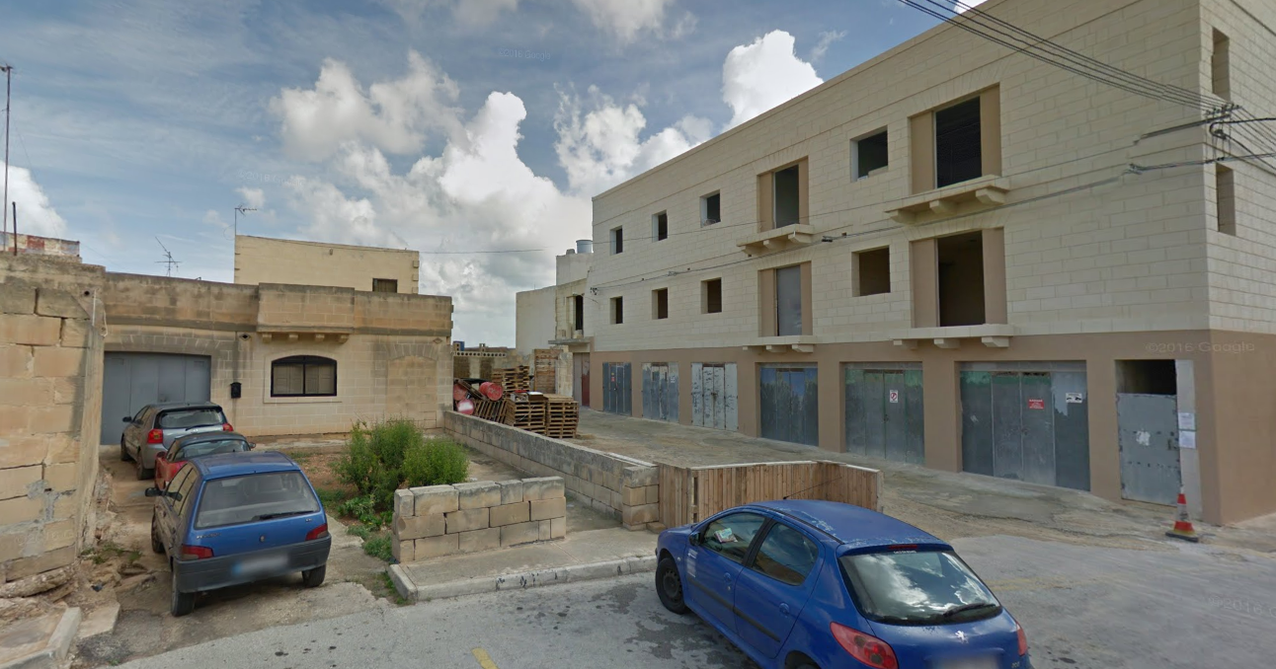
View of site 1

Slide 8
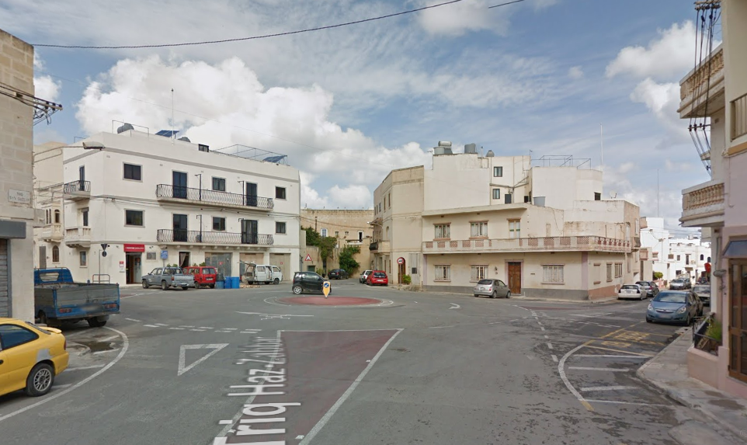
View of site 2

Slide 9
Procedures
The Executive Council agreed in principle to carry out a partial local plan of the South Malta Local Plan for Zabbar on its own motion.
In terms of article 41(2) of the Development Planning Act (Cap 552), when the Authority intends to carry out a review of a plan it must do so after consultation with the Minister.
Minister agreed to initiate partial review and to the draft objectives

Slide 10

Objectives
“To enable the implementation of a green urban open space project by rezoning for development a planned green open space at Triq il-Marlocc, Zabbar (indicated as Site 1 in the attached site plan), and zoning an alternative site currently made up of a road space junction between Triq il-Marlocc, Triq San Guzepp and Triq Salvu Astarita, Zabbar (indicated as Site 2 in the attached site plan), as a green public open space, at the expense of the owner/s of Site 1, without prejudicing proper traffic circulation and public parking provision while ensuring that there is a net public gain from the re-zoning exercise”.

Slide 11
Public Consultation on Objectives
9th October till the 30th October, 2020 – 6 submissions
Both sites should be zoned as green areas
Promotes intensification whereas more open spaces should be made available
Loss of green area replaced by a round-about
Site 1 is better suited as a public space
Rezoning Site 1 will increase transport issues
Site 2 has been upgraded with traffic improvement

Slide 12
Public Consultation on Objectives – cont.
Site 2 is unsafe for public enjoyment
Acknowledgment that Site 1 is not a ideal as a public space
No objection as long as there is a net public gain
Submission of guidelines for the consideration of public space design
Suggestion to introduce green infrastructure

Slide 13
Recommended Rezoning
Rezoning of Site 1 for residential development subject to Policy SMHO 02 with height of 3 floors and basement
Rezoning of Site 2 as public open space subject to Policy SMSE 04

Slide 14
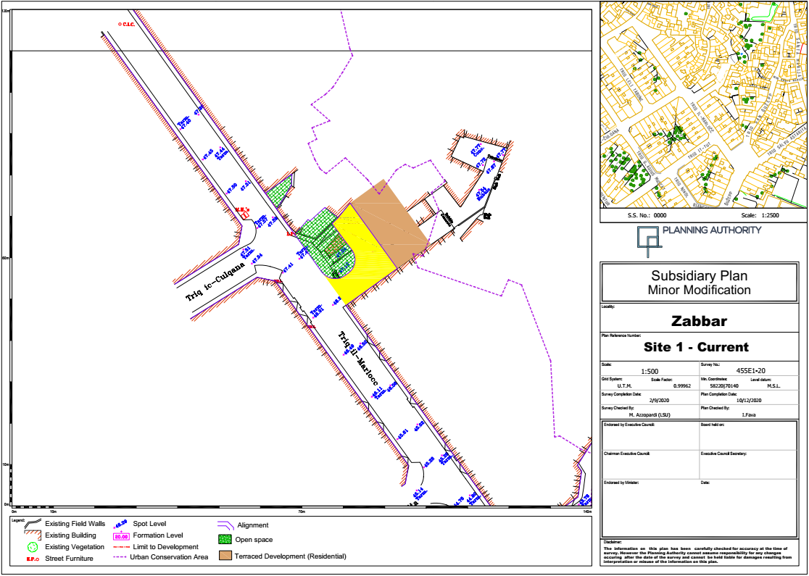

Slide 15
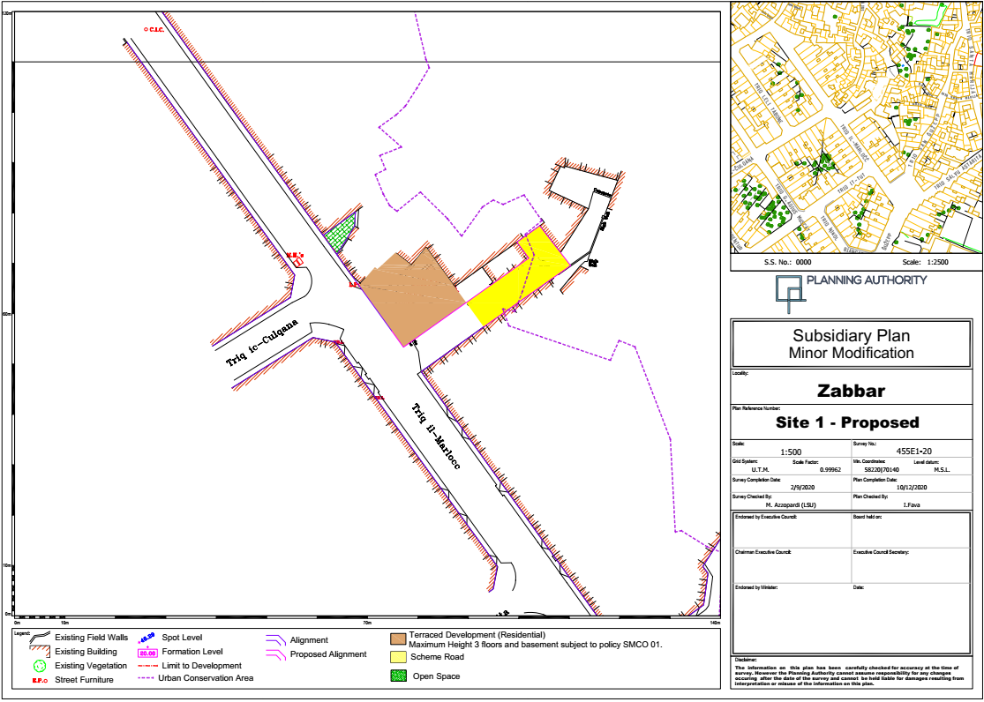

Slide 16
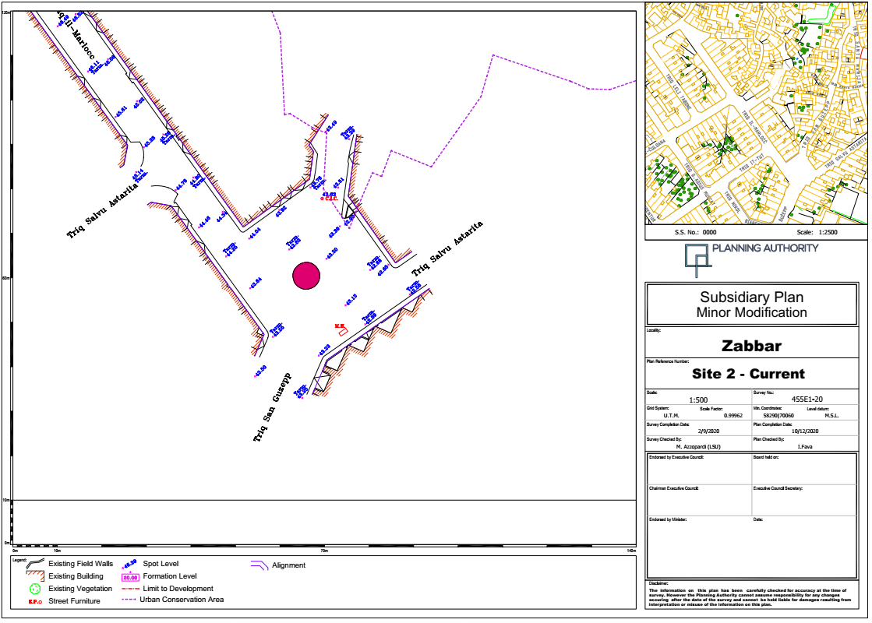

Slide 17
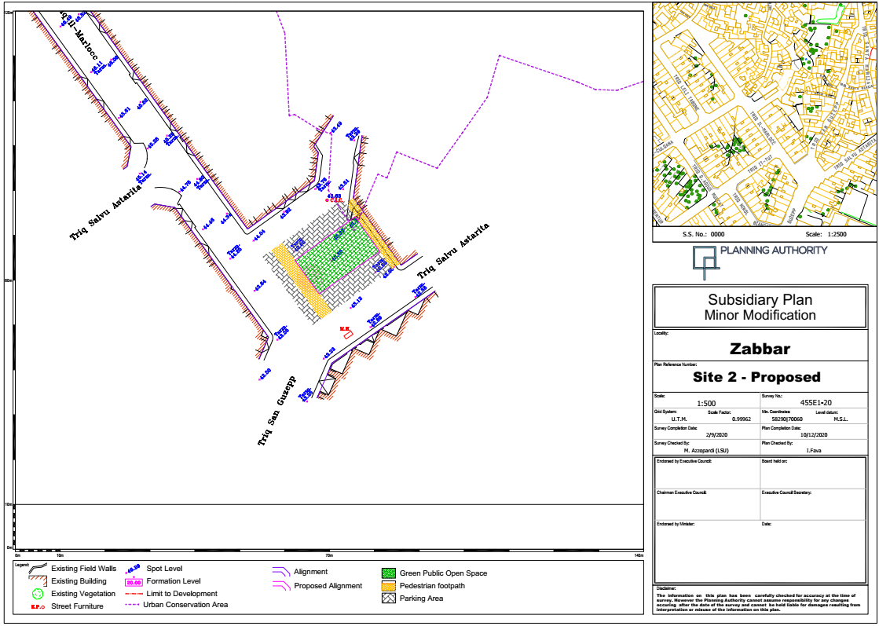

Slide 18
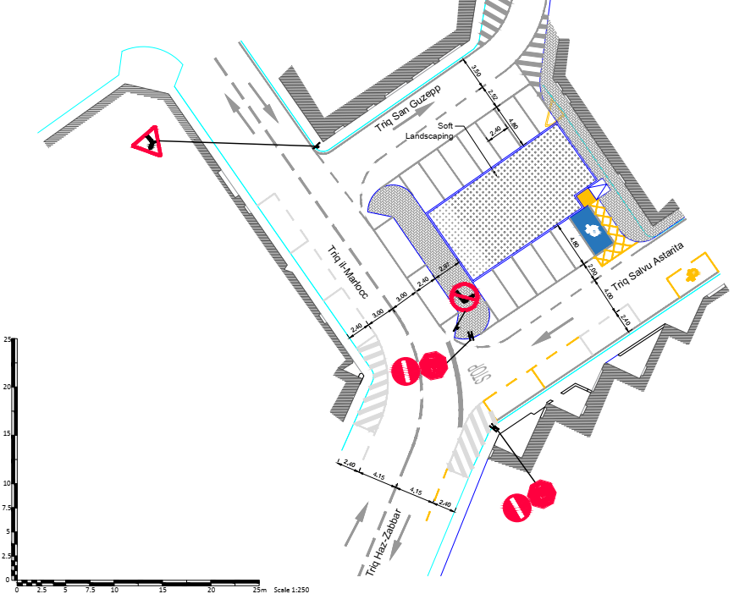

Slide 19
Conditions for rezoning of Site 1
Site 1 is zoned as a residential area and is subject to SMLP policy SMHO 02 - Residential Areas,
The building height of the rezoned Site 1 shall not exceed three floors with basement and is subject to policy SMLP policy SMCO 01 - Urban Conservation Areas and Design Priority Areas,
iii. The granting of development planning applications on Site 1 is subject to a financial planning gain which shall be specifically allocated for the development of the public open space at Site 2. The financial contribution shall be on a pro-rata basis of Eur 500 for every square meters of site area that shall be granted development permission within Site 1.

Slide 20
Way forward
The Planning Authority's Executive Council is referring this draft partial review for the scrutiny of the Standing Committee on Environment and Development Planning and also publishing it for a six-week public consultation period ending on the 5th February 2021.

Slide 21
End of Presentation

