Slide 1
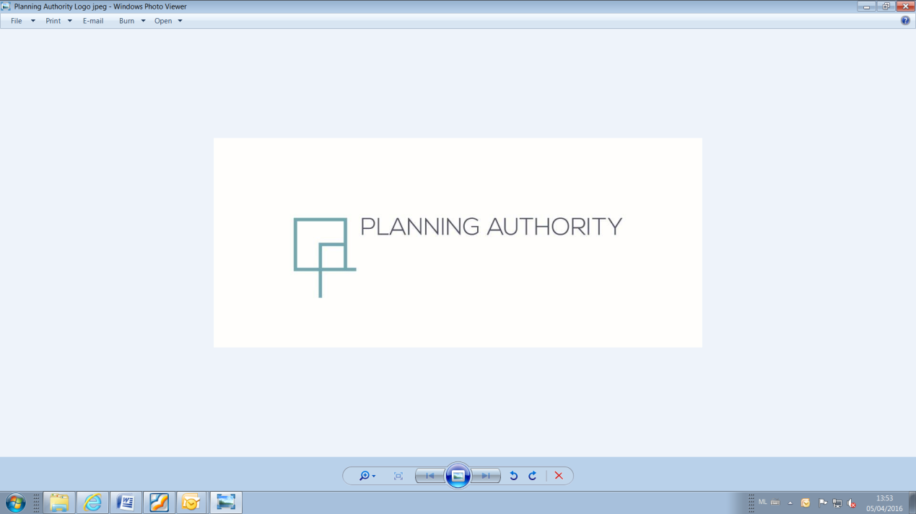
PARTIAL LOCAL PLAN REVIEW
South Malta Local Plan (Marsa Industrial Area)
Central Malta Local Plan (Imriehel Industrial Area)
Presentation to Standing Committee on Environment and Development Planning
12th January 2021

Slide 2
Partial Local Plan Review
South Malta Local Plan (Marsa Industrial Area) and the
Central Malta Local Plan (Imriehel Industrial Area)
INTRODUCTION

Slide 3
  This update to development regulations, specifically the revision of heights limitation in MIP estates, is amongst the measures identified to support the recently Government approved Industrial Infrastructure Enhancement Programme:-
    To repeal the building height limitation of 3 floors (12m) from the Marsa Industrial Estate;
    To repeal the building height limitation of 14m from the Malta Industrial Parks Estate (Area A) in Imriehel;
    To introduce non-numeric, urban design policies to guide the assessment of building heights in Marsa Industrial Estate and MIP Estate in Imriehel;
    To amend any other provisions in policies SMMR 01 & CG 14 which run counter to objectives (a) to (c) above.
OBJECTIVES
PARTIAL LOCAL PLAN REVIEW TO SMLP & CMLP
Marsa and Mriehel Industrial Estates – Introduction

Slide 4
Partial Local Plan Review
South Malta Local Plan (Marsa Industrial Area) and the
Central Malta Local Plan (Imriehel Industrial Area)
CONTEXT
MARSA INDUSTRIAL ESTATE

Slide 5
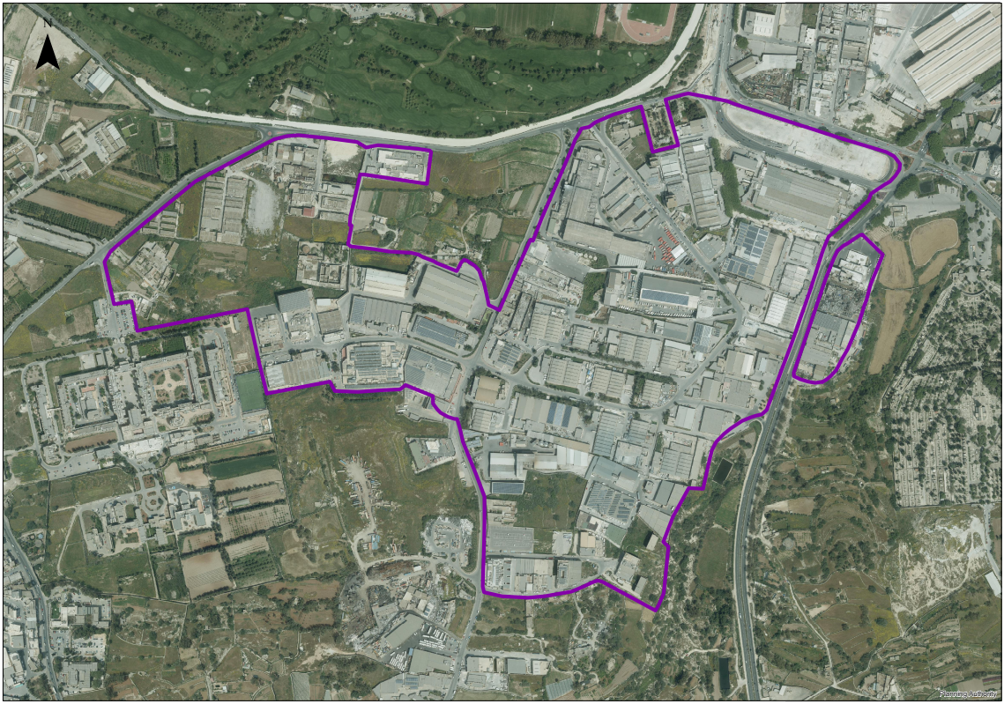
MARSA INDUSTRIAL ESTATE
PARTIAL LOCAL PLAN REVIEW TO SMLP & CMLP
Context of Marsa Industrial Estate

Slide 6
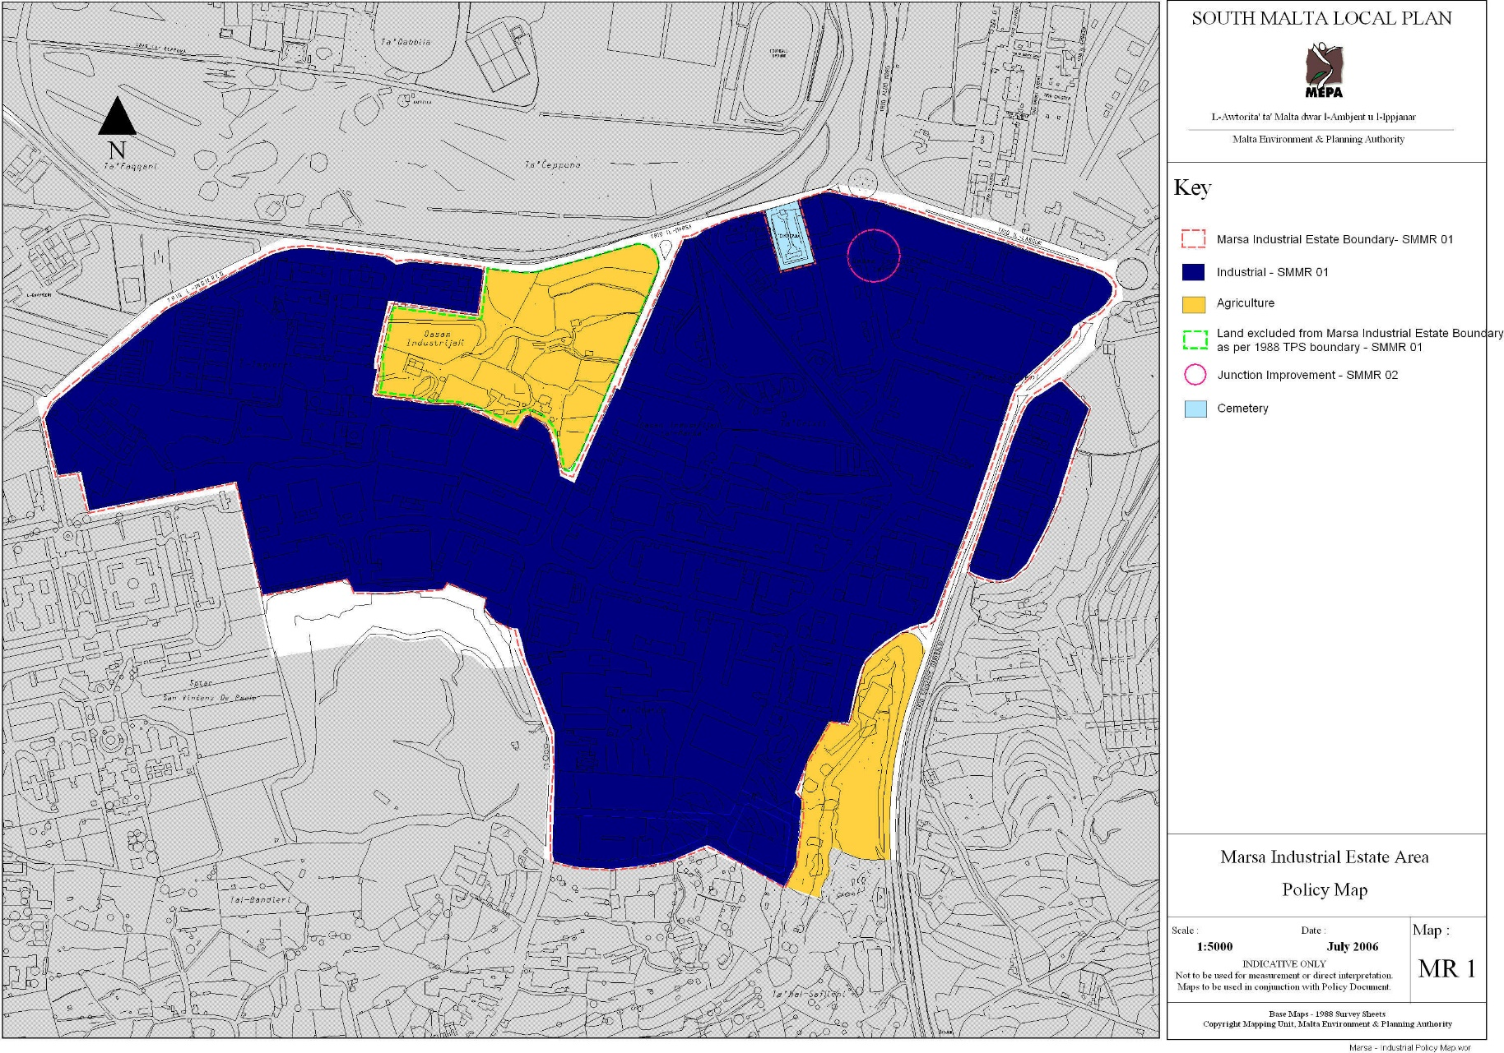
SOUTH MALTA LOCAL PLAN 2006
PARTIAL LOCAL PLAN REVIEW TO SMLP & CMLP
Context of Marsa Industrial Estate

Slide 7
SOUTH MALTA LOCAL PLAN 2006
POLICY SMMR 01 BOUNDARY LIMITS OF MARSA INDUSTRIAL ESTATE
The Limits of the Marsa Industrial Estate boundary are defined by the Temporary Provision Schemes, 1988. Amendment to the boundary is being recommended as indicated in the Marsa Industrial Estate Policy Map MR 1, to exclude an area which is considered of very good quality irrigated agricultural land.
The changes to the Limits to Development boundary of this area will only be formalized after the Structure Plan Review in line with SET 8.
Within this boundary the MEPA will only permit industrial and industrial related uses, including warehousing and storage.
In order to increase floorspace for industrial purposes and the efficient use of land, an additional storey above groundfloor level will be permitted where appropriate, however buildings should not exceed three floors (12metres). The vertical height and bulk of buildings should have no adverse visual impact and measures to introduce landscaping within the site and other site management measures will be encouraged, particularly along Triq G.Garibaldi and Triq il-Marsa.
The MEPA will seek to identify additional land for industrial use to make up for the land being proposed for exclusion. In the event of its failure to compensate for this land and Malta Industrial Park’s new emerging requirements, MEPA will consider the gradual reinstatement of this land for industrial development on the basis of individual applications subject to the preparation of an Environmental Impact Assessment which would include a cost/benefit analysis.
PARTIAL LOCAL PLAN REVIEW TO SMLP & CMLP
Context of Marsa Industrial Estate

Slide 8
*** THE FOLLOWING IS THE SUPPORTING TEXT OF POLICY SMMR 01
31.4.1 The site being excluded covers a land area of approximately 61,700 m2 and is considered as being good quality irrigated agricultural land. An application (PA 7505/94) was submitted in 1994 for the construction of a new factory for the General Soft Drinks Ltd. This application was recommended for refusal but then withdrawn by the applicant. The expropriation process for part of the site has been terminated in February 1997 by Government Notice No. 119. The MEPA will seek, together with the relevant authorities, to provide for such a shortfall in other designated areas, not necessarily within this Plan. However, should this not be possible in the short term, expansion of the existing estate, due to emerging economic factors, onto the site being excluded may be considered provided an EIA is carried out to determine the impacts relating to the proposed expansion. A cost/benefit analysis should also form part of the EIA.
31.4.2 Additional industrial floorspace can be provided for existing industries by allowing an additional floor above the ground floor level, where appropriate, provided that the two floors are not exceeded.
PARTIAL LOCAL PLAN REVIEW TO SMLP & CMLP
Context of Marsa Industrial Estate

Slide 9
Partial Local Plan Review
South Malta Local Plan (Marsa Industrial Area) and the
Central Malta Local Plan (Imriehel Industrial Area)
CONTEXT
MRIEHEL (AREA A) INDUSTRIAL ESTATE

Slide 10
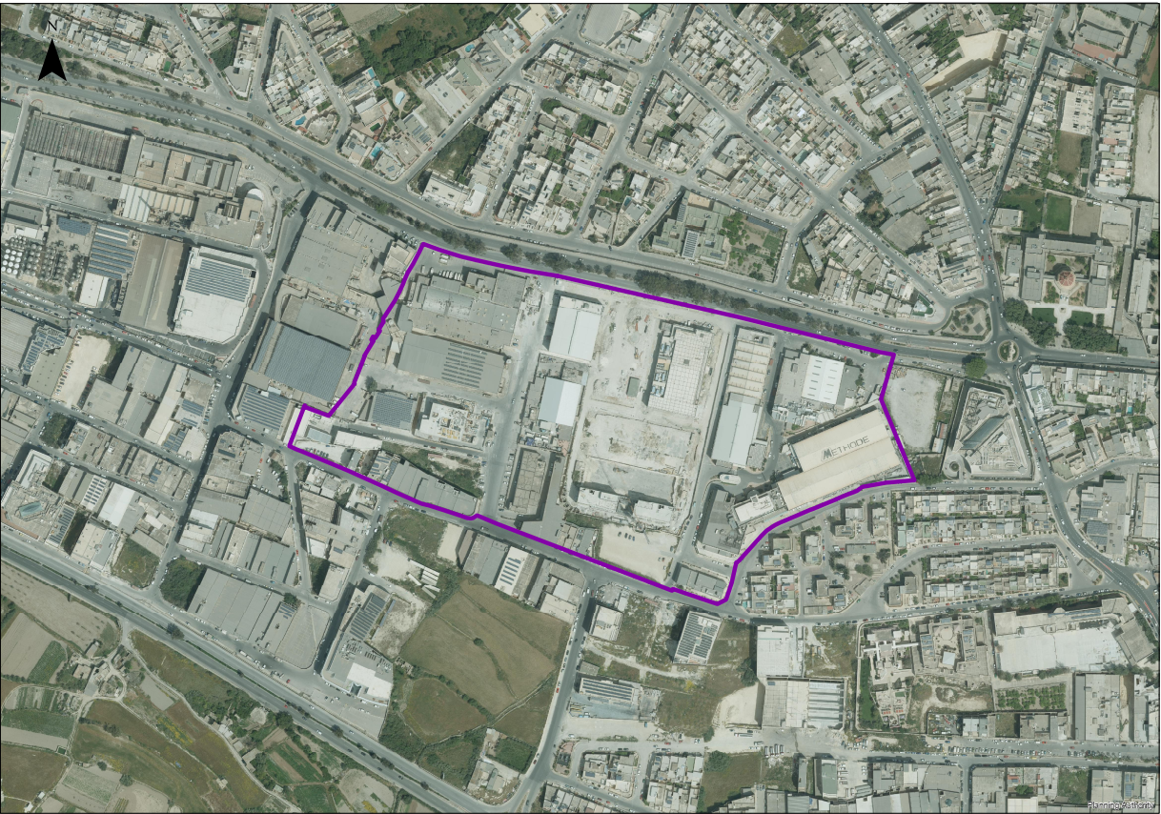
MRIEHEL INDUSTRIAL ESTATE AREA A
PARTIAL LOCAL PLAN REVIEW TO SMLP & CMLP
Context of Mriehel Industrial Estate Area A

Slide 11
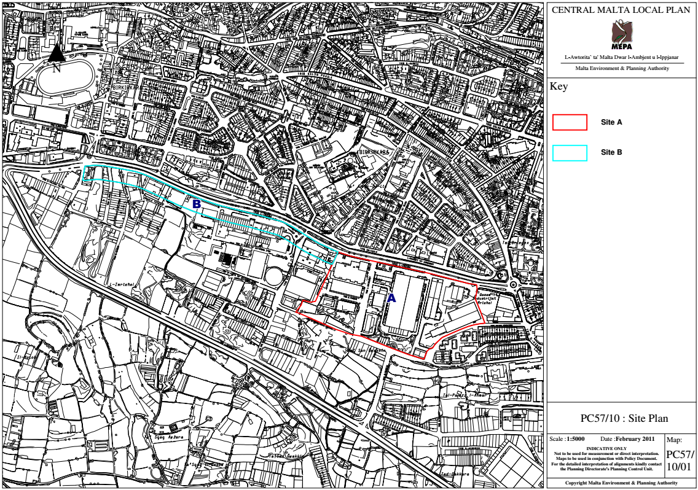
CENTRAL MALTA LOCAL PLAN 2006 AS AMENDED BY PC57/10 OF 2012
PARTIAL LOCAL PLAN REVIEW TO SMLP & CMLP
Context of Mriehel Industrial Estate Area A

Slide 12
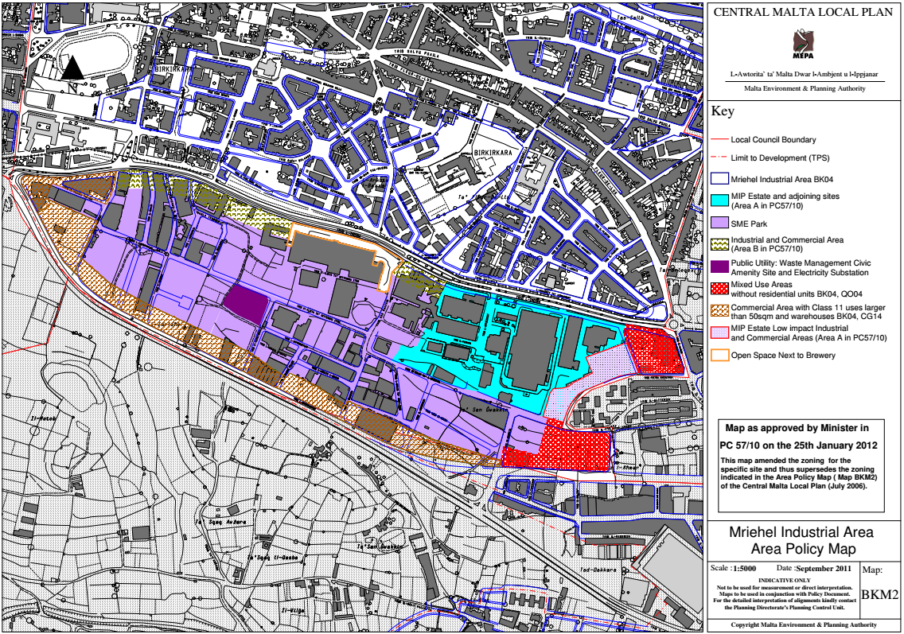
CENTRAL MALTA LOCAL PLAN 2006 AS AMENDED BY PC57/10 OF 2012
PARTIAL LOCAL PLAN REVIEW TO SMLP & CMLP
Context of Mriehel Industrial Estate Area A

Slide 13
CENTRAL MALTA LOCAL PLAN 2006 AS AMENDED BY PC57/10 OF 2012
Policy BK04 Mriehel Industrial Area
Mriehel Industrial Area is designated as an industrial, warehousing, and commercial zone as indicated in Area Policy Map BKM2 (as amended in PC57/10). MEPA may permit the development of land in the Mriehel Industrial Area in accordance with the designations indicated in the Area Policy Map BKM2 (as amended in PC 57/10) for the following land uses;
1. MIP Estate and adjoining sites (Area A in PC 57/10); for the development of Industrial Uses as specified in Policy CG15 and Commercial Uses as specified in Policy CG14 (as amended in PC57/10);
4. Industrial and Commercial Area (Area B in PC 57/10); for the development of land uses as specified in Policies CG14 (as amended in PC 57/10) and CG15;
PARTIAL LOCAL PLAN REVIEW TO SMLP & CMLP
Context of Mriehel Industrial Estate Area A

Slide 14
In granting permission for the above-listed uses, MEPA is to be satisfied that the design of the commercial development shall enhance the existing streetscapes. With regard to advertisements on buildings, these are either to be integrated with the design of the building fabric, or are to be placed in specific locations earmarked as advertising space within the Commercial Area.
In addition to the uses listed above, for those sites located within Areas A and B in Mriehel as indicated in Area Policy Map BKM2 (as amended in PC57/10) the uses stipulated in policy CG 15 may also be considered as acceptable. Land-uses falling outside those stipulated in policies CG14 and CG 15 will not be considered favourably within Areas A and B, unless there are overriding reasons to locate such uses within these areas. Development within these designated areas in Mriehel should conform to the following criteria;
Development should generally respect the predominant height of nearby buildings and would not in general be allowed to exceed a height of 14 m;
4. In cases where comprehensive development of sites having an area exceeding 25,000sq.m is contemplated, MEPA may consider a building that is higher than 14m provided that:
  The development follows best practice in terms of environmentally sustainable design, neighbour compatibility, construction, and operational management;
  The architectural design of the building is of exceptionally high quality;
  The development satisfactorily addresses short and long distance visual impacts;
  The development incorporates a significant and well designed public open space; and
  The project will not constitute over-development.
…
PARTIAL LOCAL PLAN REVIEW TO SMLP & CMLP
Context of Mriehel Industrial Estate

Slide 15
Partial Local Plan Review
South Malta Local Plan (Marsa Industrial Area) and the
Central Malta Local Plan (Imriehel Industrial Area)
PUBLIC CONSULTATION ON OBJECTIVES

Slide 16
In line with Section 53(2)(a), the objectives have been issued for a public consultation period of three weeks (09/10/20 – 30/10/20).
Changes to the height limitations are to be addressed through masterplan particularly based on the analysis of the current requirement for industrial uses.
The need for additional industrial floorspace is questionable (a) over-provision over recent years; (b) changes in practices due to work at home and; (c) can be met by the still remaining vacant designated industrial land.
A masterplan would also consider the building height in a holistic manner to ensure a smooth transition along the skyline and long-distance views.
The height and design of buildings should respect the surrounding settings, particularly protected heritage features (Grade 1 Santa Maria Addolorata Cemetery, Grade 1 Turkish Cemetery in Marsa and Grade 1 Wignacourt Aqueducts in Mriehel).
This review should also include provisions for the implementation of adequate GI & public open spaces and could also provide an opportunity to tie consents for increases in building heights with obligations relating to the installation of PV panels.
SUMMARY
PARTIAL LOCAL PLAN REVIEW TO SMLP & CMLP
Marsa and Mriehel Industrial Estates – Public Consultation on Objectives

Slide 17
Partial Local Plan Review
South Malta Local Plan (Marsa Industrial Area) and the
Central Malta Local Plan (Imriehel Industrial Area)
PROPOSED CHANGES TO SMMR 01

Slide 18
SOUTH MALTA LOCAL PLAN 2006
SMMR 01 Boundary Limits of Marsa Industrial Estate
The Limits of the Marsa Industrial Estate boundary are defined by the Temporary Provision Schemes, 1988. Amendment to the boundary is being recommended to exclude an area which is considered of very good quality irrigated agricultural land. The changes to the Limits to Development boundary of this area will only be formalized after the Structure Plan Review in line with SET 8. indicated in the Marsa Industrial Estate Policy Map MR 1
Within this boundary the MEPA will only permit industrial and industrial related uses, including warehousing and storage.
In order to increase floorspace for industrial purposes and the efficient use of land, an additional storey above groundfloor level will be permitted where appropriate, however buildings should not exceed three floors (12 metres). The vertical height and bulk of buildings should have no adverse visual impact and measures to introduce landscaping within the site and other site management measures will be encouraged, particularly along Triq G. Garibaldi and along Triq il-Marsa.
PARTIAL LOCAL PLAN REVIEW TO SMLP & CMLP
Marsa and Mriehel Industrial Estates – Changes to SMMR 01

Slide 19
… SMMR 01 Boundary Limits of Marsa Industrial Estate
The following urban design parameters are to be taken into consideration as guidance for the assessment of building heights:
the operational needs of the proposed/existing industrial use, including any requirement for plant or machinery which needs abnormal floorspace or height for its installation or operation;
the degree to which the overall height of the building can be reduced by construction below ground level;
adequate development densities to ensure quality development and any other relevant planning considerations including safeguards on existing utilities, services and infrastructure.
the topography of the site and of the area surrounding the site;
the relationship of the development to any sites and/or buildings whose amenity should be protected, in particular the setting of scheduled sites and/or monuments;
the prominence of the development in the wider landscape, and in particular the impact of the building on the skyline when seen from outside the site area;
PARTIAL LOCAL PLAN REVIEW TO SMLP & CMLP
Marsa and Mriehel Industrial Estates – Changes to SMMR 01

Slide 20
the general massing and design of the building in relation to its urban design context such that the development follows best practice in terms of environmentally sustainable design, neighbour compatibility, construction and operational management;
no blank party walls are to be created;
The PA will seek to identify additional land for industrial use to make up for the land being proposed for exclusion. In the event of its failure to compensate for this land and Malta Industrial Park’s new emerging requirements, PA will consider the gradual reinstatement of this land for industrial development on the basis of individual applications subject to the preparation of an Environmental Impact Assessment which would include a cost/benefit analysis .
31.4.1 The site being excluded covers a land area of approximately 61,700 m2 and is considered as being good quality irrigated agricultural land. An application (PA 7505/94) was submitted in 1994 for the construction of a new factory for the General Soft Drinks Ltd. This application was recommended for refusal but then withdrawn by the applicant. The expropriation process for part of the site has been terminated in February 1997 by Government Notice No. 119. The PA will seek, together with the relevant authorities, to provide for such a shortfall in other designated areas, not necessarily within this Plan. However, should this not be possible in the short term, expansion of the existing estate, due to emerging economic factors, onto the site being excluded may be considered provided an EIA is carried out to determine the impacts relating to the proposed expansion. A cost/benefit analysis should also form part of the EIA.
31.4.2 Additional industrial floorspace can be provided for existing industries by allowing an additional floor above ground floor where appropriate provided that the two floors are not exceeded through a context based approach to the assessment of building heights, provided that the above-mentioned urban design parameters are addressed .
PARTIAL LOCAL PLAN REVIEW TO SMLP & CMLP
Marsa and Mriehel Industrial Estates – Changes to SMMR 01

Slide 21
Partial Local Plan Review
South Malta Local Plan (Marsa Industrial Area) and the
Central Malta Local Plan (Imriehel Industrial Area)
PROPOSED CHANGES TO CG14

Slide 22
Development should generally respect the predominant height of nearby buildings and would not in general be allowed to exceed a height of 14 m;
PARTIAL LOCAL PLAN REVIEW TO SMLP & CMLP
Marsa and Mriehel Industrial Estates – Proposed Changes to CG14

Slide 23
(A) Within Area A, the following urban design parameters are to be taken into consideration as guidance for the assessment of building heights:
the operational needs of the proposed/existing industrial use, including any requirement for plant or machinery which needs abnormal floorspace or height for its installation or operation ;
the degree to which the overall height of the building can be reduced by construction below ground level;
adequate development densities to ensure quality development and any other relevant planning considerations including safeguard on existing utilities, services and infrastructure.
the topography of the site and of the area surrounding the site;
the relationship of the development to any sites and/or buildings whose amenity should be protected, in particular the setting of scheduled sites and/or monuments as well as the residential context.
the prominence of the development in the wider landscape, and in particular the impact of the building on the skyline when seen from outside the site area;
the general massing and design of the building in relation to its urban design context such that the development follows best practice in terms of environmentally sustainable design, neighbor compatibility, construction and operational management;
no blank party walls are to be created;
(B) Within Area B, development should generally respect the predominant height of nearby buildings and would not in general be allowed to exceed a height of 14 m;
PARTIAL LOCAL PLAN REVIEW TO SMLP & CMLP
Marsa and Mriehel Industrial Estates – Proposed Changes to CG14

Slide 24
CENTRAL MALTA LOCAL PLAN 2006 AS AMENDED BY PC57/10 OF 2012
4. In cases where comprehensive development of sites having an area exceeding 25,000sq.m is contemplated, the Planning Authority may consider a building that is higher than 14m would have been achieved by applying the provisions of criterion 1 above provided that:
    The development follows best practice in terms of environmentally sustainable design, neighbour compatibility, construction, and operational management;
    The architectural design of the building is of exceptionally high quality;
    The development satisfactorily addresses short and long-distance visual impacts;
    The development incorporates a significant and well-designed public open space; and
    The project will not constitute over-development.
…
PARTIAL LOCAL PLAN REVIEW TO SMLP & CMLP
Marsa and Mriehel Industrial Estates – Proposed Changes to CG14

Slide 25
Partial Local Plan Review
South Malta Local Plan (Marsa Industrial Area) and the
Central Malta Local Plan (Imriehel Industrial Area)
PUBLIC CONSULTATION
Public consultation open till the 29th of January 2021
Submissions received on industry.review@pa.org.mt

