Slide 1
Partial Review of the
Local Plan and Development Brief for Hal Ferh
Presentation to the Parliamentary Standing Committee on the Environment and Development Planning
23rd November 2020

Slide 2
Government Objectives
The objectives of the Review of the 2006 North West Local Plan policy NWGT 1 and of the December 2008 Hal Ferh Development Brief are:
To include Class 1 (Use Classes Order, 2014) permanent residential development in the list of acceptable land-uses on the site provided that:
(a) the primary land-use in terms of gross developable floorspace (GDF) remains tourism accommodation but the brief shall also establish a balanced allowance for residential use;
(b) no increase in the total GDF shall be allowed;
(c) the development brief shall include planning parameters for residential use, to be developed in a comprehensive manner as part of the tourist complex;
(d) all other provisions of policy NWGT 1 and the development brief shall remain unchanged without prejudice to the development already permitted in development permissions issued prior to the coming into force of the revised policy provisions.

Slide 3
Public Consultation
The Objectives were published on the 8th May 2020 and representations from the public were invited until the 1st June 2020.
The first stage consultation generated a total of 16 submissions
Submissions from 8 private individuals and from the following entities:
Malta Streets Sports Association,
Din l-Art Helwa,
Corinthia Group,
The Energy and Water Agency,
Mellieha Local Council,
Malta Chamber of Planners,
Environment and Resources Authority (ERA),
Kummissjoni Interdjocesana Ambjent

Slide 4
Issues of public concern
Objections to the Principle of residential use of the site
Proposal runs counter to SPED
Submission by Corinthia Group
Roads, parking and infrastructure
Conservation and Sustainability
Submission Requirements

Slide 5
Current Policies - SPED
Tourism as a core development sector with potential for economic growth
Thematic Objective 1 seeks the management of land resources sustainably to ensure that socio-economic development needs are met and policies TO1.2 - safeguarding prime tourism sites, TO1.5 – achieving a wider mix of compatible uses, and TO1.10 – ensuring that Rural Areas are not exploited by uses which are not legitimate or necessary, are policy tools to achieve this objective.
Rural Objective 3 states that development in the Rural Area which is justified to be located in the Rural Area in approved Government policies, plans or programmes, should be located away from protected areas and areas of high landscape sensitivity, preferably on previously developed land or existing buildings while ensuring the improvement of the quality of the rural environment.

Slide 6
Current Policies – North West Local Plan 2006
Policy NWGT 1 sets out broad guidelines on land use, building conservation and design, site layout, access and landscaping. The land uses were limited to:
the primary land uses which fall within tourism accommodation, camping and horse-riding facilities and
to supporting amenities to the main use such as retail, catering, storage, administration etc.

Slide 7
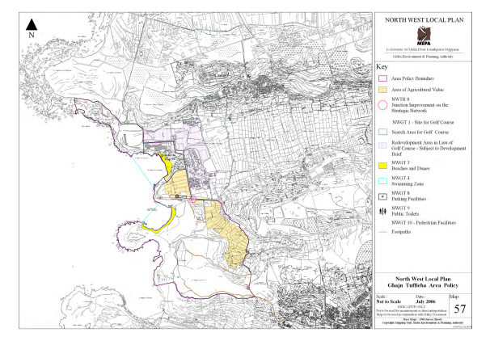
NWLP Policy Map 57

Slide 8
Current Policies – Development Brief 2008
The Development Brief covered an area of 8.5ha which included the redundant Hal-Ferh tourist complex and its immediate surrounding areas in Ghajn Tuffieha
Limited the land uses to quality tourism and recreation uses with preference to a high quality, family-oriented tourism development which includes accommodation and supporting facilities.
The Brief also encouraged the retention and rehabilitation of the former military buildings, organised the site into four zones and allocated a public carpark on zone 4.
Capping on the area covered by buildings to 16,700sqm, a total gross floorspace of 25,000sqm and a maximum building height for new buildings of either 1 floor (4.75m) or 2 floors (8.5m).

Slide 9
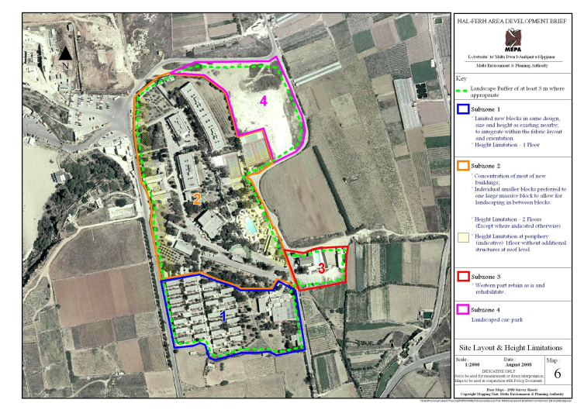
Policy Map in Development Brief

Slide 10
Current Permissions – PA4906/10, PA3134/19
PA4906/10 was granted in February 2013 and became executable in October 2018
PA3134/19 was granted in August 2019 and became executable in February 2020
Project was described as a high quality low-lying and low-density tourist resort that complements the sensitive surrounding landscape.
Included a total of 228 units (1/2/3 bed) with ancillary facilities including restaurant, small convenience shop, pools and bars, spa and underground parking facilities totalling to 293 parking spaces.
Landscaping on its accessible ‘walkway’ roof.
Did not include the retention of the former military barracks and the public carpark was located outside the site boundary delineated by the Brief

Slide 11
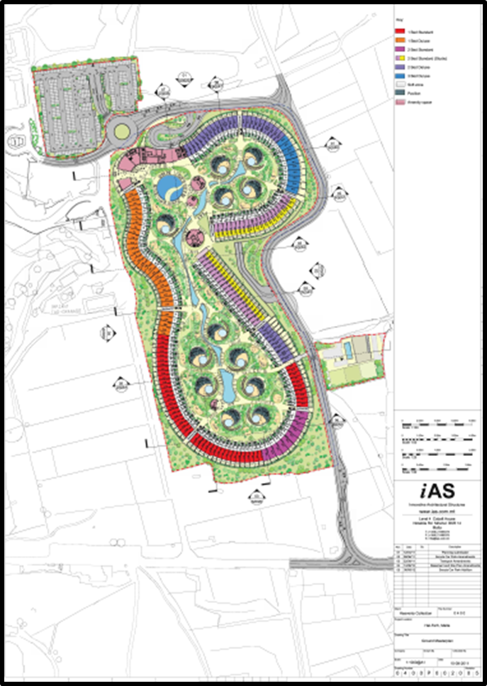

Approved Master Plan

Slide 12
Revised NWLP Policy NWGT 1
NWGT 1 Site for Golf Course
The site shown on Map 57 is being indicated as a search area for the development of a golf course with ancillary built development to accommodate supporting amenities. PA will utilise the environmental impact assessment (EIA) process to determine the best layout and design for the course and the built development within the site if the environmental impacts can be adequately mitigated.
Should Government not continue to pursue the golf course proposal, PA will favourably consider the development or complete redevelopment of the smaller area, or parts of it, on the west of the site indicated on Map 57 subject to the preparation of a Development Brief provided that:
(i) the prior approval of the Malta Tourism Authority is obtained;
(ii) the primary land uses fall within tourism accommodation, camping and horse-riding facilities with supporting amenities to the main use such as retail, catering, storage, administration etc., and separate, high quality, residential accommodation developed comprehensively as part of the tourist complex provided that the primary land-use in terms of gross developable floorspace (GDF) remains tourism accommodation;

Slide 13
Revised NWLP Policy NWGT 1
(iii) any features or structures of historical or architectural merit are conserved and integrated in the development without prejudice to any development already permitted in development permissions issued prior to the coming into force of this criterion;
(iv) new buildings are designed (height, form, massing, materials and colours) to respect and integrate well with the rural context and the contours of the site;
(v) the site layout provides appropriate open spaces between buildings to break the bulk of the built development. The Authority may consider alternative site layouts which it deems still achieve high quality design objectives;
(vi) adequate access and onsite parking is provided;
(vii) a landscaping scheme, a planting schedule and maintenance programme, in line with the PA Guidelines on Trees, Shrubs and Plants for Planting and Landscaping in the Maltese Islands, indicating the details of the hard and soft landscaped areas is submitted and approved.

Slide 14
Revisions to the Development Brief - 1
Scope of revisions:
  to bring the policy document in line with the revisions introduced in policy NWGT 1 relating to the inclusion of Class 1 (Use Classes Order, 2014) permanent residential development in the list of acceptable land-uses on the site;
  to establish a balanced allowance for residential use;
  include planning parameters for residential use;
  any development already permitted in development permissions issued after the approval of the 2008 Development Brief but prior to the coming into force of the 2020 revisions shall prevail over any provision in the Brief.

Slide 15
Revisions to the Development Brief - 2
The revised paragraph 1.5 shall read as follows:
“This Development Brief describes PA’s position on development matters relating to this site. It provides information intended to be utilised by parties having a potential interest in the development of land enabling them to assess its full value. The contents of this Brief shall not prejudice any development already permitted in development permissions issued after the approval of the 2008 Development Brief but prior to the coming into force of the 2020 revisions.”
Similar provisions were added to the sections relating to the “Overall Strategy”, “Special Conditions for Existing Buildings”, “Height Limitation for New Buildings”, “Site Layout, Plot Ratio and Design”, “Height Limitation and Design by Zones”, “Cultural Heritage Conservation Requirements” and “Transport, Improvements, Access and Parking”
The sections “Landscaping Requirements”, “Services and Infrastructure Requirements”, “Sustainable Design and Energy Efficiency in New Buildings” are deemed to be still applicable to any new development proposal.

Slide 16
Revisions to the Development Brief - 3
The revised paragraph 4.1of the Strategy shall read as follows:
“The overall strategy is to promote redevelopment and reuse of the land predominantly for tourism, whilst improving the area’s general environment and its heritage, as well as adding amenity and leisure facilities for visitors and the general public, within an overarching goal of sustainable development.”

Slide 17
Revisions to the Development Brief - 4
Under the heading “Acceptable Land Uses”, the revised paragraph 5.2 shall read as follows:
“The acceptable secondary or supporting ancillary uses to this main use include:
a. Separate, high quality, residential accommodation;
b. A small component of specialist, small, retail outlets. This may include small crafts workshops selling their products on site, e.g. lace maker, silversmith etc;
c. Ancillary food and drink facilities (restaurant and cafeteria);
d. Meeting rooms/ multi-purpose halls as ancillary to the main use of a tourism development;
e. Facilities for sports, (including horse riding facilities), recreation and health;
f. Entertainment and cultural facilities
provided that the above facilities are aimed primarily for the use of residents of the tourism development, do not include activities which are incompatible with the tourism accommodation aspect of the tourist complex, do not, on a frequent basis, attract large numbers of visitors from outside the complex and mitigation measures against any unacceptable noise disturbance to the surrounding community are integrated in the project.

Slide 18
Revisions to the Development Brief - 5
Under the heading “Developable Footprint and Floor Areas”, a new paragraph 5.14A shall be inserted after paragraph 5.14 and shall read as follows:
“5.14A. The residential component of the comprehensive scheme shall consist of not more than 9,000sqm of gross developable floorspace (GDF) and shall occupy no more than 30,600sqm of land area which can be allocated in not more than 25 detached luxury dwelling units. These planning parameters have been introduced to establish a balanced allowance for residential use as directed by Government objectives. The layout, plot sizes and built site coverage, network of pedestrian walkways and vehicular access, and architectural design of the residential enclave shall be visually and functionally integrated with the other land uses and building typologies on the site to achieve a holistic masterplan. Gates, walls, fences and other barriers beyond what is minimally required for property delineation will be strongly discouraged by the Authority.”
Explanatory Note:
Allowable Residential GDF = 36% of 25,000sqm 9,000sqm
Allowable Residential Land Area = 36% of 84,900sqm 30,564sqm

Slide 19
Revisions to development Brief - 6
It is envisaged that a full development permit for the whole site to amend the permission granted under PA4906/10 as renewed by PA3134/19, shall be issued.
Submissions are to comply with the provisions of Schedule 1 and any other relevant provisions within the Development Planning (Procedure for Applications and their Determination) Regulations, 2016 - LN 162/16.
Simplification of submission requirements

Slide 20
Way Forward
Partial Review of NWLP and the Hal Ferh Development Brief published for public consultation on the 4/11/2020 and closes on the 15/12/2020
Submissions can be made on: nwlp.halferh@pa.org.mt

