Slide 1


Early childhood education AND CARE SERVICES
0 – 3 years
Dr Jacqueline Vanhear
Director – Quality Assurance Department
Notes:
© Copyright PresentationGo.com – The free PowerPoint template library

Slide 2










why ecec matters?
By 2030, ensure that all girls and boys have access to quality early childhood development, care and pre-primary education so that they are ready for primary education

Slide 3



Slide 4
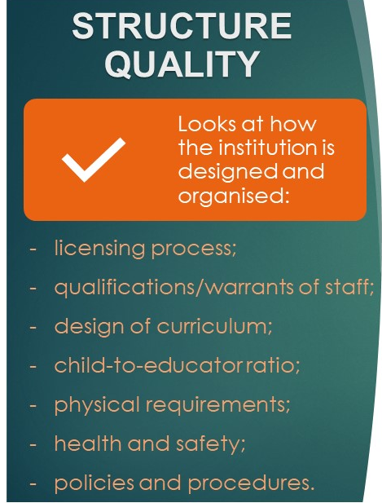

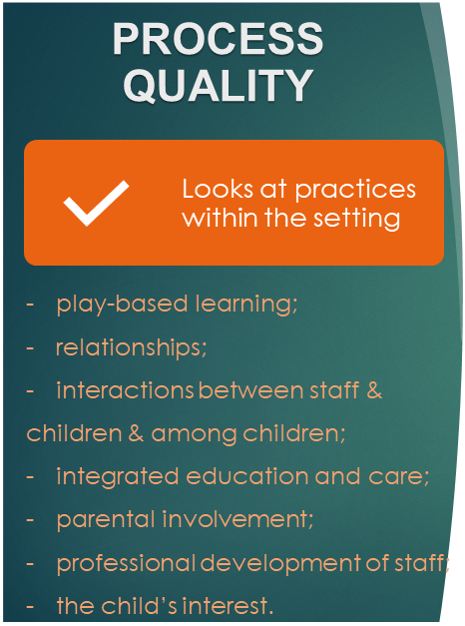




Defining Quality
Compliance Visits
External Review Visits
Legislation
Regulations
Policies
Standards

Slide 5


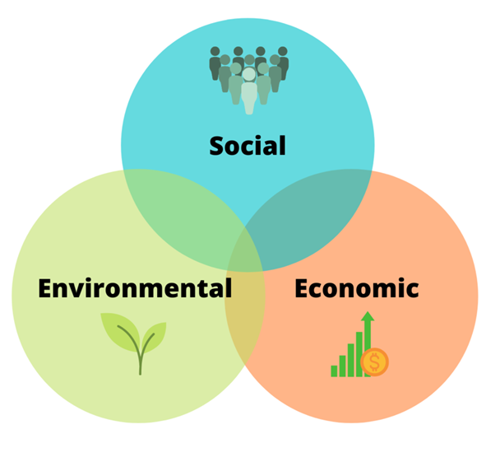
Quality Area 1
The Quality of the Learning Environment
Will directly impact outcomes quality
Structural Quality
for the benefit of
Quality Area 2
The Quality of the Learning and Care
Process Quality
By 2030, ensure that all girls and boys have access to quality early childhood development, care and pre-primary education so that they are ready for primary education

Slide 6

A Glimpse at the National Picture
STANDARDS GUIDING REGULATION & PRACTICE
CURRENT STANDARDS UPDATED STANDARDS
1 |  | Suitable Persons
2 |  | Physical Environment, Premises & Equipment
3 |  | Management & Organisation
4 |  | Health & Safety of Children
5 |  | Care, Learning & Play
6 |  | Working in Partnership with Parents
7 |  | Behaviour Management
8 |  | Child Protection
9 |  | Food & Drink
10 |  | Equal Opportunities and Children with Special Needs
Quality Area 1
The Quality of the Learning Environment
Quality Area 2
The Quality of Learning and Care
National Standards

Slide 7

ECEC QUALITY

Slide 8


CURRICULUM
One integrated Curriculum
Learning Outcomes Framework
0-16 years
Sustain play-based learning & authentic assessment

Slide 9
ACCESS

Slide 10

ACCESS
As per JobsPlus data, pre-2014, circa 1,800 children were making use of childcare services
Barcelona
Target 33%
by 2020
Source: JobsPlus and NSO

Slide 11
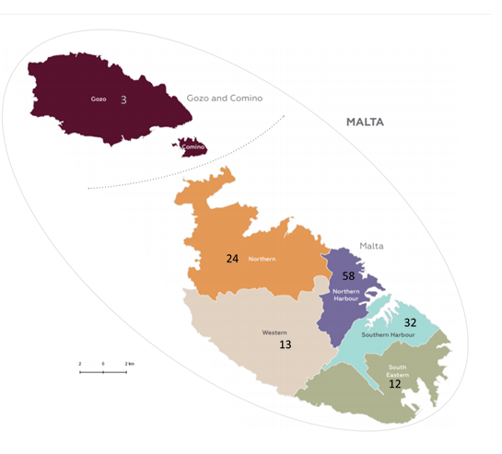
ACCESS
Number of registered ECEC centres by end of 2019 by district
(map & districts as in NSO, Regional Statistics, Malta, 2019 edition)

Slide 13

Monitoring and Evaluation
Pre-operational
Registration process
Post-operational
External Review and Compliance to renew annual registration
Planning process

Slide 14
CHILDCARE CENTRES REGISTRATION PROCESS
Submission of Application
Evaluation of documents
Site visit
Issue of registration
Online Application
Officers Communicate with Legally Responsible Persons for any missing/outdated documentation
Confirmation that site is built according to PA approved plan
Required actions identified in documents
Registration Status may be revised to provisional or remain temporary
Temporary Registration valid for 6 months
Centre eligible for Free Childcare Scheme
6 Month External Review

Slide 15
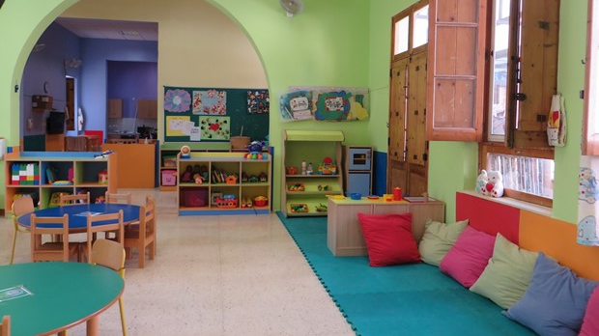
SPACES

Slide 17
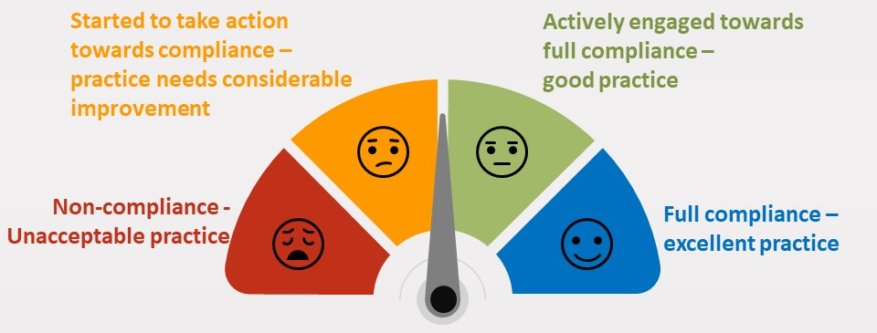
Sustaining continuous improvement

Slide 18
Monitoring and Evaluation
Only a third of European education systems have established evaluation systems which check that settings for younger children not only comply with standards but also support the learning process.

Slide 19
Workforce

Slide 20
Governance

Slide 21
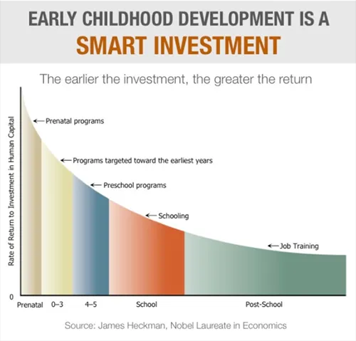
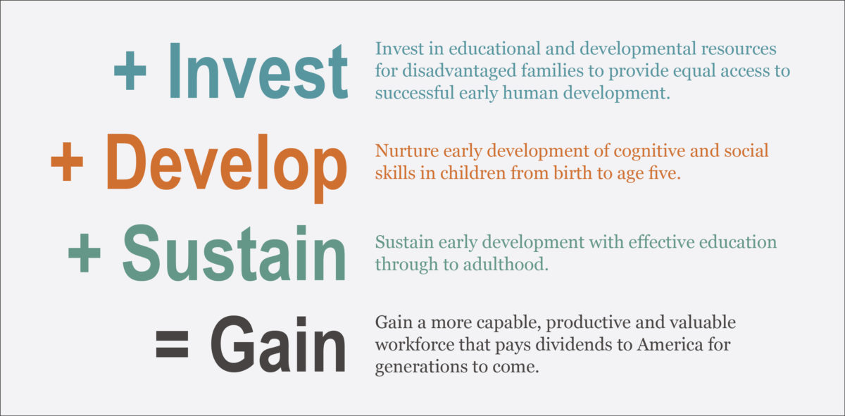
Funding

Slide 22


