Slide 1
Ta’ Qali Partial Action Plan Review
Changes to policy FOLLOWING 2ND STAGE PUBLIC CONSULTATION
PRESENTATION TO ENVIRONMENT AND DEVELOPMENT PLANNING COMMITTEE
7^{th October 2020}

Slide 2
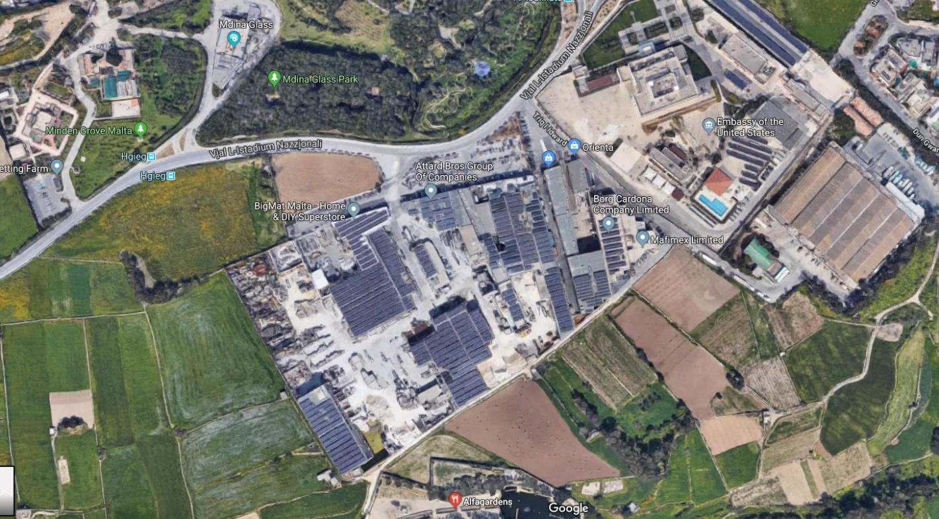
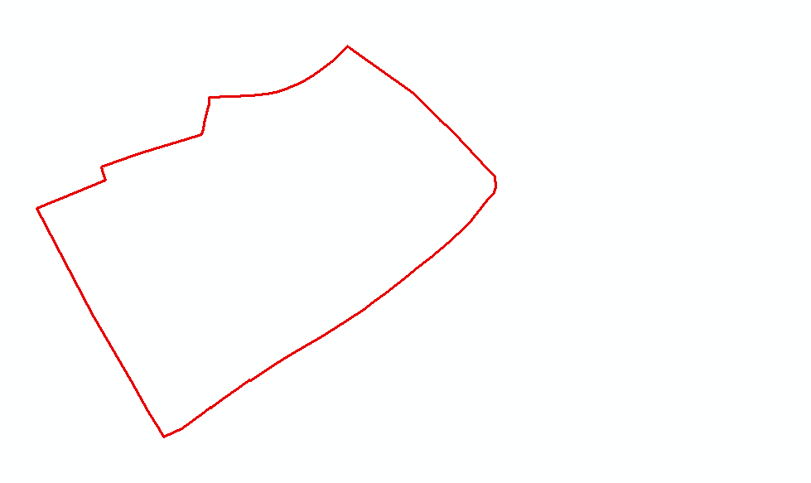
SITE BOUNDARY

Slide 3
Phase 2 Public Consultation
The 2nd stage public consultation took place between the 12th of September and 25th of October, 2019.
A total of 22 submissions were received

Slide 4
Summary of issues – Phase 2 Public Consultation
Land-use zoning
  Class 2c is an incompatible use in the vicinity of the Embassy
  Uses compatible with the National Park include sports-related uses, museums and crafts-making
Building height and views
The minimum building height is to be increased to 12.5m
The edge-of development context and views of Mdina must be respected
Transport and mobility
  The service road will impinge on existing development both above and below-ground
Parking within property boundaries should be mitigated by an additional planning gain
Environmental considerations
Development is to consider use of water reservoirs and water-table replenishment
Land ownership and planning gain
The specified planning gain of €25/m2 is inadequate
A lack of comprehensive impact assessments for the area is giving developers a free-hand

Slide 5
Policy objectives

Slide 6
Objectives for the Partial Action Plan Review
To designate the site currently covered by policy NWTQ 32 of the Ta’ Qali Action Plan into a Commercial Area;
To ensure that the designation of policy NWTQ 33 as a parking area is retained and a requirement for landscaping included;
To replace the currently allowable land uses with those allowed by Category D of the Use Classes Order (SL552.15) and prohibit any further intensification of the current uses;
To formulate a development framework which seeks to mitigate any adverse impacts from the re-designation of the site provided that the overall height of buildings shall not exceed 17.5m and shall be terraced to the heights of the existing embassy for buildings located on the perimeter of the site facing the same embassy. Upper recess shall also be taken into consideration when planning the opposite side facing Mdina. In this area (facing Mdina), heights of buildings contiguous/first in line to the ODZ area shall be kept as stipulated in the Ta’ Qali Action Plan 2000 policies with a stepping effect to 17.5m;

Slide 7
Objectives for the Partial Action Plan Review
To amend or delete all other provisions in the current policies which are deemed to run counter to the overall objectives set out in (a) to (c) above; and
Additional blank party walls are not accepted.
Following public submissions during the consultation on the Government Objectives, the Minister acceded to public requests to include the following uses or allow intensification thereof, in conjunction to the Category D uses previously listed:
    Article 4 (s) supermarkets;
    Category B: Class 2A (c) medical clinic, Class 2C education;
    Category F: Class 6A storage and distribution.
as these additional uses were deemed compatible with the long-term goal of creating a commercial area on this site.

Slide 8
Policy revisions

Slide 9
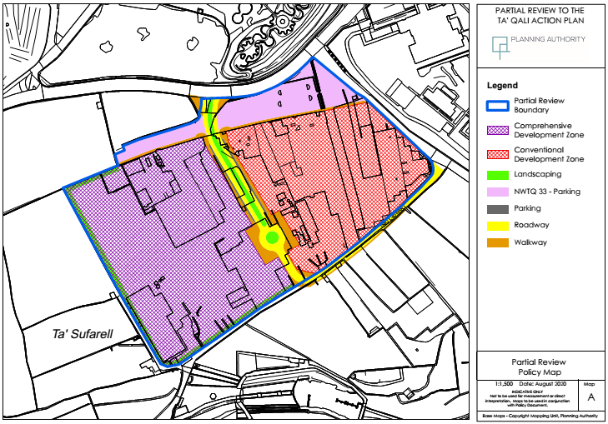

Slide 10
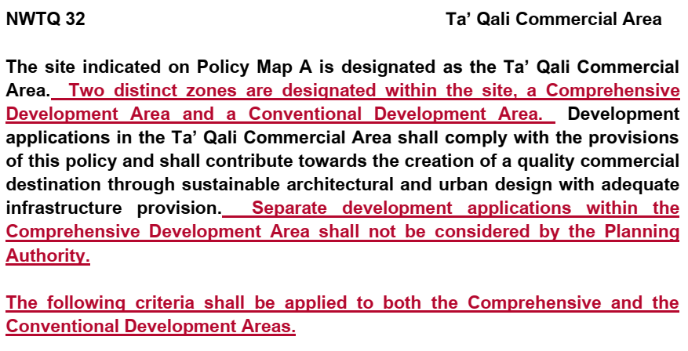

Slide 11
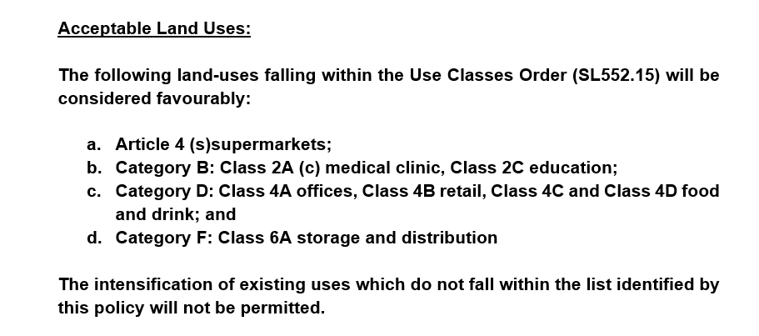

Slide 12
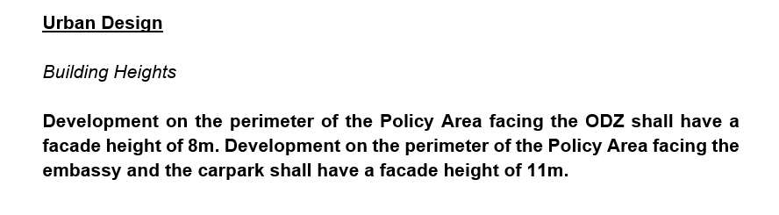
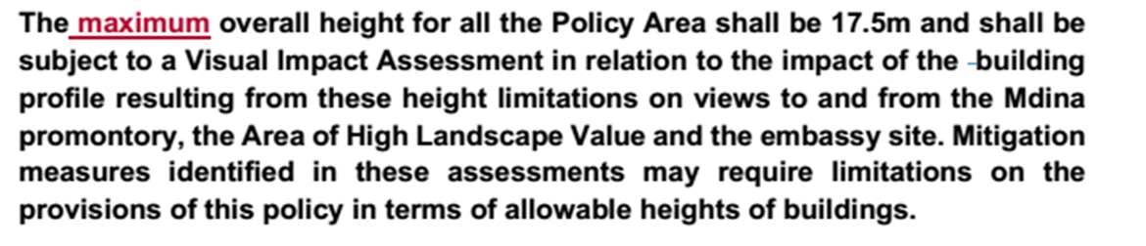

Slide 13
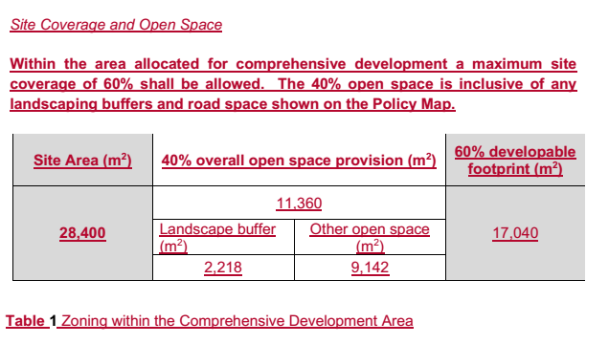

Slide 14
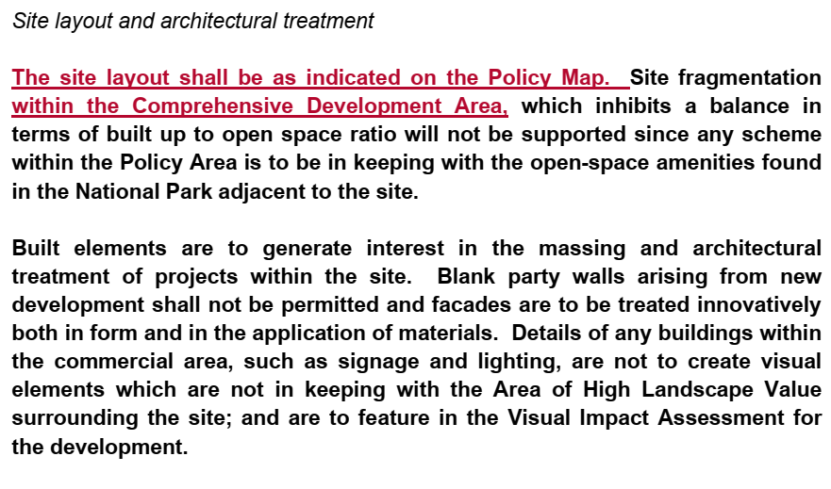

Slide 15
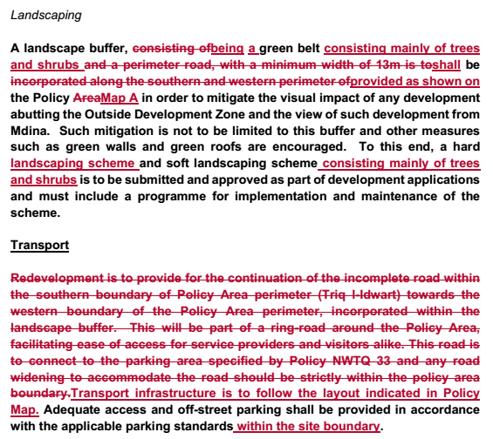

Slide 17
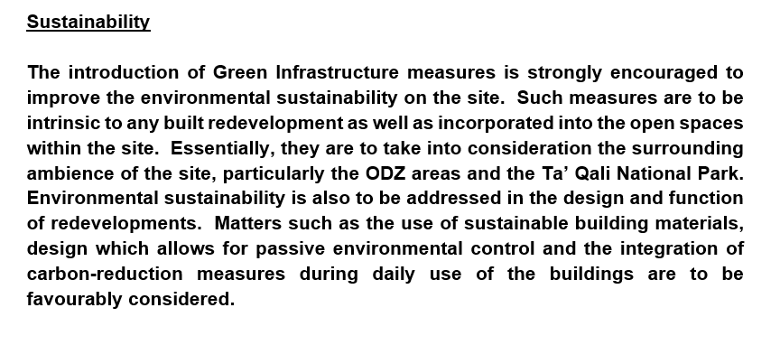

Slide 18
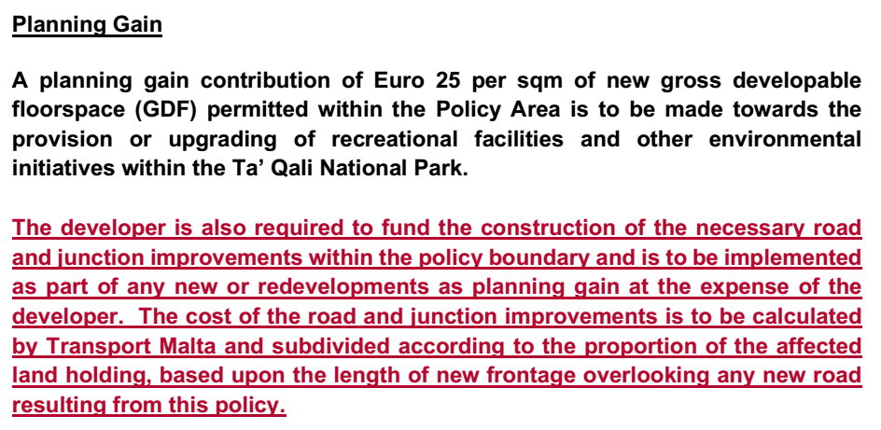

Slide 19
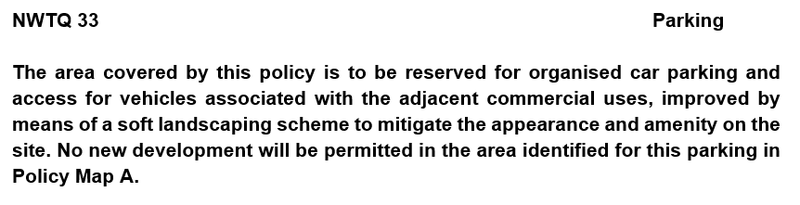


Slide 20
Way Forward
Planning Authority Executive Council approved this draft as amended for a 3rd stage public consultation which runs until 11th of October, 2020.

Slide 21
- END OF PRESENTATION -

