Slide 1



National Strategy for the Environment 2050
WELLBEING FIRST
A Vision for Malta’s Environment

Slide 2


What is the National Strategy for the Environment?
Planning for the environment to 2050, setting out where we want to go and what needs to be done within a generation
A governance strategy serving as an umbrella framework for a shared vision and common foundation across Government’s policies

Slide 3
ESTABLISHING A GENERATIONAL GOAL
Environmental pillar of the Sustainable Development Strategy (SDS) & SDGs
Shares principles and builds upon other national policies (eg. LCDS), EU & international trusts like the Green Deal, the UNEP Global Environment Outlook and OECD studies

Slide 4

WELLBEING FIRST: A Vision for Malta’s Environment
Will bring about strategic alignment across Government & its entities, to create a robust policy framework for an improved quality of life that endorses environmental limits.
Removal of silos improves environmental, social and economic dimensions of wellbeing at par with each other.
Strong political commitment for overall wellbeing, measured beyond GDP, supports a market that remains a priority and is directed towards environmental & social ethic.

Slide 5

WELLBEING FIRST: What it means
HEALTH
WASTE
Improved health from a cleaner environment; reduction in healthcare costs; challenge remains to reduce other illnesses borne from habits
Towards zero waste to landfill and resource efficiency through circular economy.
TRANSPORT
REAL ESTATE & CONSTRUCTION
Transport, environmental, & planning policies aligned to reduce air emissions; & diversification of travel choices easing congestion
Operates within a national agreed framework, adopting adequate sustainability criteria, & respecting land take-up limitations.
RESEARCH & INNOVATION
NATURAL CAPITAL
Embedded in economy to spur knowledge-driven and value-added growth, supporting efforts to address environmental challenges
Integrated into urban fabric for nature-based solutions to contribute towards resilience to climate change
CLIMATE CHANGE
TOURISM
Strategic direction strives towards carbon neutrality at the lowest investment; Climate change is mainstreamed in all workings of Government
Move towards a healthy, sustainable and equitable tourism sector respecting the Islands’ carrying capacity

Slide 6
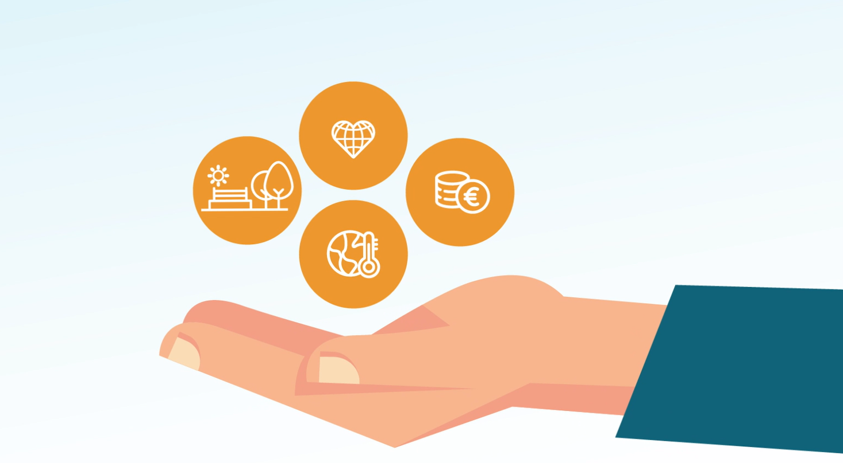
WELLBEING FIRST: What it means
Success is measured on what really matters for quality of life - environment is increasingly recognised as fundamental to the core of a system supporting overall wellbeing
Synergy between public and private domains creates a roadmap with targets and goals into which businesses willingly become involved in, and public institutions benefit from learned input derived from private enterprise

Slide 7

WELLBEING FIRST: What it means
Moving towards a balance for environment, social and economic wellbeing is no easy feat
Challenges afforded by the Islands’ carrying capacity and achieving resource efficiency milestones – tough calls to make
Behavioural change in cultural mindsets is required & met with a resistance to change
Internalisation of environmental costs seen as a burden
Effort, investment, training and perseverance required to align government are substantial; benefits are not instantaneous but in the medium to long term
But challenges will be subdued when we experience the benefits of tangible improvements that a healthy environment contributes to an overall good state of wellbeing

Slide 8
WELLBEING FIRST: What it means
Increased cross-sectoral collaboration providing strategic policies which are resilient in the long term
Environment
This vision not only values environment alongside social & economic considerations, but is based on the premise that economy operates within social relationships & society is embedded within the environment, seeking mutual opportunities from the three pillars to develop thanks to each other
Society
Environment
Economy
Society

Slide 9

WELLBEING FIRST: What it means
Digital transformation
Remote working
Environment
Remote commerce and service provision
Promoting alternative ways of doing business
Reduced need for transportation; time savings and lower transport costs
Improved health due to air quality improvements
Job creation
Remote product sales
Environment
Maintained and diversified transport infrastructure
Society
Strengthening internal food supply chains (and )

Slide 10
WELLBEING FIRST: What it means
Urban & rural
regeneration & enhancement
Collaboration with LCs, NGOs and private entities
Environment
Enhancement of wellbeing
Creation of environmental assets to be enjoyed in the long run
Generation of productive employment in the main sectors which were vulnerable to the COVID event e.g. tourism.
Maintenance and expansion of public areas
Environment
Society
Urban greening and restoration of amenities
Enhancement of tourism product

Slide 11
WELLBEING FIRST: How did we get here
VISION
SCENARIO ANALYSIS
SCENARIO PANEL
FOUR SCENARIOS
EXPERT RANKING
CITIZEN SURVEY
OUTCOME
Rigorous methodology advocated by the Partnership in European Environmental Research; Method adopted by UN Global Environmental Outlook and Climate Change assessments
Representatives from MFIN, MESDC,MFCS, NSO, ERA Board, eNGOs, Guardian for Future Generations
Wellbeing First
Sector First
Market First
Me First
Expert approach: included policy makers, policy implementers and academics to systematically rank the preferred scenario
Bottom-up approach: statistically valid survey by seasoned consultant with citizens to identify the citizens’ preferred scenario
Results of expert ranking and citizen survey were consolidated. Wellbeing First was identified as the lead scenario for the Vision

Slide 12
14 Prominent Drivers
ALL ISSUES
Economic
Growth
Climate Change
Citizen Choice
Trans-boundary
Population
Policy
spinoffs
Construction
Fisheries
Other
Technology
Transport
Tourism
Industry & Energy
Agriculture

Slide 13
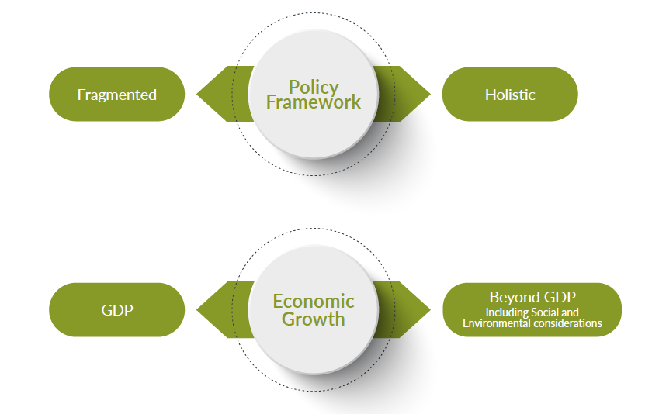
From Critical drivers to Scenario Axes

Slide 14
Four Resulting Scenarios
Beyond GDP
Environmental
Utopia
Sector
First
Wellbeing
First
Fragmented policy framework
Holistic policy framework
Me
First
Market
First
GDP
Environmental Crisis

Slide 15
FOUR POSSIBLE SCENARIOS TO 2050
Beyond GDP
Strategic alignment across government entities
Robust policy framework endorsing environmental limits leading to an improved quality of life
Greater collaboration among government, citizens and stakeholder groups in decision making
Environmental, social and economic wellbeing dimensions at par
Strong policies are adopted
Silo approach
Early adoption of environmental considerations in the policy development process is not sufficiently facilitated.
Sector
First
Wellbeing
First
Fragmented policy framework
Holistic policy framework
Me
First
Market
First
An individualist society
Specific groups and individuals push for their own interests
Policy processes are uncoordinated and adjust to further the interests of the more influential lobby groups
Priority to the market and its economic benefits
Underlying assumption that markets on their own can reinvent themselves to address any distortions
Increased economic investment and expansion of trade pursued without internalisation of environmental costs and social inequalities.
GDP

Slide 16
ONE SCENARIO TO 2050
Market
First
Me
First
Sector
First
Wellbeing First
Wellbeing First was identified as the lead scenario for a 2050 Vision for Malta’s National Strategy for the Environment.
EXPERT ANALYSIS
CITIZEN SURVEY
Wellbeing
First
Sector
First
Market
First
Elements from the other scenarios will flavour the actions that will be developed.
Me
First

Slide 17
EXPERT ANALYSIS: LEAD SCENARIO
A VISION FOR 2050
Wellbeing First
Sector First
Market First
Me First

Slide 18
SURVEY: LEAD SCENARIO
A VISION FOR 2050
Beyond GDP
(Wellbeing & Sector First Scenarios)
GDP
(Market & Me First Scenarios)

Slide 19
SURVEY: LEAD SCENARIO
A VISION FOR 2050
Wellbeing First
Sector First
Me First
Market First

Slide 20
WEIGHTED RESULTS WELLBEING LEAD SCENARIO
FOR A 2050 VISION
Wellbeing
First
Sector
First
Market
First
Me
First
scenario axes

Slide 21
NEXT STEPS
FOR A 2050 STRATEGY
STANDING COMMITTEE
PUBLICATION
NATIONAL STRATEGY FOR 2050
Presenting 2050 Vision for the National Strategy for the Environment; to also serve as a shared vision and a common foundation across Government
Publishing all documents with information that led to the identification of this Vision for consultation.
Developing strategic environmental goals to 2050; followed by 10 year Action Plans for their achievement.

Slide 22
Thank You

