Slide 1
Comprehensive Planning Area for Regeneration of the Urban Coast Ex-Jerma Palace Hotel Site, Marsascala Development Brief
Public Consultation Draft
Presentation to the Parliamentary standing committee
7th July 2020

Slide 2
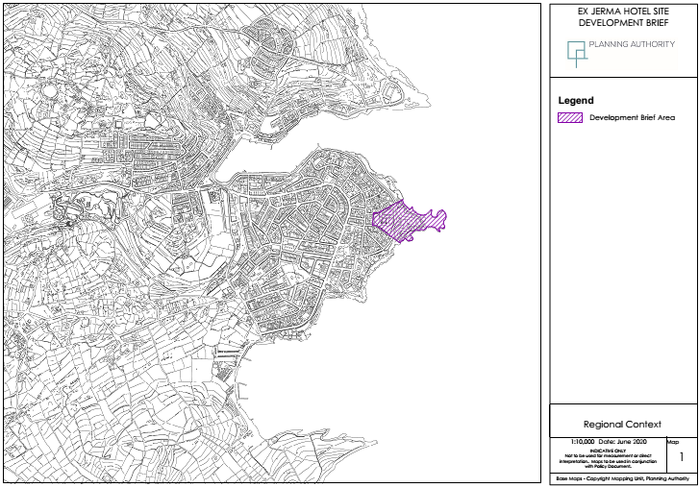
Regional Context

Slide 3
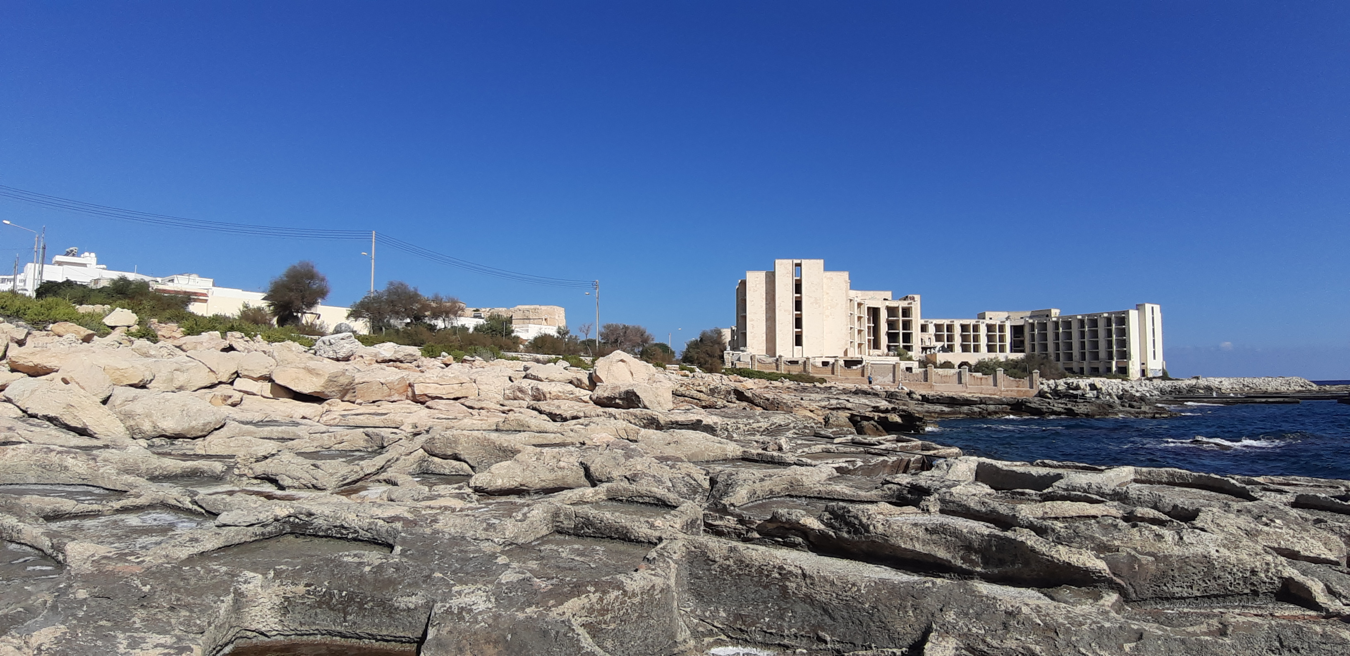
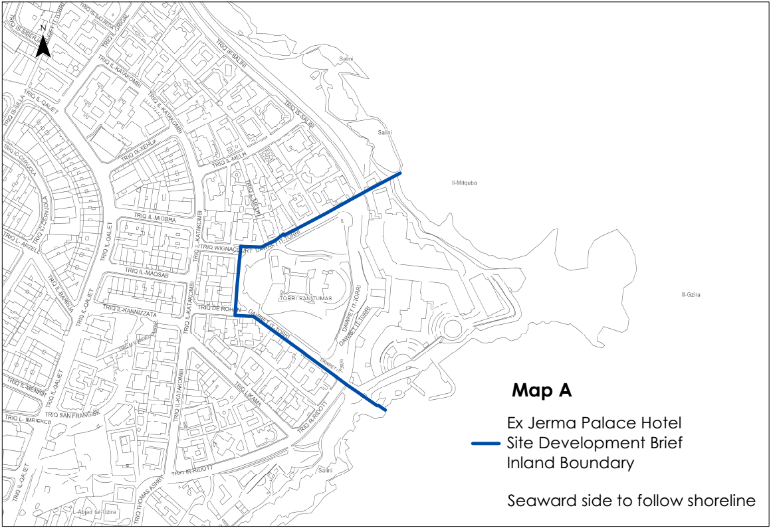
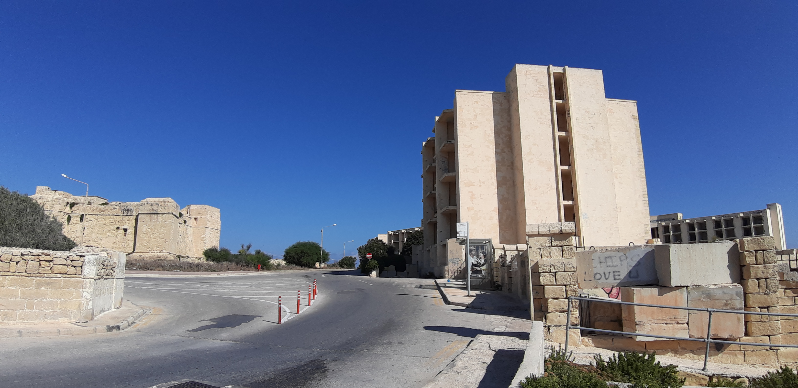
Objectives

Slide 4
Objectives
The objectives for the Development Brief are:
To designate the site shown in Map 1[as attached with objectives] as a Comprehensive Planning Area for Regeneration of the Urban Coast;
To promote the development of a mix of land uses which shall include:
Tourism accommodation which must include Class 3B (Use Classes Order (SL552.15) hotel/s which shall never be smaller, in terms of Gross Developable Floor space (GDF), than the ex-Jerma Palace Hotel;
Category A residential uses (Use Classes Order (SL552.15) which shall not exceed 40% of the total allowable GDF;
Category D commercial uses (Use Classes Order (SL552.15);
Other uses which the Authority deems can contribute to the regeneration of this part of the urban coast;

Slide 5
Objectives
To ensure that the overall development density does not exceed 100,000 sqm GDF, excluding spaces for car parks and services, irrespective of the position of the floor space in relation to any street level;
To include an urban design framework providing guidelines on the site layout, architectural treatment, massing, colour, texture and materials of the buildings, circulation, road access, parking and landscaping requirements;
Providing that a dimension for the maximum allowable building height in metres and the maximum allowable site coverage with a clear indication of how these two criteria are measured must be included;
To introduce all the necessary mitigation measures aimed at reducing any potential adverse impact from the development, particularly on scheduled buildings and the natural coast;
To require a planning gain contribution for the benefit of the community of Marsascala.

Slide 6
Public Consultation on Objectives
Public consultation between 18th October and 11th November 2019
Generated 188 submissions including
1 letter submitted by 21 individuals
1 letter submitted by 76 individuals
a petition signed by 82 residents
Marsascala Local Council
Wirt iz-Zejtun
Moviment Graffiti
Futur Ambjent Wiehed
Din l-Art Helwa
Alternattiva Demokratika
Malta Developers Association
Environment and Resources Authority
Kummissjoni Interdjocesana Ambjent

Slide 7
Issues of Public Concern
Development Brief Boundary
Land Use
St. Thomas Tower
Access to Foreshore
Gross Developable Floorspace
Building Height Limitations
Rezoning of the surrounding RPA
Further studies

Slide 8
Revised development density
Following from the public consultation on the Objectives of the Development Brief, an overall development density of a maximum of 65,000sqm GDF was adopted as the revised objective for the formulation of the development brief.

Slide 9
Policy Context
Strategic Plan for the Environment and Development (SPED)
TO1.4 requires the identification of degraded areas within the urban areas for integrated regeneration, particularly regarding declining coastal resorts including Marsascala.
TO 8 promotes the safeguarding and enhancing of cultural heritage.
CO1 requires the promotion of compatible urban uses in predominantly terrestrial urban coastal areas, as well as safeguarding of legitimate coastal uses, public and visual access, while enhancing public use of bathing areas.
UO3.4 promotes the identification of derelict sites and seeks their upgrading through high quality development.
UO 3.6 requires the establishment of appropriate building heights and development densities.
UO 3.7 has the scope of protecting and greening open spaces which contribute towards the character and amenity of the urban area.
UO3.8 promotes the upgrading of open space amenity in urban areas.

Slide 10
Policy Context
South Malta Local Plan
SMSE 03 Building Heights identifies Marsascala as a locality where medium-rise buildings can be considered.
SMSE 04 Public Urban Open Spaces, Squares and Green Areas designates the coastal zone as a green area whereby only low-key environmental improvements.
SMCO 05 Promote and safeguard public access along the coast encourages the rehabilitation of the coastal stretch between Xghajra and Marsascala and prohibits any development that would restrict public use of the coast.
SMMS 13 St. Thomas Tower’ encourages the use of the historical tower as a cultural heritage attraction with ancillary visitor facilities, including a catering operation.
SMMS 15 Development Brief for Jerma Palace Hotel Site’, requires the submission of a Development Brief with the primary focus of tourism accommodation. Residential and commercial development may be considered if they form part of a comprehensive development of the area which should include sufficient public urban open space whilst also retaining access to the foreshore.

Slide 11
Policy Context
Supplementary Planning Guidance
The Height Limitation Adjustment Policy for Hotels, 2014 and Planning Policy Guide on the Use and Applicability Use and Applicability of the Floor Area Ratio (FAR), 2014 do not apply for this site.

Slide 12
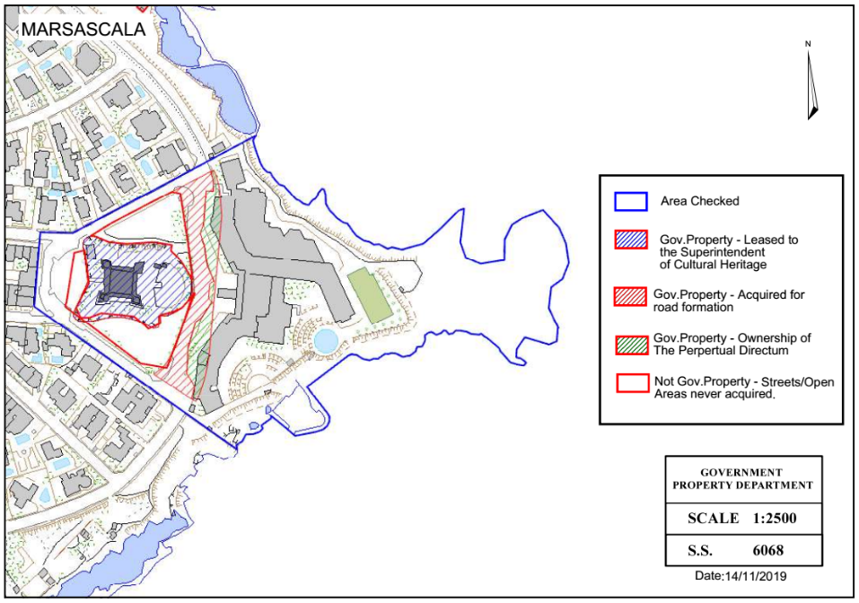
Tenure

Slide 13
Character Appraisal
Character Areas
Ex-Jerma Palace Hotel
Foreshore
St. Thomas Tower
Low Density Residential Area
Residential Area

Slide 14
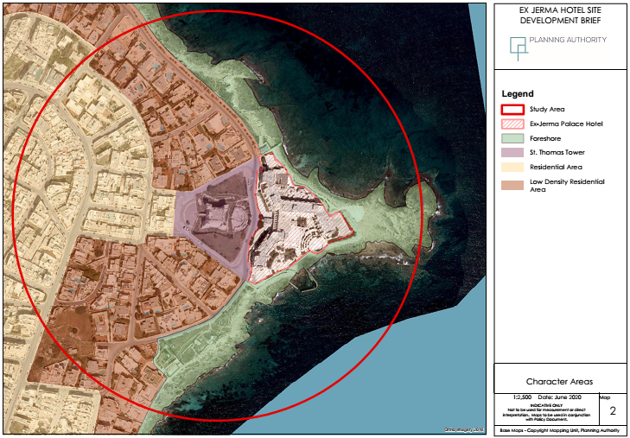

Slide 15




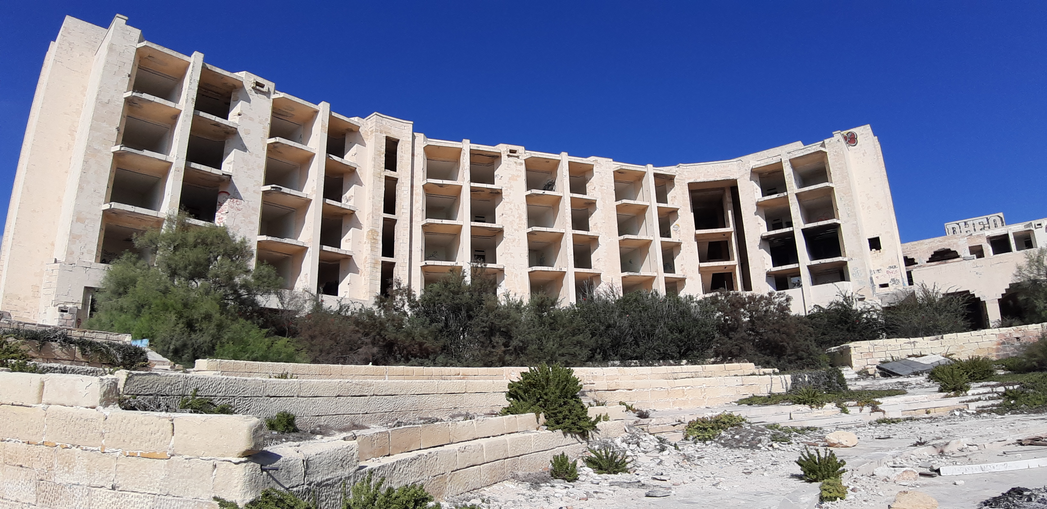

Character Appraisal
Ex-Jerma Palace Hotel
Road level in front of the hotel stands at 7.8m above sea level,
Lower level at tennis courts stands at 3 m above sea level,
Predominant building height of 5 floors (25.5m above mean sea level),
Had extensive landscaped open grounds,
Total site area of 17,600 sqm of which 8,900 sqm was unbuilt and 8,700 sqm built,
Had a total floorspace of 30,000 sqm.

Slide 16
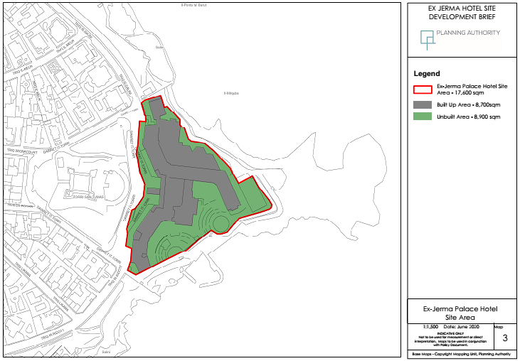

Slide 17
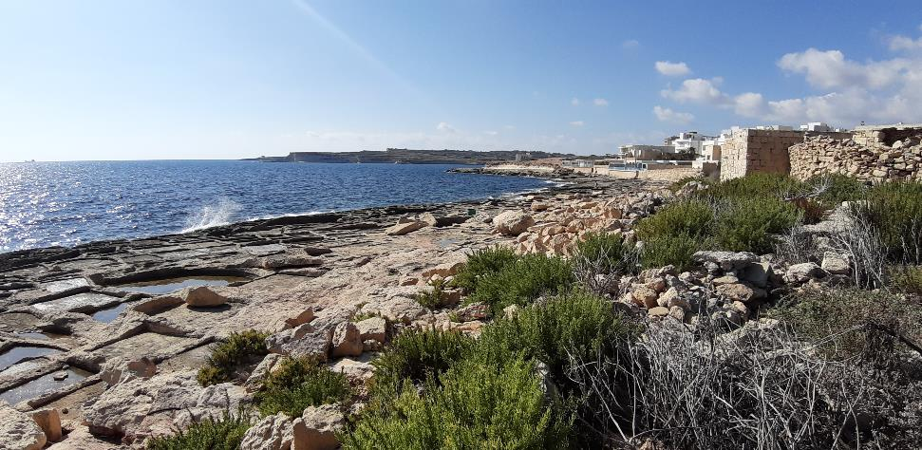
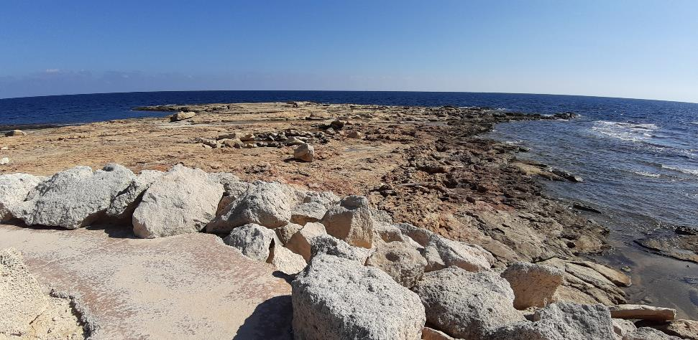
Character Appraisal
Foreshore
Low-lying rocky coast with an extensive network of rocky pools and salt pans,
Slopes down from 3m above mean sea level near the tennis courts to 1.5m above mean sea level,
Designated as part of the coastal water body MTC106 – Ix-Xaghjra sa Wied il-Ghajn as per the 2nd Water Catchment Management Plan for the Malta Water Catchment District 2015 – 2021
No public access while the hotel was in operation

Slide 18
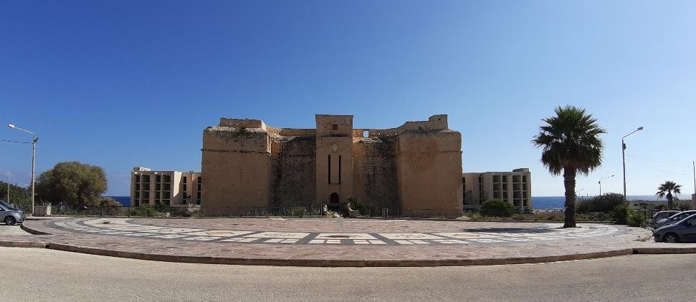
Character Appraisal
St. Thomas Tower
The tower rises to a height of 23m above mean sea level, 15.3m above street level fronting the hotel site and 11m from the open space on the landward side,
Leased to the Superintendent of Cultural Heritage and in 2008, the tower was transferred to the heritage foundation Fondazzjoni Wirt Artna,
Planning permission for the creation of a multi- sensory museum has been granted by the Planning Authority,
The development of the ex-Jerma Palace Hotel blocked the view of the tower to the sea

Slide 19
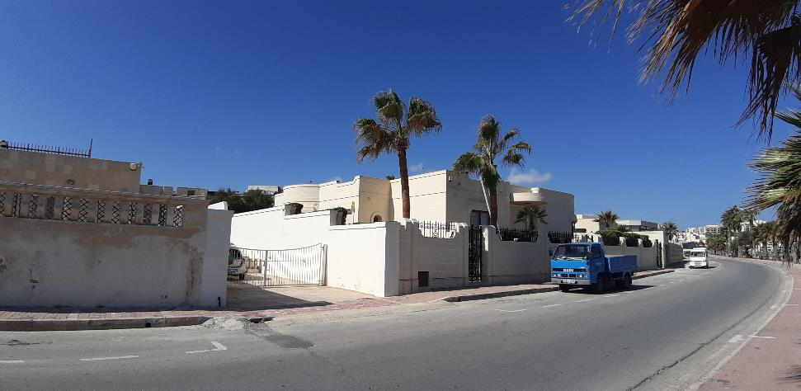
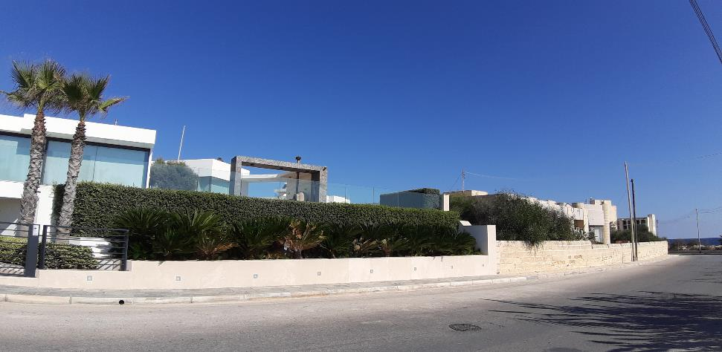
Character Appraisal
Low Density Residential Area
Residential Priority Area designated for bungalows, villas and terraced development,
Only residential uses permitted,
Bungalows – minimum site area of 1,000sqm, 40% site coverage, building height of 4.75m and a 3m site curtilage,
Semi-detached villas - minimum site area of 500sqm, 40% site coverage, building height of 8.50m and a 3m site curtilage,
RPA Terraced – building height of 16.30m

Slide 20
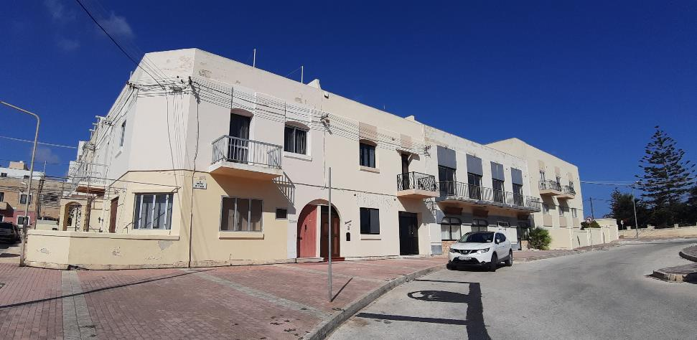
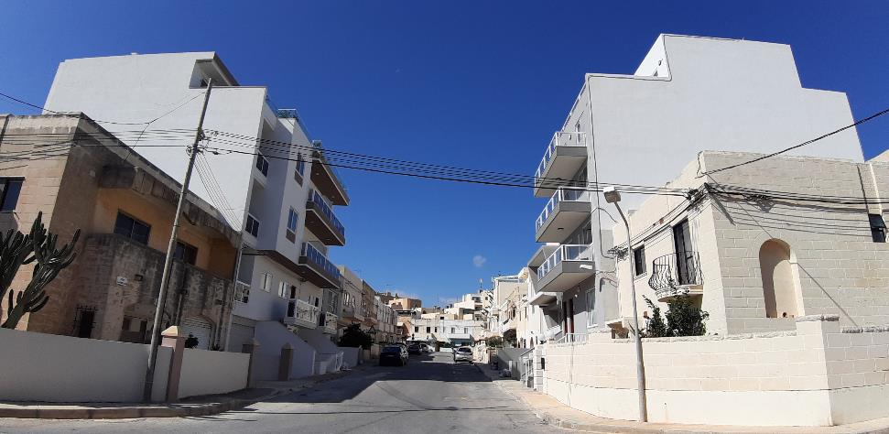
Character Appraisal
Residential Area
Primarily still consists of 2 story buildings,
SMLP allows a building height of 3 floors plus semi basement,
Changing the character of the area through increased residential densities and significantly higher buildings,
Resulting in areas of blank party walls.

Slide 21
Constraints
Environmental Protection
Proposed schedduling of coast as an AEI and SSI.
The coastal water body MTC106 – ‘Ix-Xaghjra sa Wied il-Ghajn’.
Posidonia Baseline Survey 2003 identified the area as home to Posidonia meadows.
The coastal perimeter is designated as part of the public domain by Act XXV of 2016.
Heritage Scheduling
St. Thomas Tower and the surrounding ditch is afforded Grade 1 scheduling due to its architectural and cultural value, with a proposed buffer zone around the tower.

Slide 22
Land Designations
Table 1: Zoning of the Development Brief Area
Zone | Primary Land Designation | Land Area (sqm) | % of total brief area
A | Developable site area which shall accommodate new uses and buildings | 17,700 | 33%
B | Protected foreshore which shall be safeguarded for public access and use | 18,600 | 35%
C | Scheduled building and its setting which shall be safeguarded for public use | 13,700 | 26%
D | Public streets which shall ensure access to private property outside the brief area | 2,900 | 5%
 | Total | 52,900 | 100%

Slide 23
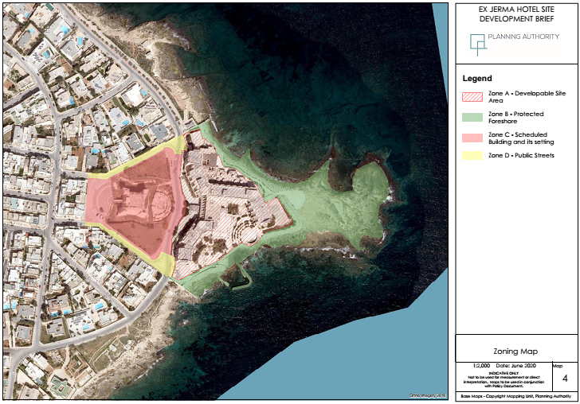

Slide 24
Urban Design Framework
Allowable mix and scale of land uses
Table 2: GDF/Land-use for Ex-Jerma Palace Hotel, Marsascala (Zone A)
Land-use | GDF
Tourism – including ancillary facilities, excluding parking and services | 33,000sqm
Residential – excluding parking and services | 26,000sqm
Commercial – Food and Drink, excluding parking and services | 4,200sqm
Commercial – Retail, excluding parking and services | 1,800sqm
Total | 65,000sqm

Slide 25
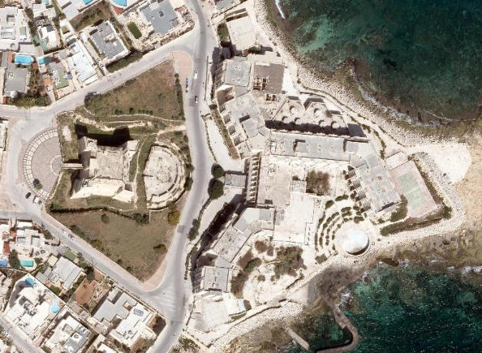
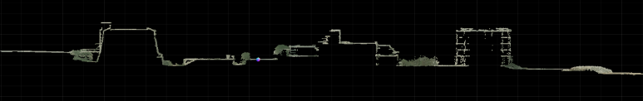
Urban Design Framework
Massing and Built Volumes
3.23m floor to floor height for residential development
3.03m floor to floor height for non-residential development
A base-point below which any development will be limited to services and parking and hence not included within the 65,000sqm GDF, has been set at 3m above sea level.

Slide 26
GDF 65,000sqm, excluding parking and services,
A building not exceeding 32m above mean sea level,
A building not exceeding 9m above as St Thomas Tower,
The incorporation of a podium floor entirely below road at 7.8m above mean sea level level is encouraged,
Any development above the podium floor shall have a maximum site coverage of 52%.

Slide 27
Urban Design Framework
Circulation and Road Access
Traffic levels are expected to be high, and a TIS shall be required to identify the impacts and propose mitigation measures
A public open space constituting the immediate setting of the tower, contiguous with the open spaces within the site of the Ex-Jerma Palace is to be created by re-routing traffic from Triq is-Salini towards and from the site,
Access to the development on the site must not cause severance within the site but must retain continuous pedestrian access from St Thomas Tower to the other newly created open spaces within the site.

Slide 28
Urban Design Framework
Electricity
Enemalta indicated that the development will require the installation of new high voltage cables and a number of substations within the development site.
Water supply and waste-water
WSC indicated that the development will require the upgrading of the waste water Pumping Station possibly in a new location,
Upgrading of rising main and pumps,
A dedicated main for the water supply will need to be installed accordingly.

Slide 29
Design Guidance by Zone –
Ex-Jerma Palace Hotel (Zone A)
Site layout, massing and scale, architectural treatament
To achieve the right balance between landscaping and opening the site for public access and public use through reduced site coverage which necessitate the increase of the height of buildings
A series of building blocks lying on a podium and separated by landscaped public open spaces
Re-introducing visual access towards the water and the visual link between the historic tower and the sea
Parking and services are to be integrated within the building envelope,

Slide 30
Design Guidance by Zone –
Ex-Jerma Palace Hotel (Zone A)
Design of residential, commercial and tourism area
Privacy of residents is to be respected in relation to views to and from adjacent units or units with apertures facing each other
A variety of commercial typologies is encouraged, especially in relation to the provision of amenities to the residential areas within and outside the development
Within the hotel, international standard ancillary uses are be provided, such as conference facilities, sports facilities and recreational facilities
Parking and vehicular access standards are also to be adhered to
The entire development is to conform to Access for All guidelines.

Slide 31
Design Guidance by Zone –
Ex-Jerma Palace Hotel (Zone A)
Environmental Considerations
Environmentally sustainable measures are to be incorporated in the development,
The impact on the existing infrastructure must be mitigated by upgrades as necessary,
Upgrades to the infrastructure are to be an integral part of the design and are to have no adverse impact on St Thomas Tower, the surrounding residential area or the foreshore,
Incorporate Green Infrastructure in the overall design of the project,
There should be no adverse environmental impact on the foreshore and surrounding sea during the construction phase or the operational phase of the development, including the avoidance of light pollution onto these areas,
Specification is to be made for the use or disposal of construction waste arising from site clearance and excavation.

Slide 32
Design Guidance by Zone
Foreshore (Zone B)
Development is not to encroach upon the foreshore but is to be restricted to the extents of the ex-hotel ,
Uninterrupted public access across the site to the foreshore through adequate access routes,
Leave the foreshore in its natural state with no development ,
Development does not prejudice the designation of an AEI and SSI.

Slide 33
Design Guidance by Zone
St. Thomas Tower (Grade 1) (Zone C)
Creation of view corridors to and from St Thomas Tower from other promontories around the site, as well as from the sea shall be a primary consideration of the design,
Restoration the tower, and the rehabilitation of the ditch and the glacis,
The public road between the Tower and the Ex-Jerma Palace Hotel will be diverted so as to create a continuous public open space extending from the glacis towards the foreshore, complementing the creation of the view corridor by forming pedestrian routes through the site.

Slide 34
Planning Gain
A contribution of Euro25 per sqm of GDF is also to be made to the Development Planning Fund as planning gain,
The funds shall be allocated towards the costs of the restoration of St Thomas Tower, including the rehabilitation of the ditch and the glacis,
Developer is to rehabilitate the foreshore, including the removal of all concrete accretions.

Slide 35
Submission Requirements
Project Description Statement to enable the screening of the project in accordance with the EIA regulations of 2007 (LN 412/17),
Visual Impact Assessment (unless required as part of an EIA),
Conservation Management Plan regarding the restoration and rehabilitation of the foreshore,
Restoration Method Statement regarding any proposed intervention on St. Thomas Tower and its glacis,
Traffic Impact Statement,
Construction Management Plan, and
Utilities Plan including means of incorporating Green Infrastructure.

Slide 36
Way Forward
The Development Brief was published for 6 weeks public consultation period on the 15th of June 2020.
The Planning Authority invites the public to submit representations on the proposed development brief.
Any such submissions are to be sent by email address: smlp_consultation@pa.org.mt
Submissions must be sent to the Authority by Wednesday 29th July 2020.

