Slide 1

Commodification of bodies
JosAnn Cutajar
Department of Gender and Sexualities
Faculty for Social Wellbeing,
University of Malta

Slide 2
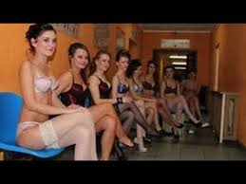
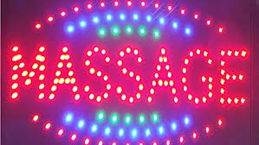
Prostitution
Men (predominantly) purchase sex.
The global prostitution industry is the second most lucrative industry after drugs
The value of this global trade in women and children as commodities for sex industries estimated to be between seven and twelve billion dollars annually.
Notes:
http://www.equalitiesinhealth.org/public_html/Prostitution.html

Slide 3
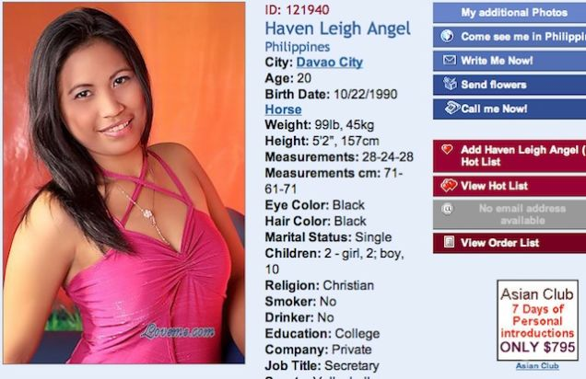
Theoretical stands
Self-determination over women’s own bodies
vs
Objectification of women’s bodies
This debate takes place in a society where men possess greater economic and political power than women - imbalance of power
Imbalance of power due to
  disadvantaged economic position of women,
  higher female poverty rates,
  the discrimination of women on the labour market,
  high level of domestic and sexual violence against women in society
Notes:
European Parliament (2014) Sexual exploitation and prostitution and its impact on gender equality https://www.europarl.europa.eu/RegData/etudes/etudes/join/2014/493040/IPOL-FEMM_ET(2014)493040_EN.pdf

Slide 4
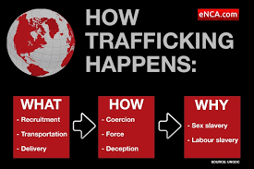
Vulnerable groups who feature in this industry
Those who
Suffer from absolute or relative poverty,
Poor educational involvement or have low literacy levels,
Have experienced abuse by family members and early sexual grooming,
Have unstable families and/or lived in residential or foster care,
Have a history of alcohol and drug use,
Face homelessness
Notes:
European Parliament (2014) Sexual exploitation and prostitution and its impact on gender equality https://www.europarl.europa.eu/RegData/etudes/etudes/join/2014/493040/IPOL-FEMM_ET(2014)493040_EN.pdf

Slide 5

The need of sex in this liberal age …
Prevalent mind-set that men “need” to have sex.
This mind-set legitimates the sexual commodification and exploitation.
Educational campaigns are needed to debunk the theories on male sexuality and their need for sex and titillation.
Libido lies: 32% of people still think men need sex more than women
7 months ago by Kate Brayden
Notes:
https://www.shemazing.net/latest-study-shows-32-of-people-think-men-need-sex-more-than-women/

Slide 6

Men and sex
Qualitative studies report a higher readiness of men buying sex to use violence.
Estimations on the number of men using sexual services range from “few” to “one third”.
This low number undermines the assumption that prostitution was needed to satisfy an irresistible sexual desire inherent to men.
Experts have found a relation between the liberalisation of prostitution and increasing numbers of trafficking in human beings
”In 2005, just five years after the Netherlands legalised prostitution with the goal of protecting sex workers, reports made plain that Amsterdam's ballooning red light district was a hotbed of criminal activity, coercion and violence. The Netherlands remains a major global destination for human trafficking. Germany's decriminalisation in 2002 also led to an increase in prostitution, and Germany too is now a focal point for human trafficking.”
https://www.theguardian.com/commentisfree/2013/dec/24/legal-changes-canada-sex-workers-risk
Notes:
European Parliament (2014) Sexual exploitation and prostitution and its impact on gender equality https://www.europarl.europa.eu/RegData/etudes/etudes/join/2014/493040/IPOL-FEMM_ET(2014)493040_EN.pdf

Slide 7
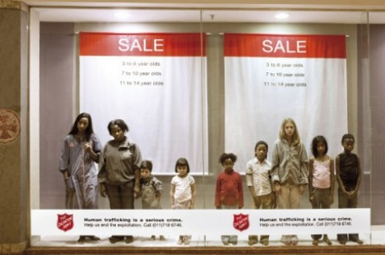
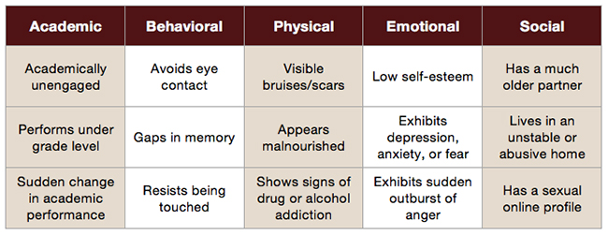
Those involved in sex industry are victims, not criminals
These persons should not be criminalised or subject to other sanctions
The media has a role to play here – teach public about signs related to human trafficking
The general public needs to be taught that human trafficking is a criminal act
Notes:
https://txssc.txstate.edu/topics/school-violence/articles/recognizing-human-trafficking

Slide 8
European Parliament (2014)
Regulatory Approach – Germany, NL
Abolitionist Approach – Sweden, Spain
Ignores the effects of gender inequalities in society
The working conditions of prostitutes and the level of violence have not improved – according to government reports.
Several studies state that the legislation on prostitution increases the flow of trafficking for sexual exploitation
Criminalization of all activities linked to prostitution
Swedish legislation targets the buyer and criminalises the demand side
According to official evaluations, it has reduced demand and deterred traffickers.

Slide 9
Those involved in prostitution
Reported experiences of
  emotional abuse,
  physical violence,
  sexual abuse and
  rape and sexual assault.
Psychological trauma of having to repeatedly submit to unwanted sex.
Health consequences of involvement in prostitution include
  physical injuries associated with physical violence including fractures, concussion, burns, and back pain.
  Gynecological conditions such as pelvic inflammatory disease, infertility, ovarian cysts, chronic pelvic pain, and positive pap smears
  emotional trauma,
  addiction issues and
  mental health problems such as depression, eating disorders, suicidal ideation and self-harm.
Notes:
http://www.equalitiesinhealth.org/public_html/Prostitution.html

Slide 10
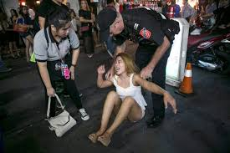
Those involved in sex industry are victims, not criminals
Sensitive, informed policing is needed to help protect those providing sexual services .
Decriminalization, regularization, abolition of prostitution will not stop prostitutes from being raped, sexually assaulted, assaulted and robbed when they seek help from the authorities.

Slide 11
Specialized and mainstream services
Need dedicated workers trained on how to deal with these clients in health, legal and social services
Sensitive service provision - prostitutes report violence by law enforcement agents, as well as other forms of degrading treatment by the authorities
Resourcing - Liz Kelly said “Regulation is invariably under-enforced and under-resourced, with a lack of clarity in law and policy as to who is responsible. This has led, in many regimes, to unchecked growth in illegal sectors and/or a failure to police the exploitations of prostitution offences.” (European Parliament, 2014)

Slide 12
To help prostitutes exist from industry …
Social needs – adequate housing and a basic income.
Psycho-social needs: to help combat the feelings of low-self-esteem, lack of self-worth, loneliness, isolation, fear, shame, trauma linked to their experience in the sex industry, together with experiences of violence, discrimination, drug or alcohol dependency. Culturally appropriate counselling services are recommended.
Health needs include general, reproductive, sexual, and mental health; drug and alcohol dependency. Ongoing psychological and counselling support.
Violence: domestic violence, rape and sexual assault necessitate specialist support services (refuges and rape crisis centres).
Financial needs: Education and retraining takes time and money.
Legal advice and services should be provided in a language they understand.
A coordinated response is needed between immigration, legal, health, education and psycho-social services and social work teams to help people working in the sex industry.

Slide 13
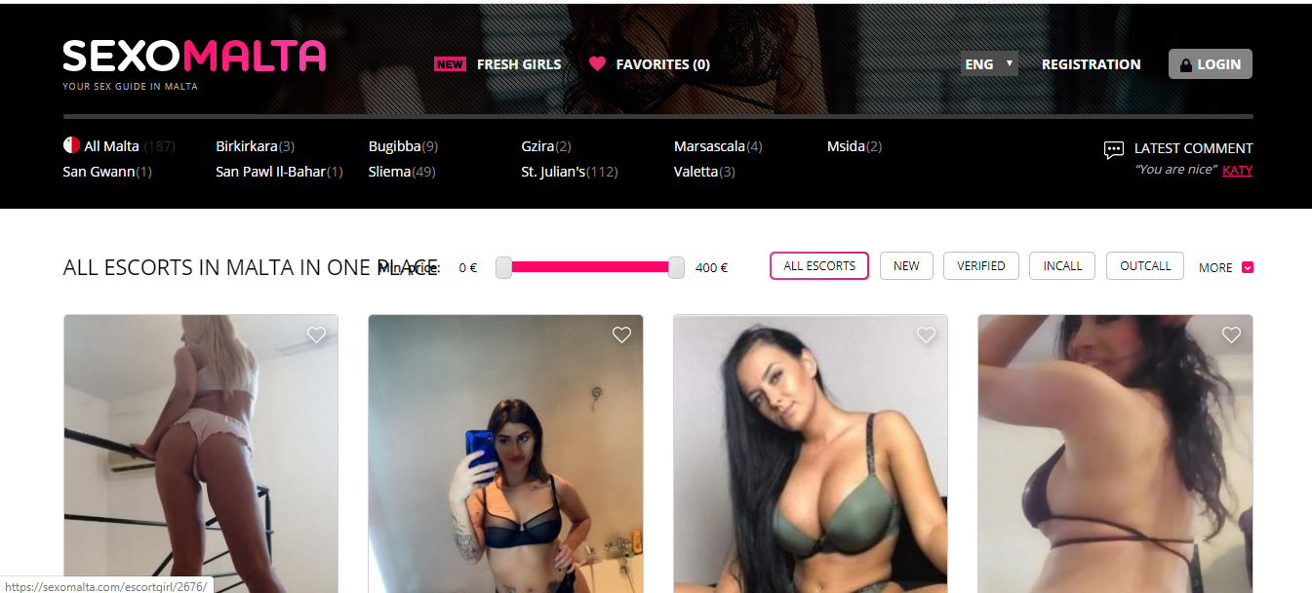

Slide 14
Link between prostitution and surrogacy
Notes:
European Centre for Law and Justice (2012) Surrogate motherhood: A violation of human rights. https://www.ieb-eib.org/ancien-site/pdf/surrogacy-motherhood-icjl.pdf, 13, 4

