Slide 1

Prostitution from a gendered lens
Romina Lopez

Slide 2
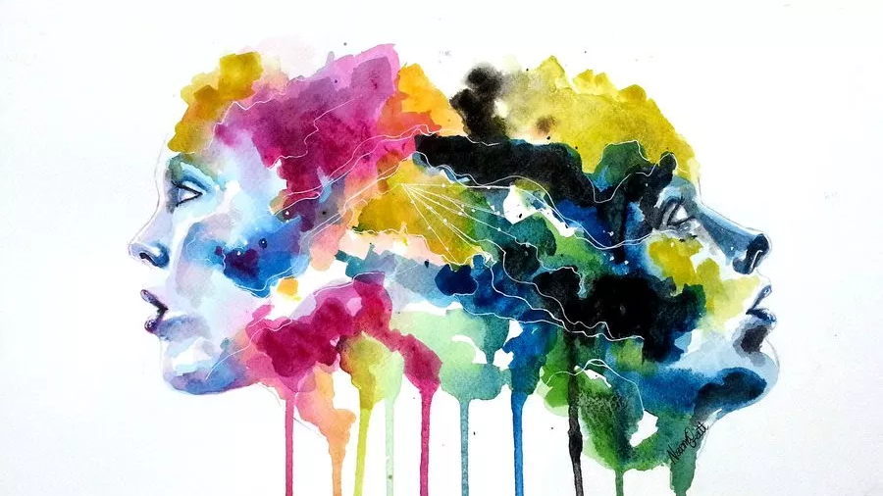
Addressing prostitution
Sex workers ?
Prostituted women?
Polarized approach → sex work model or sexual exploitation approach

Slide 3

contradictory terms
Oppression / Agency
Victimization / Choice
Coercion / Free will

Slide 4

Influence of discourse
Political agendas
Policies
Normalisation:
  how prostituted women & sex buyers are perceived
  pimps; strip clubs
Society
Culture

Slide 5
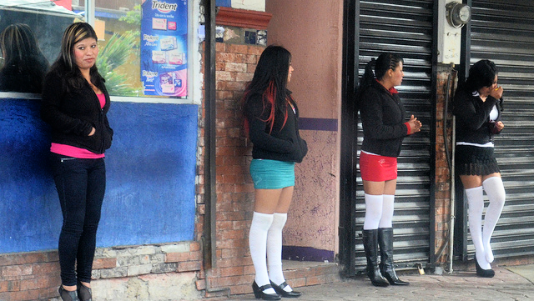
Consent in prostitution
Consent is Debatable since:
  The Majority of women are under the age of 18 (KRAUS, 2016)
  Desperate financial conditions (Farley & Kelly, 2000)
  Maintaining problem drug use (Young et al. 2000)
  Fear of harm – pimps or boyfriends (giobbe, 1993)
  The conditions which make genuine consent possible are absent:
    physical safety
    Equal power with customers
    Real alternatives (Hernandez, 2001)

Slide 6

The invisibility of prostitution
Prostitution formalizes women’s subordination by gender, race, and class.
Poverty, racism, and sexism are connected in prostitution.
Women are purchased because they are vulnerable as a result of
  lack of educational options
  as a result of previous physical and emotional harm.
                (Farley, 2003)

Slide 7

Paradigm for understanding prostitution
Prostitution is domestic violence
Comparisons of pimps and batterers identified the following similarities
  extreme physical violence to control women,
  The manner in which they forced women into social isolation
  used minimization and denial, threats, intimidation, verbal and sexual abuse
  had an attitude of ownership
                (Giobbe, 1993)

Slide 8
Prostitution – a gendered practice
Gender Inequality
The purchase to access of women`s bodies
Sexual consumerism increasingly merged into mainstream capitalism transforming the organisation of prostitution
(Jeffreys, 2009)
It occurs in a context of material inequalities between women and men
  Men`s greater economic capital
  Disproportionate share of political decision-making
  Violence against women and girls which occurs globally
  (Walby, 2001)

Slide 9
Gendered division of labour
Prostitution disproportionately involves men buying access to women`s bodies
Power
  Gaining control over women`s bodies
  Globalisation
  Emotional dimensions as gender regime
  Normative constructions of masculinity
  Stigmatisation of women (Coy, 2012)

Slide 10
The effects of prostitution in society
“The normalization of prostitution also has devastating effects in a society as a whole: it supports and cements a discriminating, gender hierarchical attitude of men towards women ….. Prostitution is violence against women! It reinforces and it promotes patriarchal gender relations, it is a symbol for the domination of men over women as well as for the collective degradation of women.“
                Heiliger (2015)

Slide 11
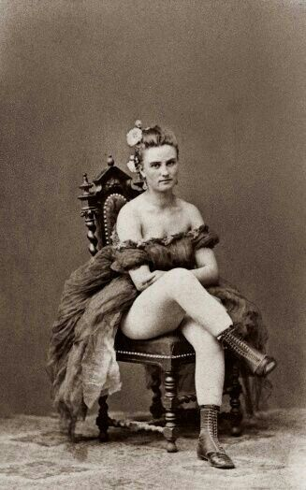
Oldest profession or oldest oppression?

Slide 12
References
Coy, M. (2012), Prostitution, Harm and Gender Inequality: Theory, research and policy. London: Routledge
Farley, M. (2003). Prostitution and the Invisibility of Harm. Women & Therapy, 26(3-4), 247-280. doi: 10.1300/j015v26n03_06
Farley, M., & Kelly, V. (2000). Prostitution. Women & Criminal Justice, 11(4), 29-64. doi: 10.1300/j012v11n04_04
Giobbe, E. (1993). An analysis of individual, institutional & cultural pimping. Michigan Journal of Gender & Law, 1, 33-57.
Heiliger, A. (2015) Zur Realität in der Prostitution und ihre gesellschaftlichen Auswirkungen
Hernandez, T. K. (2001). Sexual harassment and racial disparity: The mutual construction of gender and race, University of Iowa Journal of Gender, Race & Justice, 4, 183-224.
Jeffreys, S. (2009). Prostitution, trafficking and feminism: An update on the debate. Women's Studies International Forum, 32(4), pp.316-320.
Kraus, I. (2016). Prostitution is Violence against Women! https://www.trauma-and-prostitution.eu/en/2017/01/03/prostitution-is-violence-against-women/
Letherby, G. (2007). Feminist Research in Theory and Practice. Maidenhead: McGraw-Hill International (UK) Ltd.
Millen, D. (1997). Some Methodological and Epistemological Implications of Doing Feminist Research on Non-Feminist Women. Sociological Research Online, 2(3). doi: 10.5153/sro.106
Walby, S. (2011) The future of feminism. Cambbridge: polity press.
Young, A., Boyd, C., & Hubbell, A. (2000). Prostitution, Drug Use, and Coping with Psychological Distress. Journal of Drug Issues, 30(4), 789-800. doi: 10.1177/0022042600030004

