Slide 1


Dr Anna Borg - February 2020
On behalf of the Coalition for the Joint Submission to Government Public Consultation Process

Slide 2
This presentation
Introducing the core group and the endorsers
Our proposal – an overview
Our overall key message – you cannot separate trafficking from prostitution – Why?
What is the impact of prostitution and trafficking on the country and those involved?
Discuss the model proposed – the Equality Model

Slide 3
Who are we?
The Core Group
This Submission was drafted and endorsed by a multi-disciplinary collective of Malta’s leading experts on prostitution and trafficking-
Dr Anna Borg – Academic, Director of the Centre for Labour Studies at the University of Malta and Women’s Rights Activist.
Dr Anna Vella – Medical Doctor involved in the management of Dar Hosea
Dr Lara Dimitrijevic– Lawyer and Women’s Rights Activist
Dr Helen Burrows - International Human Rights Lawyer and Justice Reform Practitioner
Ms Romina Gatt Lopez – Researcher – Worked directly with prostituted women
Ms Marietherese Gatt – Researcher and Women’s rights activist
The proposal has been endorsed by 42 organisations

Slide 4
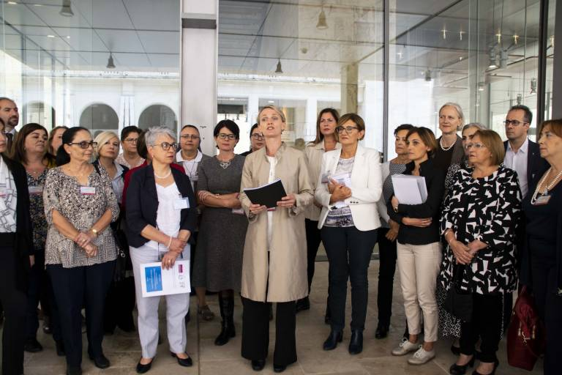

Slide 5






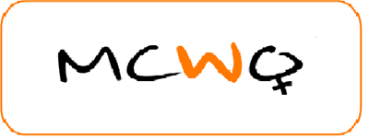

Slide 6


Slide 7
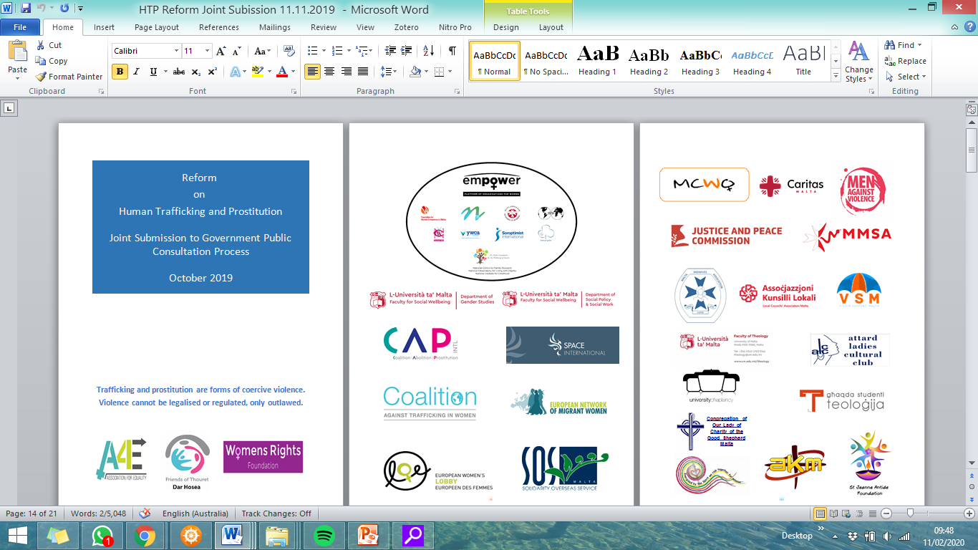
The Proposals

Slide 8
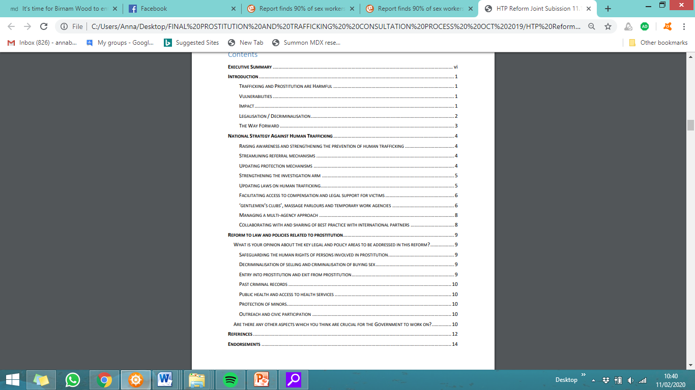

Slide 9
What is our overall key message in this proposal?
FACT: Decriminalising prostitution without criminalising the buying increases human trafficking
Decriminalising prostitution (without criminalising the buying) implies that selling/buying sex will become legal and acceptable and normalised.
This leads to more men buying sex (it is legal and acceptable)
There is not enough supply to deal with the increased legal demand (increase demand, increase supply)
So pimps and traffickers use force and coercion to trap more women/girls/boys/men/trans into prostitution to keep up with the demand and get richer.

Slide 10

Decriminalisation = Green light
What message will Decriminalisation only bring to the traffickers, the pimps and the johns?
“Traffickers will only sell persons for sexual exploitation when market conditions make it profitable” (UNODC 2009).

Slide 11
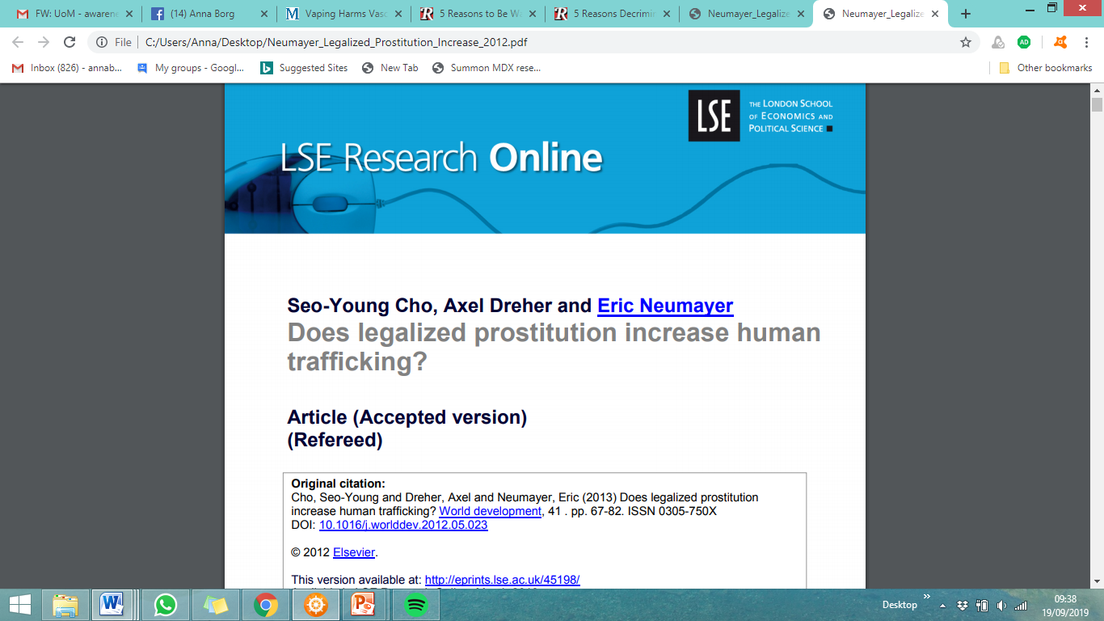
“Our empirical analysis for a cross-section of up to 150 countries shows that…on average, countries where prostitution is legal experience larger reported human trafficking inflows.

Slide 12
What is our key message?
It is money handed over by sex buyers that lines the pockets of pimps and traffickers.
Without their demand, there would be no need to ‘supply’ or ‘traffic’ women/girls (+boys, trans, men) into the sex trade.
So you cannot separate trafficking from prostitution – the two are intertwined.

Slide 13
Some key facts - Trafficking
The profitability of trafficking in a given country hinges on the characteristics of that country’s market for commercial sex (decriminalisation/criminalisation)
A crucial factor for the profitability of commercial sex is the legal framework surrounding it”.
What legal framework will Malta adopt?
Jakobsson & Kotsadam (2013)

Slide 14
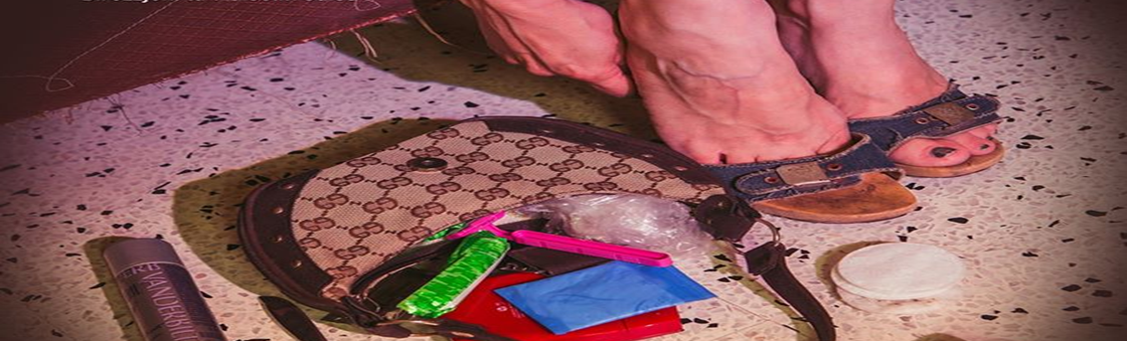
Is Prostitution a bit of harmless fun?

Slide 15
Trafficking and Prostitution are harmful
Prostitution is often trivialised and seen as harmless fun.
It is assumed to be a purely commercial transaction between two consenting adults and that the power dynamic between the buyer and the seller are equal.
The reality however, is that many prostituted people are controlled by pimps and gangs and are increasingly being trafficked.

Slide 16

Some sobering facts
90% of people involved in prostitution (the vast majority of whom are women) are dependent on a male procurer (Fondation Scelles as quoted in EU, 2014).
Conservative statistics suggest that 1 in 7 prostitutes in Europe are victims of trafficking – this goes up 60% and 90% in some member states (EU, 2014).
Coercion is often used by pimps to entrap both children and women (O’Hara, 2018, Coy, 2016).

Slide 17
Some key facts – Exploiting Vulnerability from a young age
The most vulnerable children and youths are specifically targeted by pimps and groomed into prostitution:
Dysfunctional families
Mental health problems
Deprived backgrounds
Addiction problems
Homelessness
Apart from pimps these can also be groomed by their boyfriends, family members, pseudo work agents (EU, 2016).

Slide 18
Some key facts – Exploiting Vulnerability from a young age
For the vast majority of women in prostitution, the age of entry is below 18 (EU, 2014).
Unaccompanied children are increasingly being trafficked for sexual exploitation and forced criminality (EU, 2016).
Some girls are groomed from a young age, as early as 12 – 13 (EU, 2014).

Slide 19
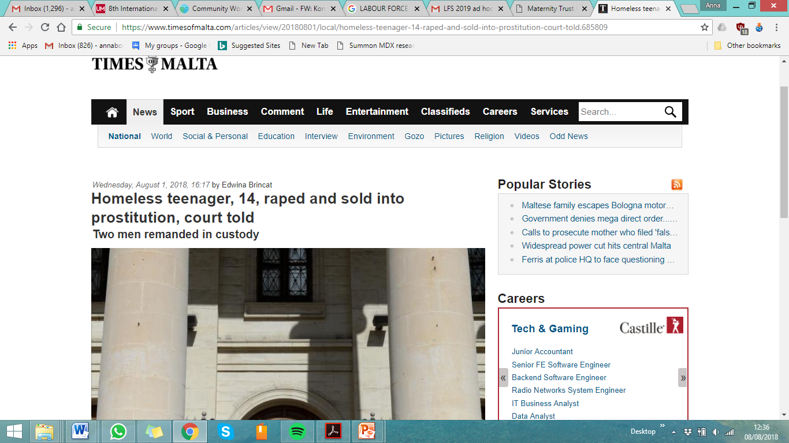


Slide 20
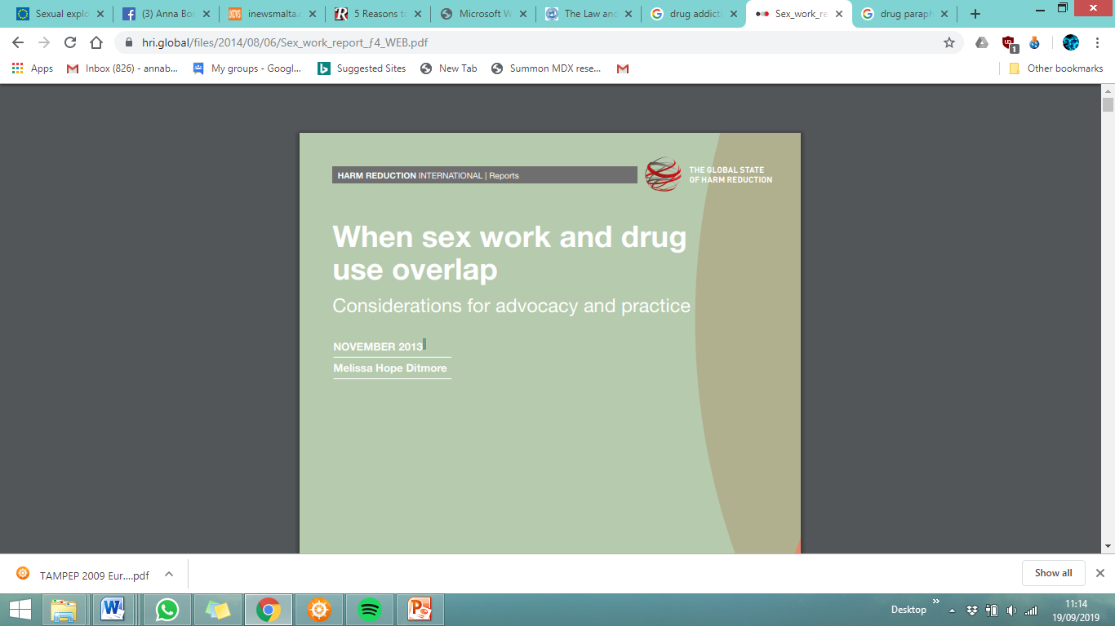
Some key facts – Exploiting addiction and victimisation
Drugs are often used as trapping factors making it difficult for the prostituted person to exit, once dependent.
“..both prostitution and substance abuse are the behavioral translations of these women's endless cycles of victimization and severely disturbed backgrounds, as well as an expression of the self-destructive pull, the sense of hopelessness, helplessness, negative self-concept and psychological paralysis reported by almost every subject in the study”.
(https://www.ncbi.nlm.nih.gov/pubmed/7143150)

Slide 21

Is prostitution cost-neutral?

Slide 22
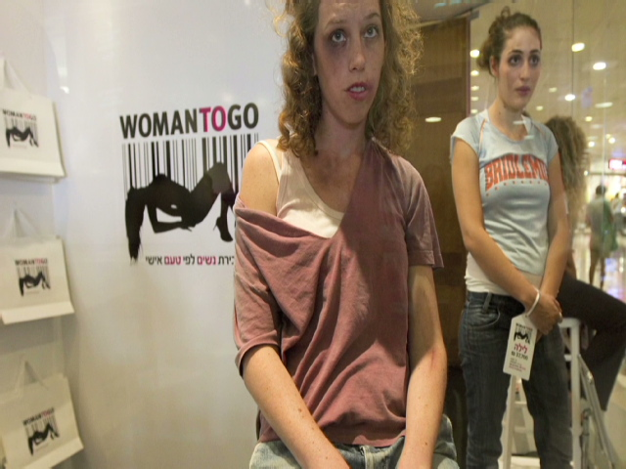
The impact of prostitution: some facts!
What is the physical, mental and social impact of prostitution?

Slide 23
Some key facts -The physical impact of violence
As more men are watching pornography, male demands on prostituted persons are becoming more extreme and leading to painful and degrading sexual practices.
People used in the sex industry often need medical care as a result of the ever-present violence and infectious diseases (Farley et al, 2003)
The infectious diseases also affect the buyers and their innocent partner/s making this a serious public health issue.

Slide 24
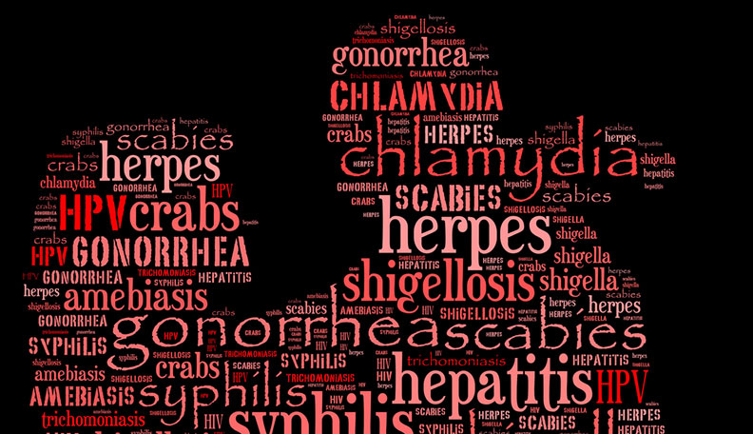
This harmless fun is not cost neutral
HIV + AIDS
Syphilis
Chlamydia
Hepatitis B + C
Gonorrhoea
HPV leading to cancer
Herpes
Pubic Lice
Genital Warts

Slide 25
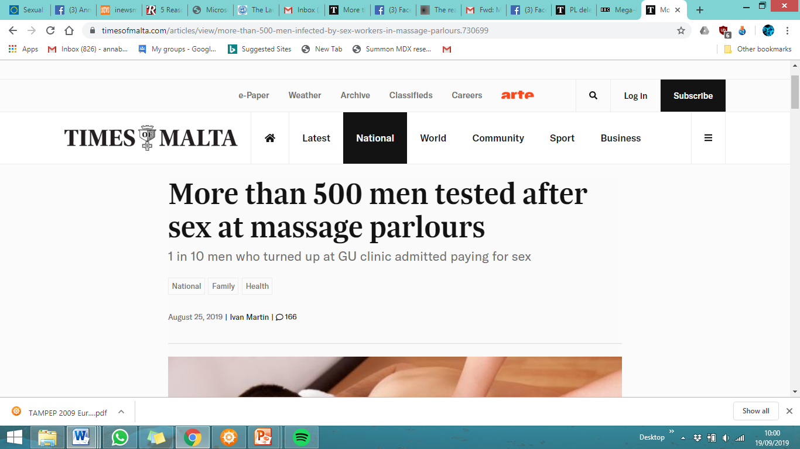

Slide 26
Some key facts –The mental health impact
Survivors frequently need mental health care for post-traumatic stress disorder, psychotic episodes and suicide attempts.
From a study over 9 countries, it emerged that the mortality rate of prostituted persons can be up to 40 times higher than the average population (Lynne, J., Zumbeck, S., Spiwak, F., Reyes, M.E., Alvarez , D., Sezgin, U. 2003).
A study showed that 89% of prostituted persons indicated they wanted to leave, but they did not see a way out or another option to survive (Farley et al, 2003).

Slide 27
Prostitution - is not cost neutral!
Physical /Mental health Impact on the prostituted person
Public Health Issue (johns and their partner/s)
Trafficking through criminal gangs
Normalisation of prostitution leads to the commodification of (mostly) women’s bodies and assumes that a ‘subset’ of girls/women can be sacrificed to keep men sexually satisfied and happy.

Slide 28

What model have the most feminist countries adopted?
Equality Model

Slide 29
The Equality Model – 3 guiding principles
Decriminalisation of those who are prostituted – they should not be criminalised or victimised further for the abuse they endure
Buying human beings for sex is exploitative and harmful – so it cannot be normalised and legitimised
Offer exit programmes and related support services

Slide 30

The Equality Model
Sweden, Norway, Iceland, Ireland, France, Israel and Canada have adopted the Equality (Spain too now, is considering this Model).
The Equality model is endorsed by the European Women’s Lobby and the European Parliament (EU, 2014).
The model is shunned by the traffickers/ pimps/johns – who get the clear message that what they are doing (exploiting the vulnerable) – will no longer be tolerated.

Slide 31
THE IMPACT OF THE EQUALITY MODEL IN SWEDEN - SINCE 1999
Fewer women experiencing sexual and physical violence.
Significant decrease in the size of prostitution.
Decrease in trafficking
No murders of prostituted persons since 1999.
(Coy, Pringle & Tyler, 2016, Swedish Institute, 2010)

Slide 32
What are we proposing?

Slide 33
What are we proposing?
1. Decriminalisation of those who are prostituted - Persons caught up in prostitution should not be criminalised or victimised further for the abuse they endure.
2. Exit services - Offer high quality services to support those in prostitution and help them build a new life outside it.
3. Buying sex becomes a criminal offence - Buying human beings for sex is exploitative and harmful - and so it cannot be normalised or legitimised.
These 3 proposals are interlinked and cannot be separated

Slide 34
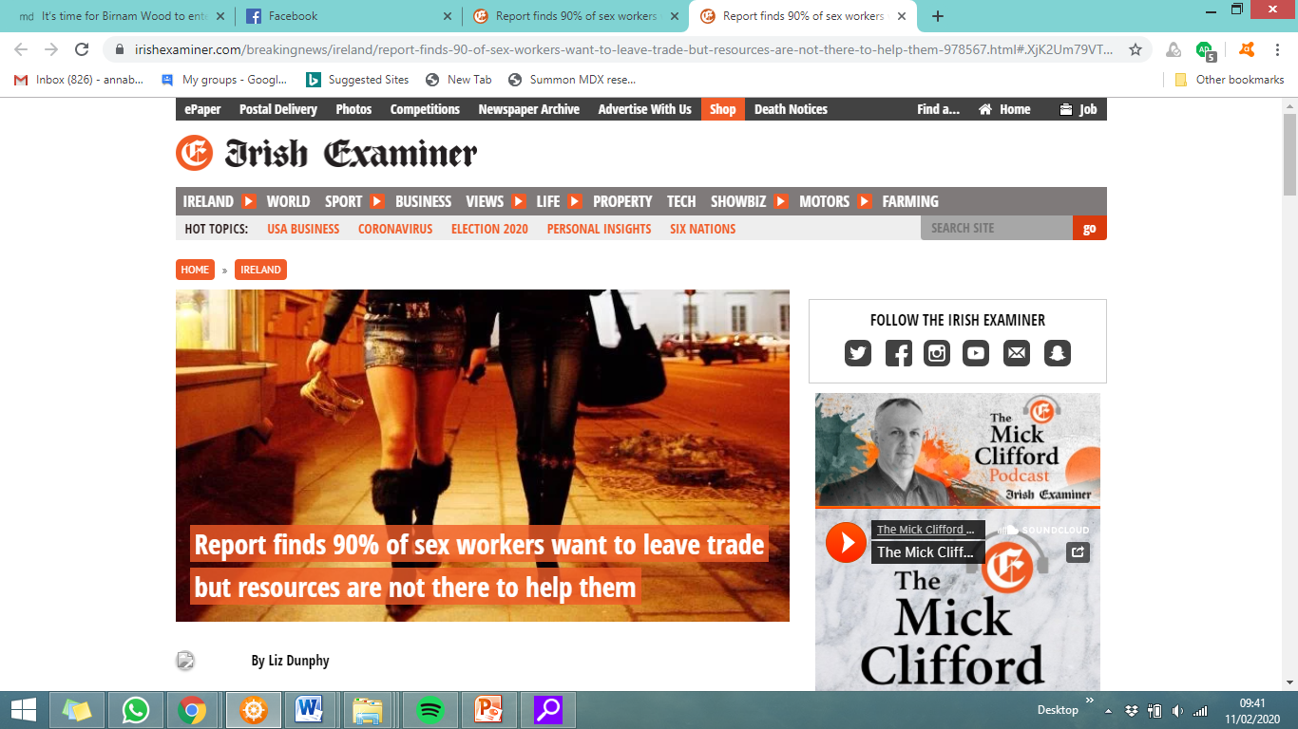

Slide 35
Conclusion - Tackling the issue holistically
We are urging government to enact a law for the common good, not for the exceptions.
We need to learn from other jurisdictions and draft a good solid law that tackles the interlinking issues holistically in ways that protect the vulnerable and punish the exploiters in line with the avant-garde countries that embrace gender equality and human rights.

Slide 36

Questions/Comments?

