Slide 1

Research on Couple Relationships in Malta
NATIONAL CENTRE FOR FAMILY RESEARCH
Professor Angela Abela
Associate Professor Suzanne Piscopo
Dr. Sue Vella

Slide 2
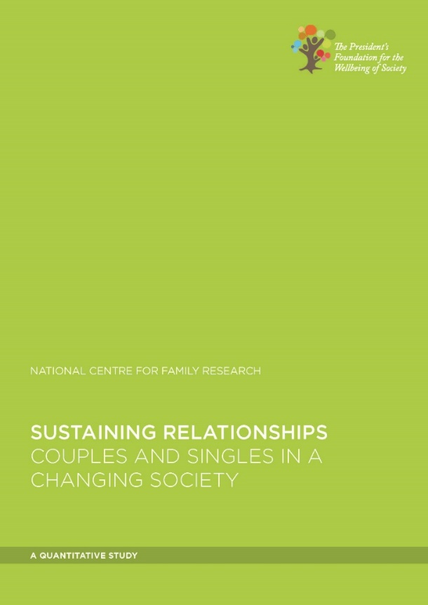
Two Research Studies
2016
2017

Slide 3
Sustaining Relationships:
Couples and Singles in a Changing Society
NATIONAL CENTRE FOR FAMILY RESEARCH
Professor Angela Abela
Dr Neville Calleja
Dr Suzanne Piscopo
Dr Dr. Sue Vella
Allison Zammit Said

Slide 4
RESEARCH AIMS, DESIGN &
DESCRIPTIVES

Slide 5
Main Research Question
Do significant differences exist in the life satisfaction and relationships of persons in diverse life situations in Malta?
If so, what are these differences and among which groups are these differences significant?

Slide 6

Methodology and Questionnaire
2469 participants, stratified by parenthood, gender and residential arrangements
Computer Assisted Telephone Interviewing (CATI)
Semi-structured questionnaire
  Part 1: Demographic data of the respondent
  Part 2: Information/perceptions about relationships
  Part 3: Use of relationship support

Slide 7
FINDINGS:
LIFE SATISFACTION

Slide 8
Key Questions
How do adults rate their life satisfaction?
What variables, if any, predict life satisfaction?
Do predictors of life satisfaction, if they exist, differ according to relationship status?
Does parental status impact life satisfaction, and if yes, how?

Slide 9
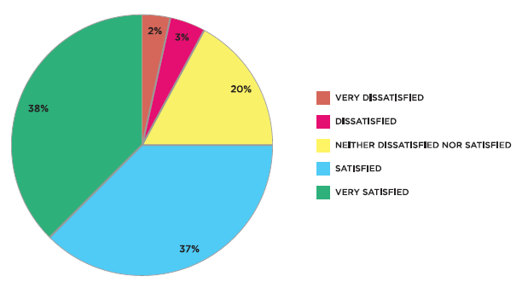
Life Satisfaction
Satisfaction was measured on a five point scale from 1 (very negative) to 5 (very positive).
The mean score was 4.05
75% were either very satisfied (38%) or satisfied (37%).
Notes:
96% of the Maltese stated that they were very satisfied or fairly satisfied in 2018 regarding their personal or economic situations 1% less than Ireland.

Slide 10

For those in a relationship…

Slide 11


Predictors of Life Satisfaction for those in a Relationship
Increase
Decrease
Being married
Income adequacy
Conflict in personal relationships
Problems at work
Facing big problems at the moment
Income inadequacy
Mental health problems
Health problems
Strongest negative influences:
Mental health problems
Conflict in personal relationships
Notes:
REFER TO SILC AUG 2019
The at risk of poverty rate has gone up slightly between 2013 and 2018 from 15.75% TO 16.85%
The at risk of poverty and social exclusion rate has gone down from 24% in 2013 to 19% in 2018
30.6% cannot afford one week holiday away from home
13.9% cannot afford to face unexpected expenses
7%in arrears on mortgage, rent payments, utility bills, hire purchase instalments
7.6% not able to keep the house adequately warm in Winter
DR GRECH reported between one and three cases of self harm and attempted suicide daily

Slide 12
Life Satisfaction, Civil status and Being in a Relationship
Significant difference in life satisfaction based on civil status
  Married persons reported highest levels of life satisfaction, followed by single, separated, widowed and divorced.
Being in a relationship was associated with higher life satisfaction.
Satisfaction in one’s relationship was associated with life satisfaction.

Slide 13
Life Satisfaction and Employment Status of Those in a Relationship
Significant difference in life satisfaction based on employment status of respondents and their partners.
Proportions of ‘satisfied’ or ‘very satisfied’ responses:
  85.0% One partner works full-time while the other works part-time
  82.9% Dual earner couples
  80.8% One partner working full-time with the other keeping the home
  80.5% Couples where both were retired
25% of all those in a relationship where both partners were unemployed and on benefits reported being ‘dissatisfied’ or ‘very dissatisfied’.

Slide 14


For those not in a relationship

Slide 15

Predictors of Life Satisfaction for those Not in a Relationship
Increase
Decrease
Being female
‘Everything is going well for me and my family’
Type of lifestyle
Income adequacy*
Conflict in personal relationships*
Problems at work*
Facing big problems at the moment*
* Same as those IN a relationship

Slide 16

Being a parent

Slide 17
Life Satisfaction and Being a Parent
There was no significant difference in life satisfaction between persons who have or do not have children.
Among parents, married persons reported highest life satisfaction.
Among parents, persons in a relationship reported higher life satisfaction
Parenting alone lowered life satisfaction, particularly if parenting adolescents
Higher life satisfaction reported by parents with:
  Daughters younger than 9 years
  Sons aged 20+ years
Lower life satisfaction reported by parents with:
  Daughters/Sons aged 10 – 19 years

Slide 18
FINDINGS:
RELATIONSHIP SATISFACTION
(results for those in a relationship)

Slide 19
Key Questions
How many describe their relationship as positive or negative?
What variables, if any, predict relationship satisfaction?
Are there other important correlates of relationship satisfaction?
What do respondents value most in their relationship?
What are the main problems respondents face in their relationships?
Do respondents think that faith matters to their relationships?
Have respondents sought help with their relationship, and from whom?

Slide 20
Relationship Satisfaction
Satisfaction was measured on a five point scale from 1 (very negative) to 5 (very positive).
The mean score was 4.49.
90.4% of respondents described their relationship as ‘positive’ or ‘very positive’
No significant differences by:
Gender
Educational attainment
Notes:
THIS INCLUDES ALL RELATIONSHIPS , NOT ONLY MARRIED COUPLES; THIS MEANS THAT 9.6% WERE DISTRESSED
IN 2005, Abela, Frosh and Dowling found that when making use of the Marital Adjustment Test, 10.9% of the married population were distressed
In 2011, 21.6% of the parent population were distressed (Abela 2015)

Slide 21
What predicts relationship satisfaction?
The only significant predictor of satisfaction in one’s current relationship was civil status.
Married respondents had the highest positive responses, with a mean score of 4.5.
Civil Status | Mean | Std. error
Married | 4.504 | 0.019
Single | 4.484 | 0.044
Separated | 4.409 | 0.068
Widowed (not remarried) | 4.185 | 0.131
Divorced (not remarried) | 4.13 | 0.165

Slide 22
Other correlates of relationship satisfaction…
Significant correlations were also found between satisfaction and:
Age
  Older adults (61+) were more likely to describe their relationship as ‘very positive’
Income adequacy
  The lower the income adequacy, the lower the relationship satisfaction
Employment status
  Most satisfied: 1 partner working FT, 1 partner working PT
  Least satisfied: Both partners unemployed, on benefits

Slide 23
Parenting and Relationship Satisfaction
Parental status was not predictive of relationship satisfaction
Dual earning couples with children were twice as likely to describe their relationship as ‘negative’, ‘very negative’ or ‘average’ (10.5%), than those without children (5.1%)
Parents reporting highest levels of relationship satisfaction had, in this order:
  Daughters aged 9 years or younger
  Sons aged 9 years or younger
Parents reporting lower levels of relationship satisfaction had male or female adolescents
Notes:
In tune with a study STUDY – THE RELATIONSHIP BETWEEN ADOLESCENTS AND THEIR PARENTS (2013)
HBSC survey 2012 adolescents found it difficult to confide in their mother and father

Slide 24
What Respondents Valued in their Relationship
Overall, respondents value:
  24.5% Respect
  17.8% Communication
  16.3% Trust
  15.2% Love
  9.4% Fidelity
Young and middle-aged valued most:
  Communication
  Trust
Older age groups valued most:
  Forgiveness
  Understanding
Respondents with high relationship satisfaction valued most:
  Communication

Slide 25
What respondents liked least in their relationship
Overall, respondents reported the following difficulties:
  4.13% “We work too much and
  have no time for the
  relationship”
  3.65% “Poor communication”
  2.45% “My partner is always at work”
  1.97% “My partner is rarely at home”
  1.56% “Lack of financial security”
Respondents with low levels of relationship satisfaction reported the following:
  39.1% “Poor communication
  33.3% “Lack of fidelity”
  16.7% “Lack of financial
  security”
  8.3% “Violence”
  8.3% “Little or no
  demonstration of
  affection”

Slide 26
Seeking Help with Relationships
13.8% of respondents reported having sought help with a relationship.
Of those who did not, the vast majority (96.5%) said that they did not need it.
Most likely to have sought support
Higher level of education
Middle-aged
Divorced and separated persons
Parents of adolescents
Least likely to have sought support
Young adults
Older adults

Slide 27
Sources of Relationship Support

Slide 28
Sustaining Relationships:
The Expectations and Lived Experiences of
Couples in Malta
NATIONAL CENTRE FOR FAMILY RESEARCH
Professor Angela Abela
Assistant Professor Suzanne Piscopo
Dr. Sue Vella
Allison Zammit Said

Slide 29
Introduction and Rationale
for the Study

Slide 30

AIM OF THIS STUDY
To build on the findings from Phase 1 of the study through
exploring qualitatively:
What major factors influence the couple relationship
What helps and hinders relationship satisfaction in long-term couple relationships.

Slide 31
Research Design and
Participants

Slide 32
METHODOLOGY
Sample of 23 recruited from the population of 2469 respondents who participated in the Phase 1 Sustaining Relationships study (PFWS, 2016).
  Respondents who were in a relationship
  9 males and 14 females aged 18 and over, residing in Malta and Gozo
  Half had reported relationship satisfaction, half dissatisfaction
  Different socio-economic and educational backgrounds
Four focus groups and five semi-structured individual interviews

Slide 33
Understanding the Context of
Couple Relationships

Slide 34

COUPLES CONVERGED AROUND
FIVE DIMENSIONS OF THEIR CONTEXT
Coping with consumerism
Work-family balance
Mass media
Technology
Perceived ease of marital dissolution

Slide 35

COPING WITH
Almost all participants lamented how consumerist norms have led to a reordering of people’s priorities – adding to economic pressures and decreasing quality time together.
Parents do not want their children to feel deprived or different, eg. the cost of extensive extracurricular activities.
Maintaining a ‘socially acceptable’ lifestyle has become financially demanding and sometimes results in conflict between partners over consumption choices.

Slide 36

WORK-FAMILY BALANCE
All participants valued quality time together as a couple.
Yet, they struggled to balance work and family life
Telework as mixed blessing
Fear of infidelity with long hours at work & socialising after work
Some experienced inadequate income and could not make ends meet

Slide 37

MASS MEDIA
Participants shared mixed opinions over the impact of mass media, particularly in respect of they way they shape individuals’ expectations of couple relationships and marriage.
The idealised nature of romance and married life was seen to leave couples ill-prepared for reality.

Slide 38

TECHNOLOGY
Communication technologies were also seen to deeply affect the couple relationship.
On a positive note, they were seen to facilitate communication during long working hours, allowing partners to ‘touch base’.
For many, though, social media was seen to intrude upon quality time, especially where people were more attentive to their devices than to their partners.
ICTs were also perceived by some to increase the risk of infidelity, creating opportunities to form parallel relationships with relative ease.

Slide 39

PERCEIVED EASE OF MARITAL DISSOLUTION
All study participants entered marriage with the hope that it would last forever, and emphasised the importance of working hard at one’s marriage, especially where children are involved.

Slide 40

PERCEIVED EASE OF MARITAL DISSOLUTION
Almost all, however, spoke of how fragile they have come to perceive marriage, and how easy people perceive marital dissolution to be.
Respondents attributed this to:
  Media influences
  A weakened sense of commitment
  Weakening of social norms around fidelity and exclusivity
  The demands of work
  The relative ease of obtaining legal separation/divorce

Slide 41
Expectations of a
Long-term Relationship

Slide 42


EXPECTATIONS ARE CHANGING
Cultural expectations of the relationship
Past = priority given to children
Present = priority given to companionship of partner

Slide 43
SEVEN CENTRAL EMERGENT THEMES
Respect
Expectations of a long-term relationship
Love
Trust
Com-munication
Reciprocity
Companion-ship and shared quality time
Fidelity and Loyalty
Themes are:
Interrelated
Many grow over time
Require an ongoing
effort by each partner

Slide 44
Conclusions and Recommendations

Slide 45

RECOMMENDATIONS FOR POLICY AND PRACTICE
The importance of nurturing the couple relationship was highlighted and considered as vital to the quality of life of individuals and their dependent children.
In order to promote stable, mutually satisfying couple relationships which contribute to individual and family wellbeing, relationship education requires prioritisation in our policies.
Courses in relationship education that are evidence-based are to be offered to all couples, irrespective of their religious beliefs or whether they are married or not.

Slide 46

RECOMMENDATIONS FOR POLICY AND PRACTICE
In the case of couples with children, co-parenting is to be given its due importance as suggested in the Strategic Policy for Positive Parenting 2016 -2020.
Parenting programmes are needed and should not simply focus on the skills needed to raise children, but should adopt a more systemic approach which addresses the couple relationship, recognising parents as partners.
Relationship education should also address the reality of post-separation and divorce, and blended families, with particular emphasis on co-parenting in this context.
Notes:
REFER TO NEW STUDY ON BLENDED COUPLES

Slide 47

RECOMMENDATIONS FOR POLICY AND PRACTICE
Given the negative impact which long working hours was found to have on the wellbeing of the couple in Maltese society, and the high value given to spending quality time together for relationship satisfaction Family friendly policies are to be further developed and encouraged across the various segments of the labour market..
Guidance on time management for parents can be offered as part of wellness initiatives at the workplace.

Slide 48

RECOMMENDATIONS FOR POLICY AND PRACTICE
Income inadequacy was found to contribute significantly to couple distress. The presence of children was indicated as adding to financial pressures on the couple relationship. These findings substantiate outcomes from the quantitative CATI survey (PFWS, 2016). Adequate income support to meet basic needs should be guaranteed.
There is a need to strengthen school- based consumer and media education and to provide lifelong learning opportunities for nurturing consumer and media literate adults and parents.
Notes:
Check

Slide 49

RECOMMENDATIONS FOR POLICY AND PRACTICE
Personal ﬁnance education using a values-based active
learning approach, which looks at assessment of needs
versus wants, smart and responsible decision-making
around consumption, and planning of realistic budgets to
meet couple or family needs – needs to be strengthened both within formal and informal education systems and via community initiatives.
Current awareness–raising public campaigns promoting wise use of money are encouraging.

Slide 50


SUGGESTIONS FOR FURTHER RESEARCH
Given that some minority groups were not captured in the sample, further in-depth qualitative research with LGBTI, multi-faith and multi-cultural couples is suggested.
Likewise, the study did not capture the experiences of couples who have children outside marriage at a relatively younger age. The experiences of these couples, including the higher incidence of breakdown in this particular group of couples, need to be studied in more depth.
Notes:
% OF MALTESE WITH NON-MALTESE MARRIAGES:
732 (2012), 745 (2013), 931 (2014),882 (2015),1033 (2016),1014 (2017) from PQ
Births outside marriage multiplied by six in a decade from 5.8% in 1996 (NSO, 2010) to 31.8% in 2016 (Eurostat 2019).

Slide 51
SUGGESTIONS FOR FURTHER RESEARCH
We need to pay much more policy and practice attention to blended families.
In our qualitative study, people who entered into a blended relationship spoke of their challenges in many respects such as living arrangements, parenting challenges and relationship challenges.
NCFR is currently preparing to undertake a qualitative study on blended families with a view to developing policy and practice recommendations by mid-2021.

