Slide 1
The effective use of tablets in State, Church & Independent Primary Schools
IT Audit report

Slide 2
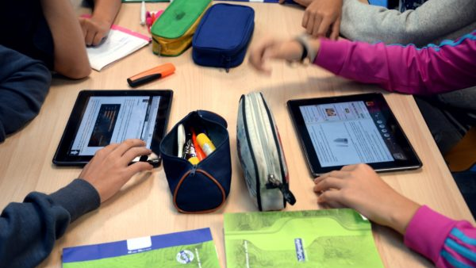
Introduction

Slide 3
Audit Scope & Objectives
To analyse the effective use of tablets in State & non-State Primary schools:
  Review the implementation of the One-tablet-per-Child (OTPC) project in these schools between the scholastic years 2016/2017 and 2018/2019
  The use of tablets by the students in class & at home
  The digital content available for the tablets
  The level of training offered to educators
  The support provided by the Directorate for Digital Literacy and Transversal Skills (DDLTS) and the contractor

Slide 4



Setting the context …

Slide 5
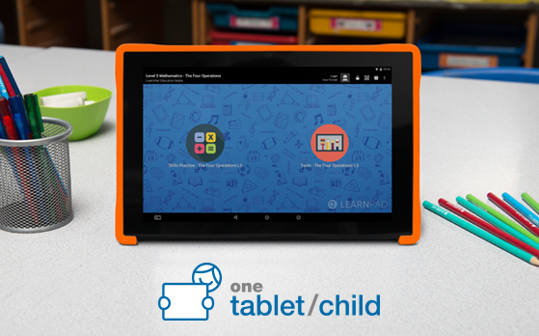
OTPC Pilot Project
Launched in 2014.
An expression of interest was published for interested parties from the private sector to offer their solutions for evaluation – in total 13 applicants from the private sector submitted their interests in this pilot study.
Pilot project was divided into two phases:
    March 2014 – educators were given the opportunity to try out different tablets in schools.
    October 2014 – a number of students from a selected number of State and non-State Primary Schools were also given the opportunity to utilise the tablets in class.

Slide 6
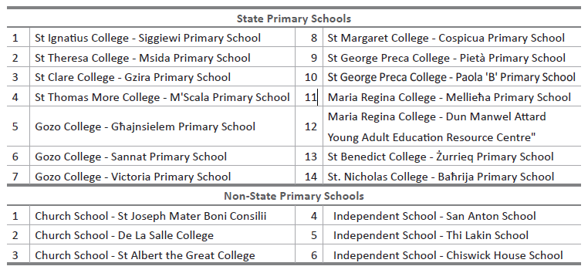
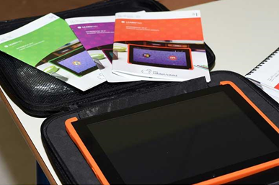
  In total, 22 class teachers, 21 Learning Support Educators (LSEs) and 335 students coming from 14 State Primary schools, 3 Church schools and 3 Independent schools participated in this pilot study.
  Most of the participating classes were from Year 4, although a few Year 3 and Year 5 classes were also involved to widen the scope for evaluation

Slide 7
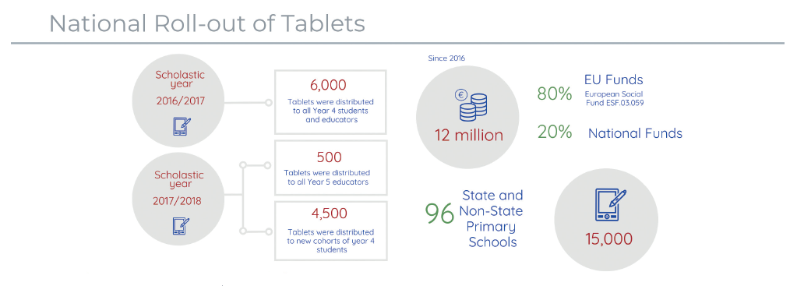
National Roll-out of Tablets in State, Church and Independent Primary Schools

Slide 8
Audit Methodology
The IT audit was divided into 5 different stages:
An informal meeting was held with the Director General for the Department for Curriculum, Lifelong Learning and Employability & key stakeholders involved in the OTPC project.
Another meeting was held at the DDLTS to understand how the OTPC evolved throughout these past 3 years & the pedagogical use of digital technologies to support & enhance learning & teaching.
A number of meetings were scheduled with Heads of State & non-State Primary schools to gain further insight how the tablets are being used in their respective schools.
Two separate online surveys (for parents and teachers) were created & sent to all the educators (teachers & LSEs) and parents of students in Years 4, 5 & 6 through an internal memo issued by MEDE & sent to all Heads of State & non-State Primary schools.
All the responses received from both surveys were analysed thoroughly before proceeding with the drafting of the audit report.

Slide 9
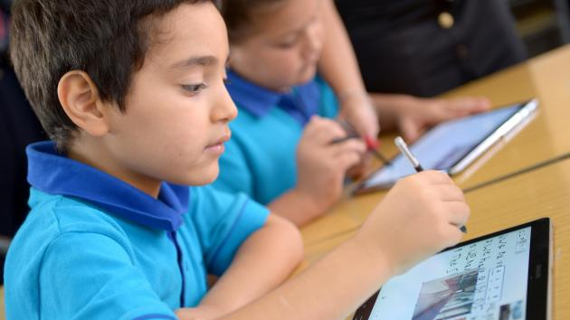
OTPC Scheme

Slide 10
Distribution of tablets

Slide 11
Hardware inventory
Inconsistencies with the hardware inventory
  MEDE provided the NAO with a complete list of the number of tablets distributed in each school. However, the NAO observed that the list was not quite complete:
    The number of tablets in one of the schools that the NAO visited was actually higher than that shown in the list.
    Some tablet registration forms were not collected from MEDE and still at the school. This was also confirmed by another school.
  The NAO asked for another list of tablet asset numbers in each school. The NAO noted that the number of tablets registered at the schools visited was closer to the quantity reported by the school.
  The NAO understands that an inventory of tablets is not static, it is recommended that an effort is to be made to keep the inventory updated continuously to reflect any changes in terms of new tablets, change of location, and replacements amongst others

Slide 12
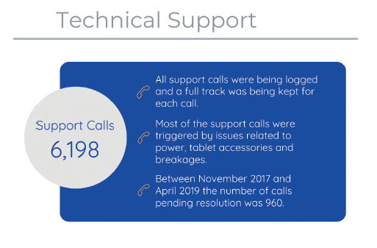

Slide 13
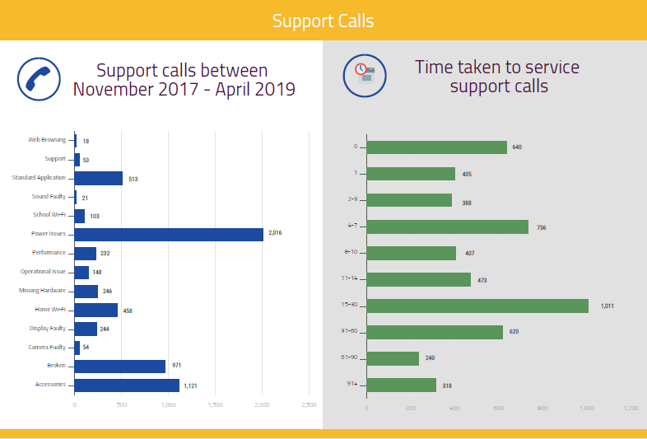

Slide 14

Analysis of Surveys

Slide 15
Survey methodology
2 separate surveys – Teachers and Parents
Quantitative and qualitative research – close-ended questions
Online format
All 96 Primary schools in Malta and Gozo where Years 4, 5 & 6 are taught
Similar set of questions, with further questions for Educators
Surveys in English, with Maltese language option for Parents
Introduced to schools by MEDE circular
Open for a two-week period post 2019 scholastic Easter break
Data cleaning – incomplete / duplicate responses, validation of asset numbers, etc.

Slide 16
Survey design
1st part – tablet asset number – cross-checked with list provided by MEDE
2nd part – type of school, name of school, and year taught/attending
3rd part – multiple choice + likert scale, mandatory questions, with logic applied to some depending on feedback.

Slide 17
Survey respondents
Majority from State schools, followed by Church schools and then Independent schools
Relatively evenly spread between Years 4, 5 & 6
Educators from 73 schools
Parents representing 92 schools

Slide 18
Survey highlights
Under-utilisation of Tablets
Digital Content limitations
Tablet related issues
Support concerns

Slide 19
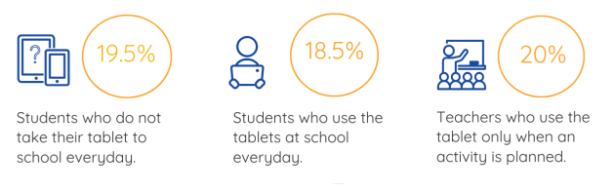
Survey results
Under-utilisation
Figure 7 - Teachers' survey

Slide 20
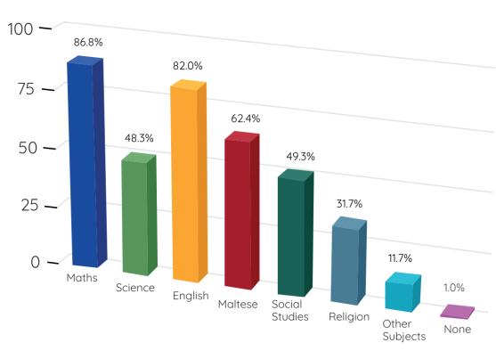
Survey results
Which subjects/topics do you generally use the tablet for?
Under-utilisation
Figure 9 - Teachers' survey

Slide 21
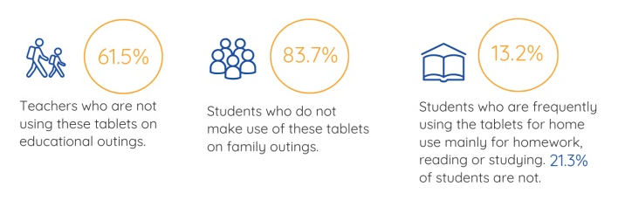
Survey results
Under-utilisation
Figure 13 - Parents' survey

Slide 22
Survey results
Digital Content
Figure 19 - Teachers' survey

Slide 23
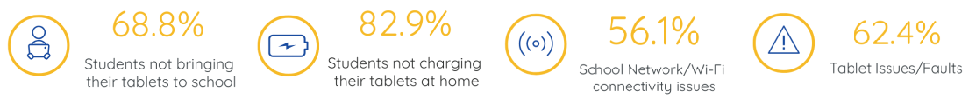
Survey results
Tablet related issues
Figure 25 - Teachers' survey

Slide 24
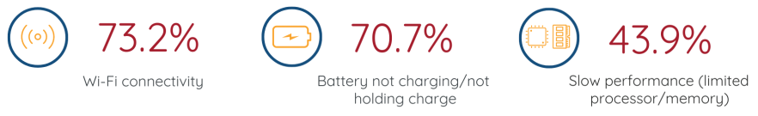
Survey results
Tablet related issues
Figure 26 - Teachers' survey

Slide 25
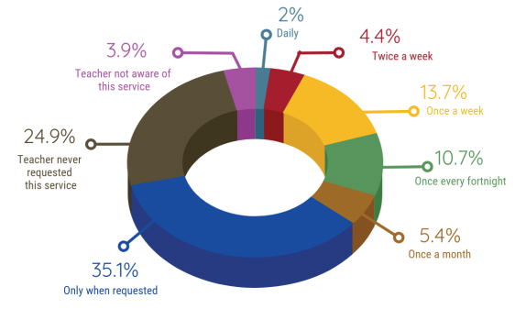
Survey results
Have you ever asked for MEDE (incl. Digital Literacy) support, and if yes, how often is this service available
(frequency of visits)?
71.2% Teachers have requested this service
Support concerns
Figure 21 - Teachers' survey

Slide 26
Survey results
Figure 28 - Teachers' survey
Overall views and perceptions
Figure 29 - Teachers’ & Parents’ surveys

