Slide 1
Ta’ Qali Action Plan Partial Review
Presentation to the Environment and Development Planning Committee
Policy objectives
Site analysis
Proposed policy
Phase 1 representations
9th October 2019

Slide 2
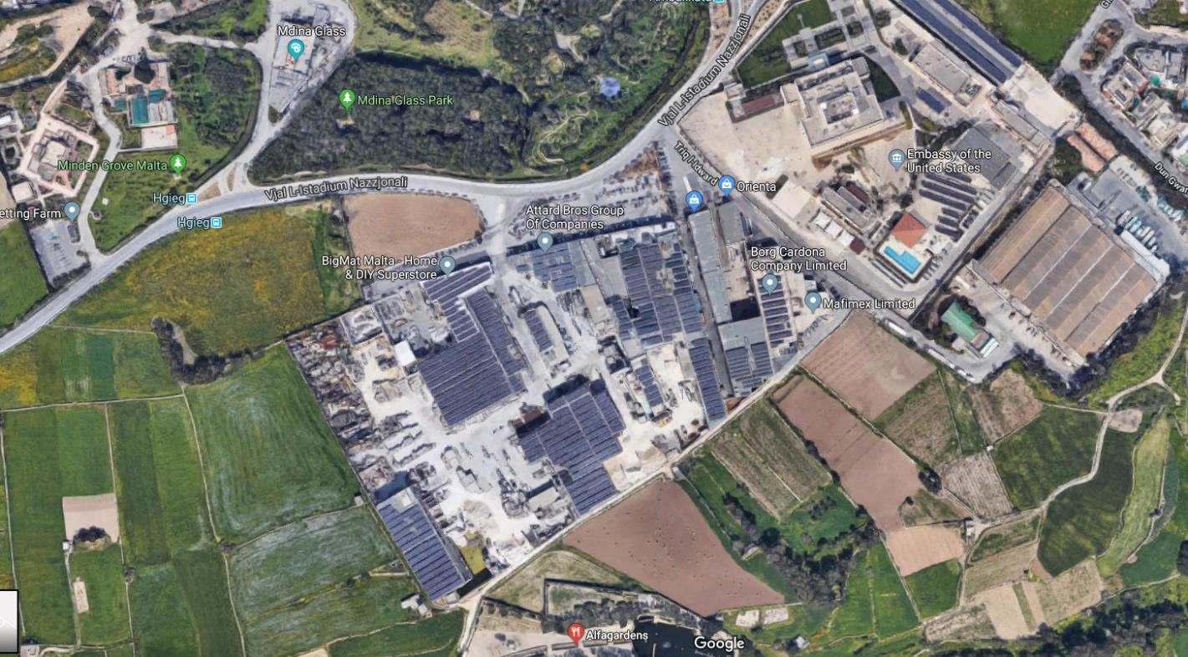
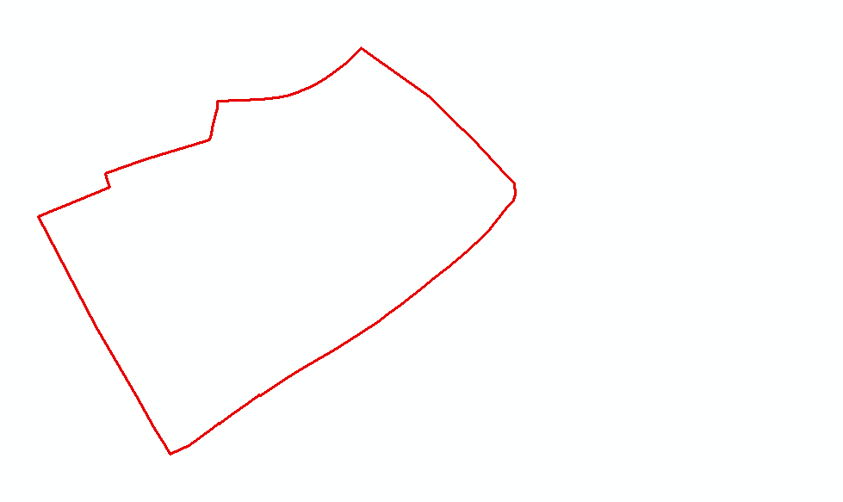
SITE BOUNDARY

Slide 3
Policy objectives

Slide 4
Objectives for the Partial Action Plan Review
To designate the site currently covered by policy NWTQ 32 of the Ta’ Qali Action Plan into a Commercial Area;
To ensure that the designation of policy NWTQ 33 as a parking area is retained and a requirement for landscaping included;
To replace the currently allowable land uses with those allowed by Category D of the Use Classes Order (SL552.15) and prohibit any further intensification of the current uses;
To formulate a development framework which seeks to mitigate any adverse impacts from the re-designation of the site provided that the overall height of buildings shall not exceed 17.5m and shall be terraced to the heights of the existing embassy for buildings located on the perimeter of the site facing the same embassy. Upper recess shall also be taken into consideration when planning the opposite side facing Mdina. In this area (facing Mdina), heights of buildings contiguous/first in line to the ODZ area shall be kept as stipulated in the Ta’ Qali Action Plan 2000 policies with a stepping effect to 17.5m;

Slide 5
Objectives for the Partial Action Plan Review
To amend or delete all other provisions in the current policies which are deemed to run counter to the overall objectives set out in (a) to (c) above; and
Additional blank party walls are not accepted.
Following public submissions during the consultation on the Government Objectives, the Minister acceded to public requests to include the following uses or allow intensification thereof, in conjunction to the Category D uses previously listed:
    Article 4 (s) supermarkets;
    Category B: Class 2A (c) medical clinic, Class 2C education;
    Category F: Class 6A storage and distribution.
as these additional uses were deemed compatible with the long-term goal of creating a commercial area on this site.

Slide 6
Phase 1 Representations

Slide 7
Phase 1 Representations
Rep. No. | Author
TAQ001 | Flimkien ghal Ambjent Ahjar
TAQ002 TAQ004 | Dr. Andrea Gera De Petri Testaferrata on behalf of Testaferrata Bonici Ltd
TAQ003 TAQ005 | Perit Joseph C. Grech obo owners of adjacent site
TAQ006 TAQ008 TAQ010 | Perit George Tonna obo Nectar Ltd Perit George Tonna obo Nectar Ltd Perit George Tonna obo Attard Bros. Co Ltd
TAQ007 | Perit Sebastian Grima (Raniolo & Associates Ltd) obo Mafimex Ltd
TAQ009 | Alexander Bonanno obo ERA

Slide 8
Flimkien għal Ambjent Aħjar (FAA)
Enabling of further development to an extent which cannot be considered to benefit the general public in any way
It is not necessary or desirable for Class D uses to be located outside of the urban area
Proposal results in a reduction of land available for industry in turn necessitating the conversion of further sites in the rural areas for such use
Questionable as to how to allow for the sustainable management of the area given that large extents of the site are already committed to industrial use
Any increases to the current height are being deemed excessive and unnecessary in view of the Area of High Landscape Value
Any development proposed along its perimeter should be adequately set back from the site boundary by at least the width of one carriageway such that the building has fenestrated facades on all fronts
TAQ001

Slide 9
Flimkien għal Ambjent Aħjar (FAA)
The change in use, increase in floor area and volume and overall increase in density and
users would necessitate an S.E.A.
The area is not well linked to public transport services and limitation of nearby junctions to cope with increased trips and traffic loads
The laws which are applicable to other overarching contexts cannot be revised – on a piecemeal basis –because of this proposal
The proposal is in breach of several provisions of SPED, namely:
  Breach of the sequential approach listed in SPED
  Breach of the directing of buildings towards the Urban Area, increasing green open space and the exploitation of rural areas by uses which are not legitimately necessary
  Against enhancing the positive qualities of landscape in a Strategic Open Gap
TAQ001

Slide 10
Dr. Alfred Gera De Petri on behalf of Testaferrata Bonici Ltd
In favour of the designation of area NWTQ 32 into a commercial area
Class 6A (Storage and Distribution) is to be retained in consideration that Category F is highly complementary with Category D
Agree that the height of the periphery facing the embassy (the Triq l-Idwart side) should be as high as the embassy i.e. 15m stepping up to 17.5m
Some buildings in the area facing Mdina were approved with only one course over highest roof and reaching the height of 10m (prior to the coming of force of DC2016);
    The minimum height limitation should therefore be 11m including the parapet wall, with the stepping up to the 17.5m as proposed
TAQ002 and TAQ004
Notes:
Height of Embassy is 15m

Slide 11
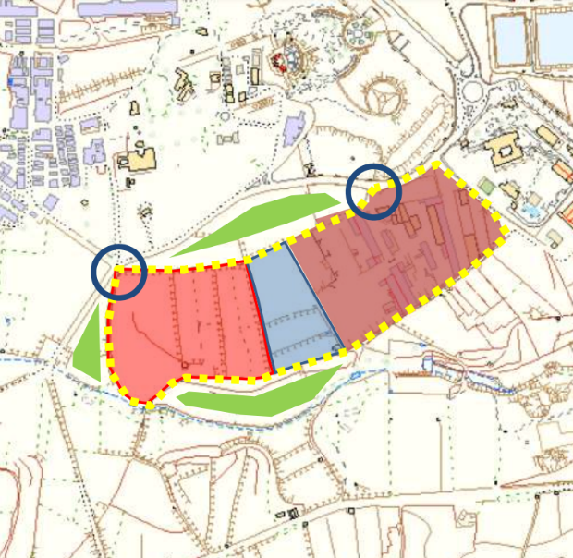
Perit Joseph C. Grech obo owners of adjacent site
It is a missed opportunity to focus on minor changes to the designation of the policy site (1) rather than rationalising planning parameters on a much larger extent of potentially developable land (2)
This will extend the provision of large retail/warehouse units onto a much larger and manageable commercial enclave
The extension will justify the development of a new access route (yellow dotted line), junction upgrading (blue circles) and a landscape buffer (green shading)
1
2
TAQ003 and TAQ005

Slide 12
Perit George Tonna obo Nectar Ltd.
The objectives are agreeable in principle
Disagree with a blanket prohibition of the extension to all the current uses, since these are compatible with the new designation of the area
Appropriate use Classes include
  Class 2A (b,c and d) – Hospital or nursing home, medical clinic, clinic for medical professionals, Class 2C - Education;
  Class 3A (d) - Hostel, Class 3C – Assembly and Leisure;
  Class 5A – Light industry;
  Category F – Storage and boathouse uses; and
  Article 4 a, b, c, d, o, r, s and u – Amusement arcade, recreation centre or funfair; fuel station; public service garage; conference centre; sale of motor vehicles; supermarkets; and bingo halls, casinos, gaming shops, betting shops and lotto offices respectively.
  NB: Article 4c is not included in TAQ008
TAQ006 and TAQ008
Notes:
Which exactly is 4c – take Use Classes Order

Slide 13
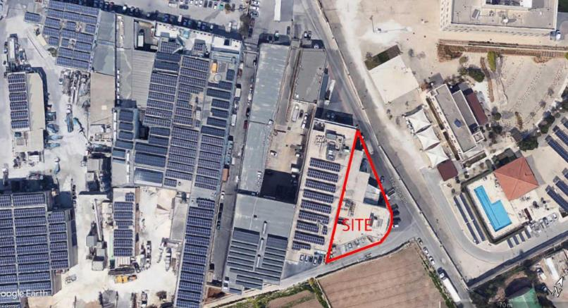
Perit Sebastian Grima (Raniolo & Associates Ltd.) obo Mafimex Ltd.
Agreement that the height limitation for the site is 17.5m since:
  The site in caption will be lower than the maximum height of the existing embassy
  The site in caption is at a considerable distance from the recreational areas
  Any development below 17.5m on this site will be the cause of blank party walls
TAQ007

Slide 14
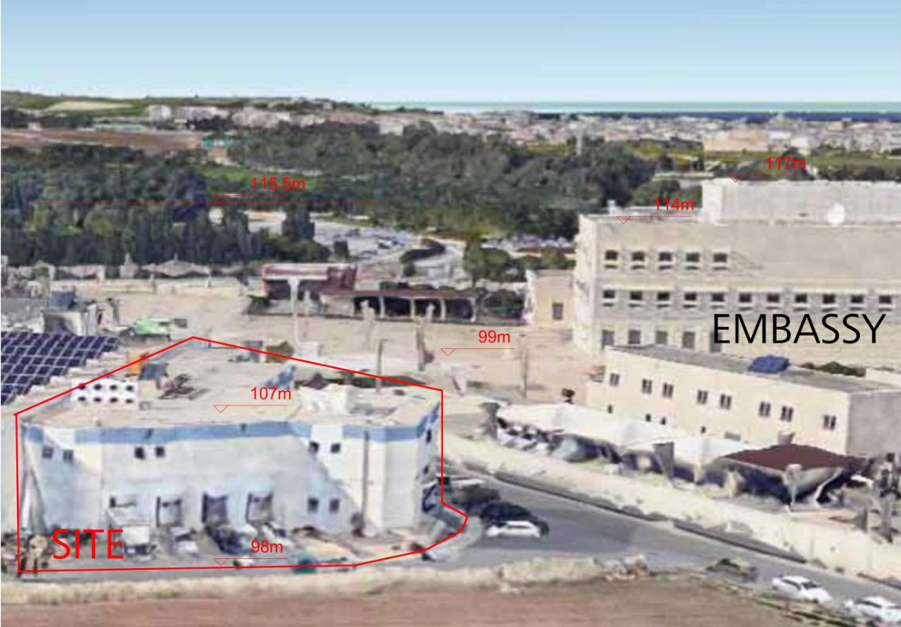
TAQ007
Notes:
Height of Embassy is 18m

Slide 15
Environment and Resources Authority
The increase in the building height will multiply the site’s capacity, possibly resulting in environmental impacts due to increased traffic and pressure on infrastructure
This area should remain to cater for uses that cannot be easily accommodated in other commercial areas, to limit pressure for industrial development in ODZ
All future development and related interventions should be confined within the existing boundary of the designated Industrial Area
Any required infrastructure should be factored into the advance planning of the site and located within the boundary of the designated area
The design of buildings and space should minimize potential visual impacts on long distance views, the rural character and other popular recreational areas at Ta’ Qali
Development projects should make provision for the allocation of sufficient space for
the implementation of adequate soft landscaping and green spaces within the site
TAQ009

Slide 16
Environment & Resources Authority
Development should not be a source of light pollution and should be subject to related conditions as specified
Roads and pavements should incorporate facilities whereby all services and ancillary
infrastructure are located underground without overhead infrastructure
Unmitigated urban runoff should not be discharged directly onto surrounding fields or watercourses
Development should not result in any intended or unintended discharge of surface
water
Cycling parking and cycling infrastructure should be provided within the designated area and should be factored into the advance planning of the site
Uncontaminated, inert material resulting from development should either be used or be transported in accordance with the relevant waste management regulations
TAQ009

Slide 17
Perit George Tonna obo Attard Bros. Co. Ltd.
The objectives are agreeable in principle
Disagree with a blanket prohibition of the extension to all the current uses, since these are compatible with the new designation of the area
Appropriate use Classes include
  Class 2A (b,c and d) – Hospital or nursing home, medical clinic, clinic for medical professionals, Class 2C - Education;
  Class 3A – Guest houses, palazzini, boutique tourism accommodation, hostel, Class 3C – Assembly and Leisure;
  Article 4 o, s and u - conference centre; supermarkets; and bingo halls, casinos, gaming shops, betting shops and lotto offices respectively
TAQ010 (similar to TAQ006 and TAQ008)

Slide 18
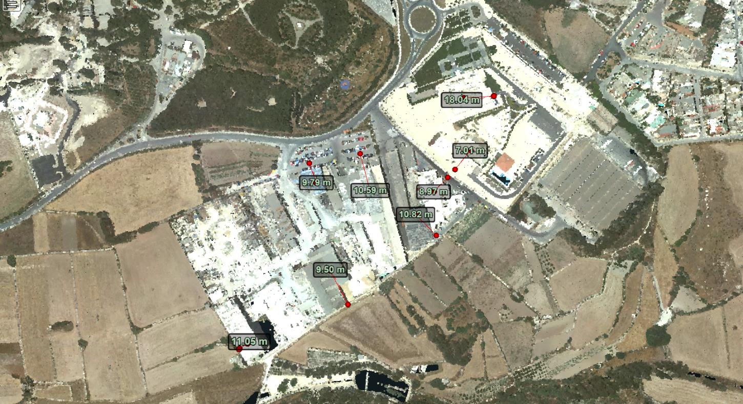
Existing building heights

Slide 19
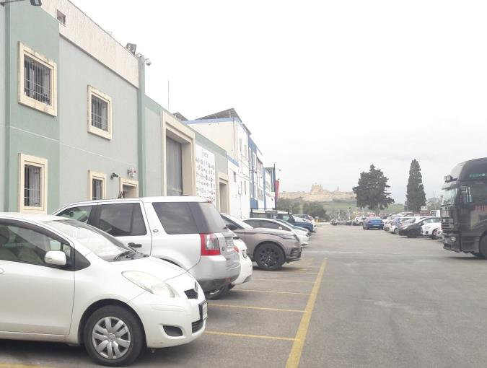
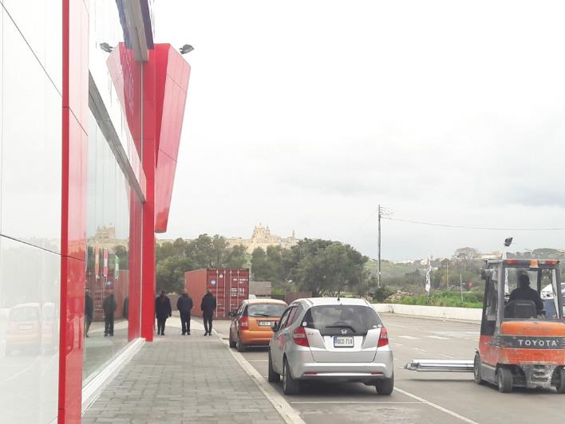
View of Mdina from two locations within site

Slide 20
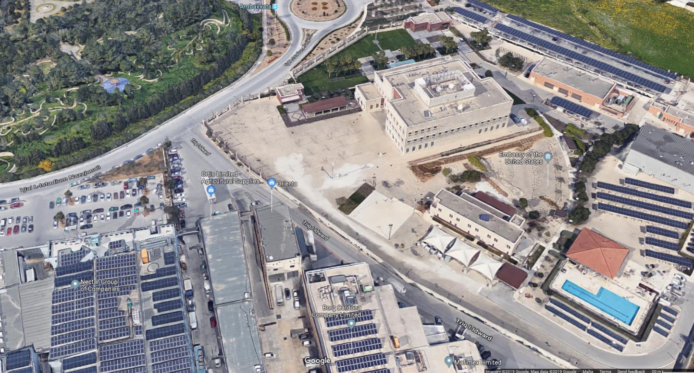
Aerial view of the Embassy of the United States

Slide 21
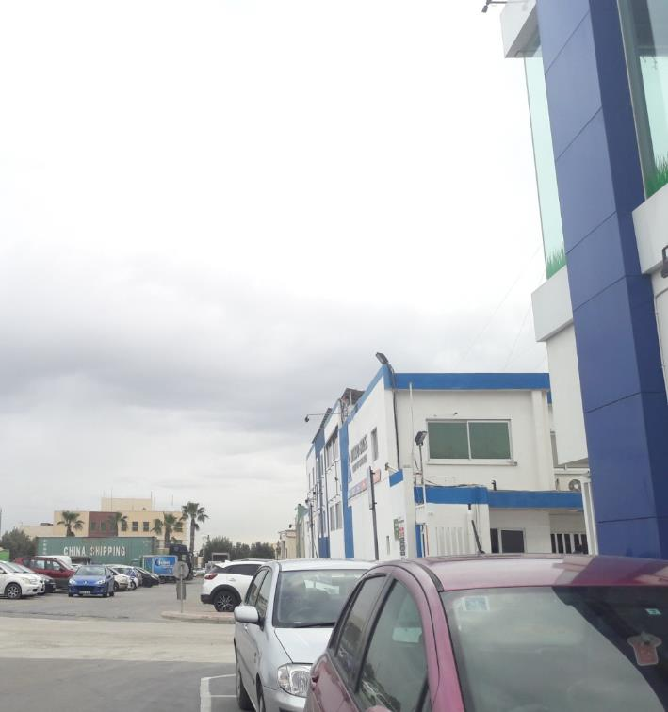
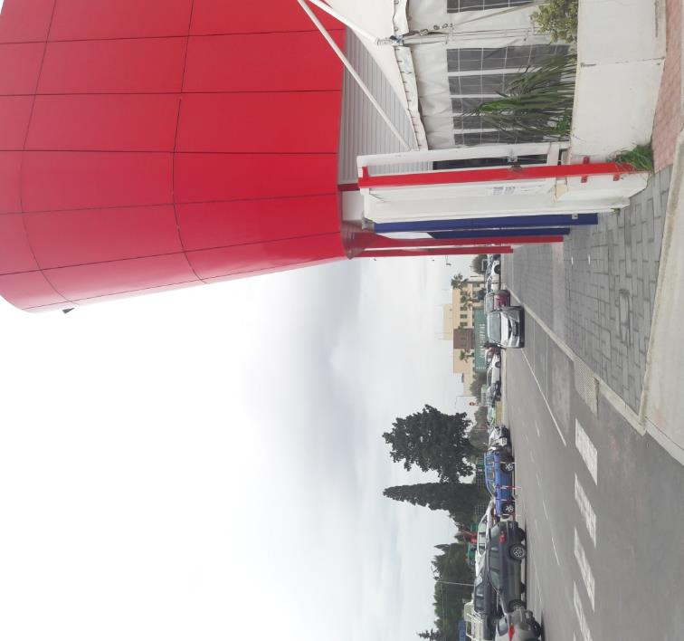
View of Embassy from two locations within site

Slide 22
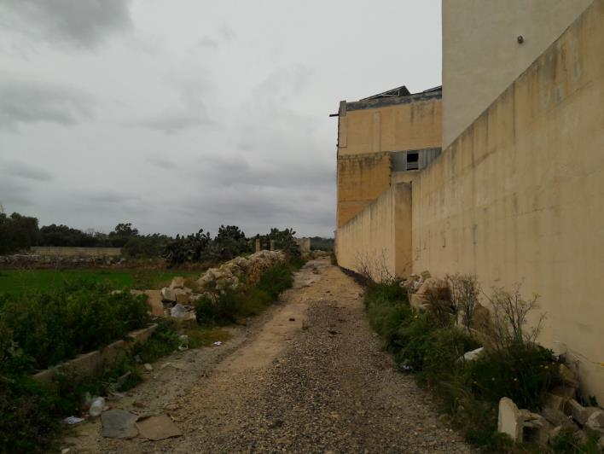
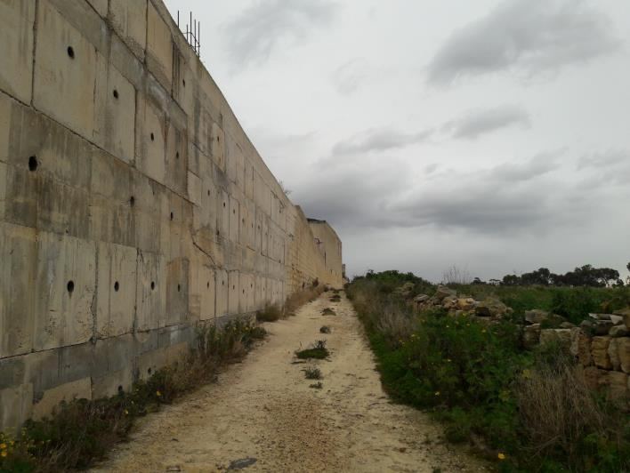
Path along southern boundary of the site

Slide 23
EXISTING policy

Slide 24
Existing Policy Context
NWTQ 32
Within Policy Area NWTQ 32 of the Action Plan, permission will only be given for development proposals falling within Class 11 Business and Light Industry, Class 12, General Industrial, and Class 17 Storage and Distribution, as defined by the Development Planning (Use Classes) Order 1994
  Priority will be given to non-confirming uses currently within the National Recreation Centre identified for relocation
  Adequate access & off-street parking is provided
  The proposal would not result in a significant build up of traffic
  Noise and visual intrusion is minimised
  The development does not exceed a height of 8m
  A landscape scheme and a programme for implementation and maintenance are submitted and approved

Slide 25
Existing Policy Context
NWTQ 33
No new development will be permitted within Policy Area NWTQ 33. The zone will be safeguarded to provide organised car parking and turning facilities for vehicles associated with adjacent uses. The area should be enhanced through the removal of stored materials and a landscaping scheme to improve its general appearance.

Slide 26
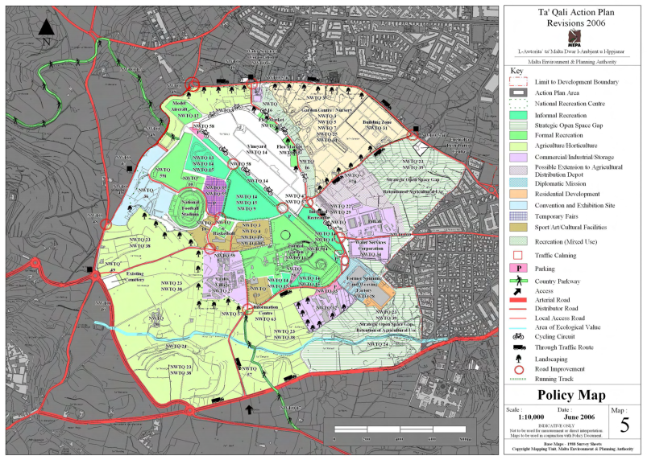

Slide 27
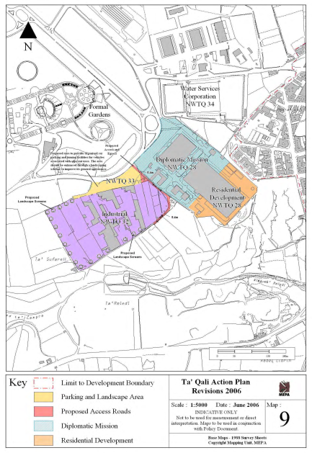
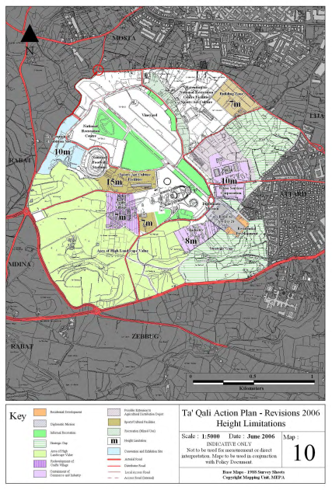

Slide 28
NUMBER OF PERMITS GRANTED OVER TIME
(BY PREDOMINANT USE)
Decision Year | Office | Retail | Industrial | Warehousing
2008 |  |  |  | 2
2009 |  |  | 1 | 1
2010 |  |  |  | 2
2013 |  |  |  | 2
2015 |  | 1
2017 | 1
NB: Permits constituting renewals of previous permits have not been included

Slide 29
PERMITTED FLOORSPACE BY USE-TYPE
Decision Year | Office | Retail | Food & Drink | Industrial | Warehouse
2008 | 0 | 88 | 0 | 0 | 1255
2009 | 119 | 0 | 0 | 4614 | 1518
2010 | 184 | 64 | 0 | 64 | 1160
2013 | 418 | 825 | 0 | 75 | 3875
2015 | 208 | 1161 | 0 | 0 | 31
2017 | 849 | 0 | 0 | 0 | 149
Total | 1778 | 2138 | 0 | 4753 | 7988
NB: Permits constituting renewals of previous permits have not been included

Slide 30
Proposed policy

Slide 31
NWTQ 32 Ta’ Qali Commercial Area
Acceptable Land Uses
The following land-uses falling within the Use Classes Order (SL552.15) will be considered favourably:
Article 4 (s)supermarkets;
Category B: Class 2A (c) medical clinic, Class 2C education;
Category D: Class 4A offices, Class 4B retail, Class 4C and Class 4D food and drink; and
Category F: Class 6A storage and distribution
The intensification of existing uses which do not fall within the list identified by this policy will not be permitted.

Slide 32
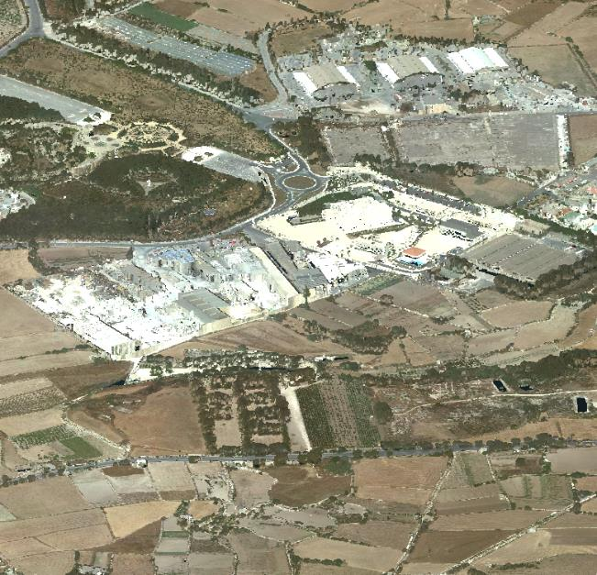
NWTQ 32 Ta’ Qali Commercial Area
Urban Design
Building Heights
Development on the perimeter of the Policy Area facing the ODZ shall have a facade height of 8m.
Development on the perimeter of the Policy Area facing the embassy and the carpark shall have a facade height of 11m.
The overall height for all the Policy Area shall be 17.5m and shall be subject to a Visual Impact Assessment

Slide 33
NWTQ 32 Ta’ Qali Commercial Area
Site layout and architectural treatment
Site fragmentation which inhibits a balance in terms of built up to open space ratio will not be supported
Blank party walls arising from new development shall not be permitted
Details of any buildings are not to create visual elements which are not in keeping with the Area of High Landscape Value surrounding the site; and are to feature in the Visual Impact Assessment for the development.
Landscaping
A landscape buffer, consisting of green belt and a perimeter road, with a minimum width of 13m is to be incorporated along the southern and western perimeter of the Policy Area.
A hard and soft landscaping scheme is to be submitted and must include a programme for implementation and maintenance of the scheme.

Slide 34
NWTQ 32 Ta’ Qali Commercial Area
Transport
Redevelopment is to provide for the continuation of the incomplete road within the southern boundary of Policy Area perimeter (Triq l-Idwart) towards the western boundary of the Policy Area perimeter, incorporated within the landscape buffer.
Any road widening to accommodate the road should be strictly within the policy area boundary.
Adequate access and off-street parking shall be provided in accordance with the applicable parking standards.
Sustainability
The introduction of Green Infrastructure measures is strongly encouraged.
Matters such as the use of sustainable building materials, design which allows for passive environmental control and the integration of carbon-reduction measures during daily use of the buildings are to be favourably considered.

Slide 35
NWTQ 32 Ta’ Qali Commercial Area
Planning Gain
A planning gain contribution of Euro 25 per sqm of new gross developable floorspace (GDF) permitted within the Policy Area is to be made towards the provision or upgrading of recreational facilities and other environmental initiatives within the Ta’ Qali National Park.

Slide 36
NWTQ 33 Parking
The area covered by this policy is to be reserved for organised car parking and access for vehicles associated with the adjacent commercial uses, improved by means of a soft landscaping scheme to mitigate the appearance and amenity on the site. No new development will be permitted in the area identified for this parking in Policy Map A.

Slide 37
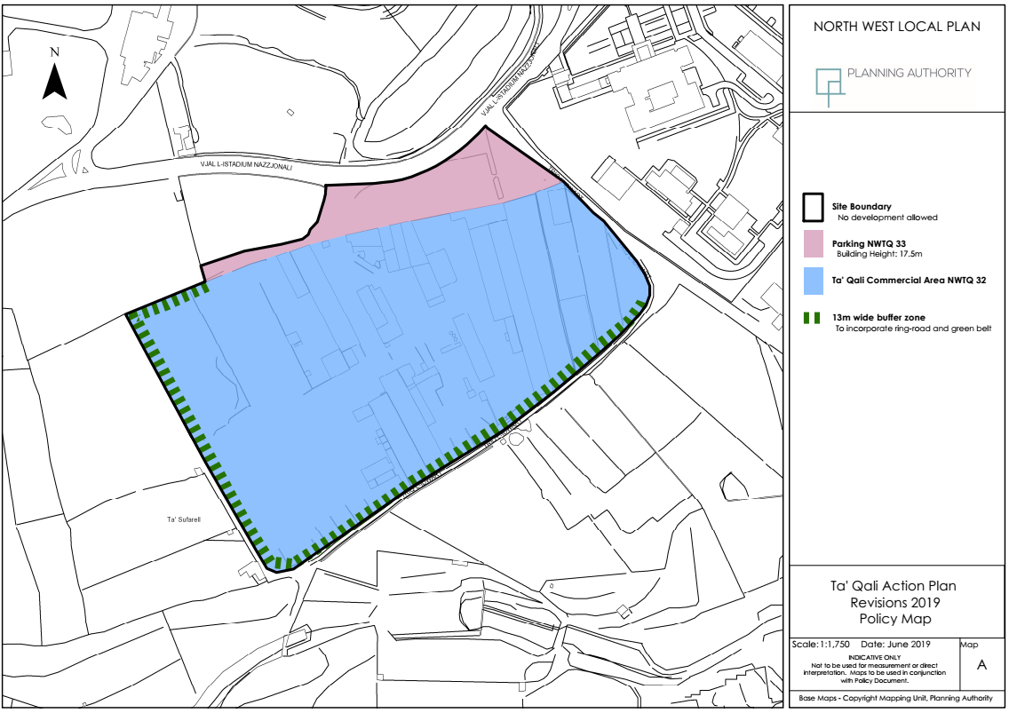

Slide 38
Way Forward
Submissions on the proposed review are to be received by Friday 25th October 2019
nwlp.taqali@pa.org.mt

Slide 39
- END OF PRESENTATION -

