Slide 1
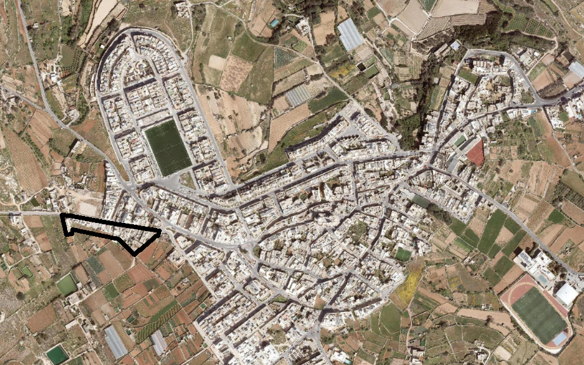
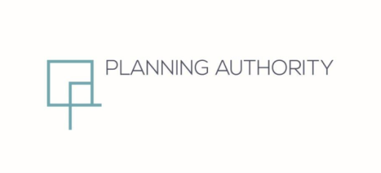
Dingli – Ta` Kalc
Presentation to the Parliamentary Committee
August 2019

Slide 2
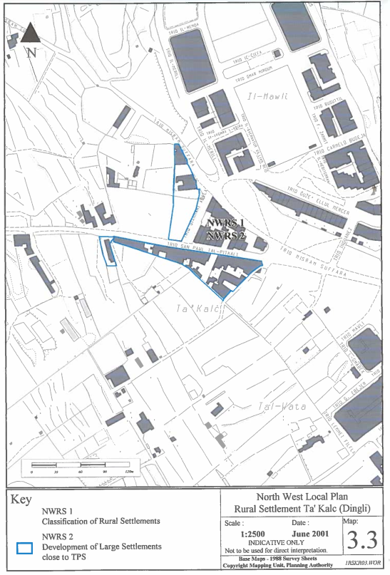
Background
Public Consultation Draft
North West Local Plan 2001
Proposed the designation of the site as a NWRS 2 - Development of Large Settlements close to TPS
Building typology and land uses within them does not distinguish them from the urban settlement within the boundary
Inclusion of these areas within the settlement boundary at the next Structure Plan review will not substantially increase the amount of released for development since the large part of them are already built up.

Slide 3
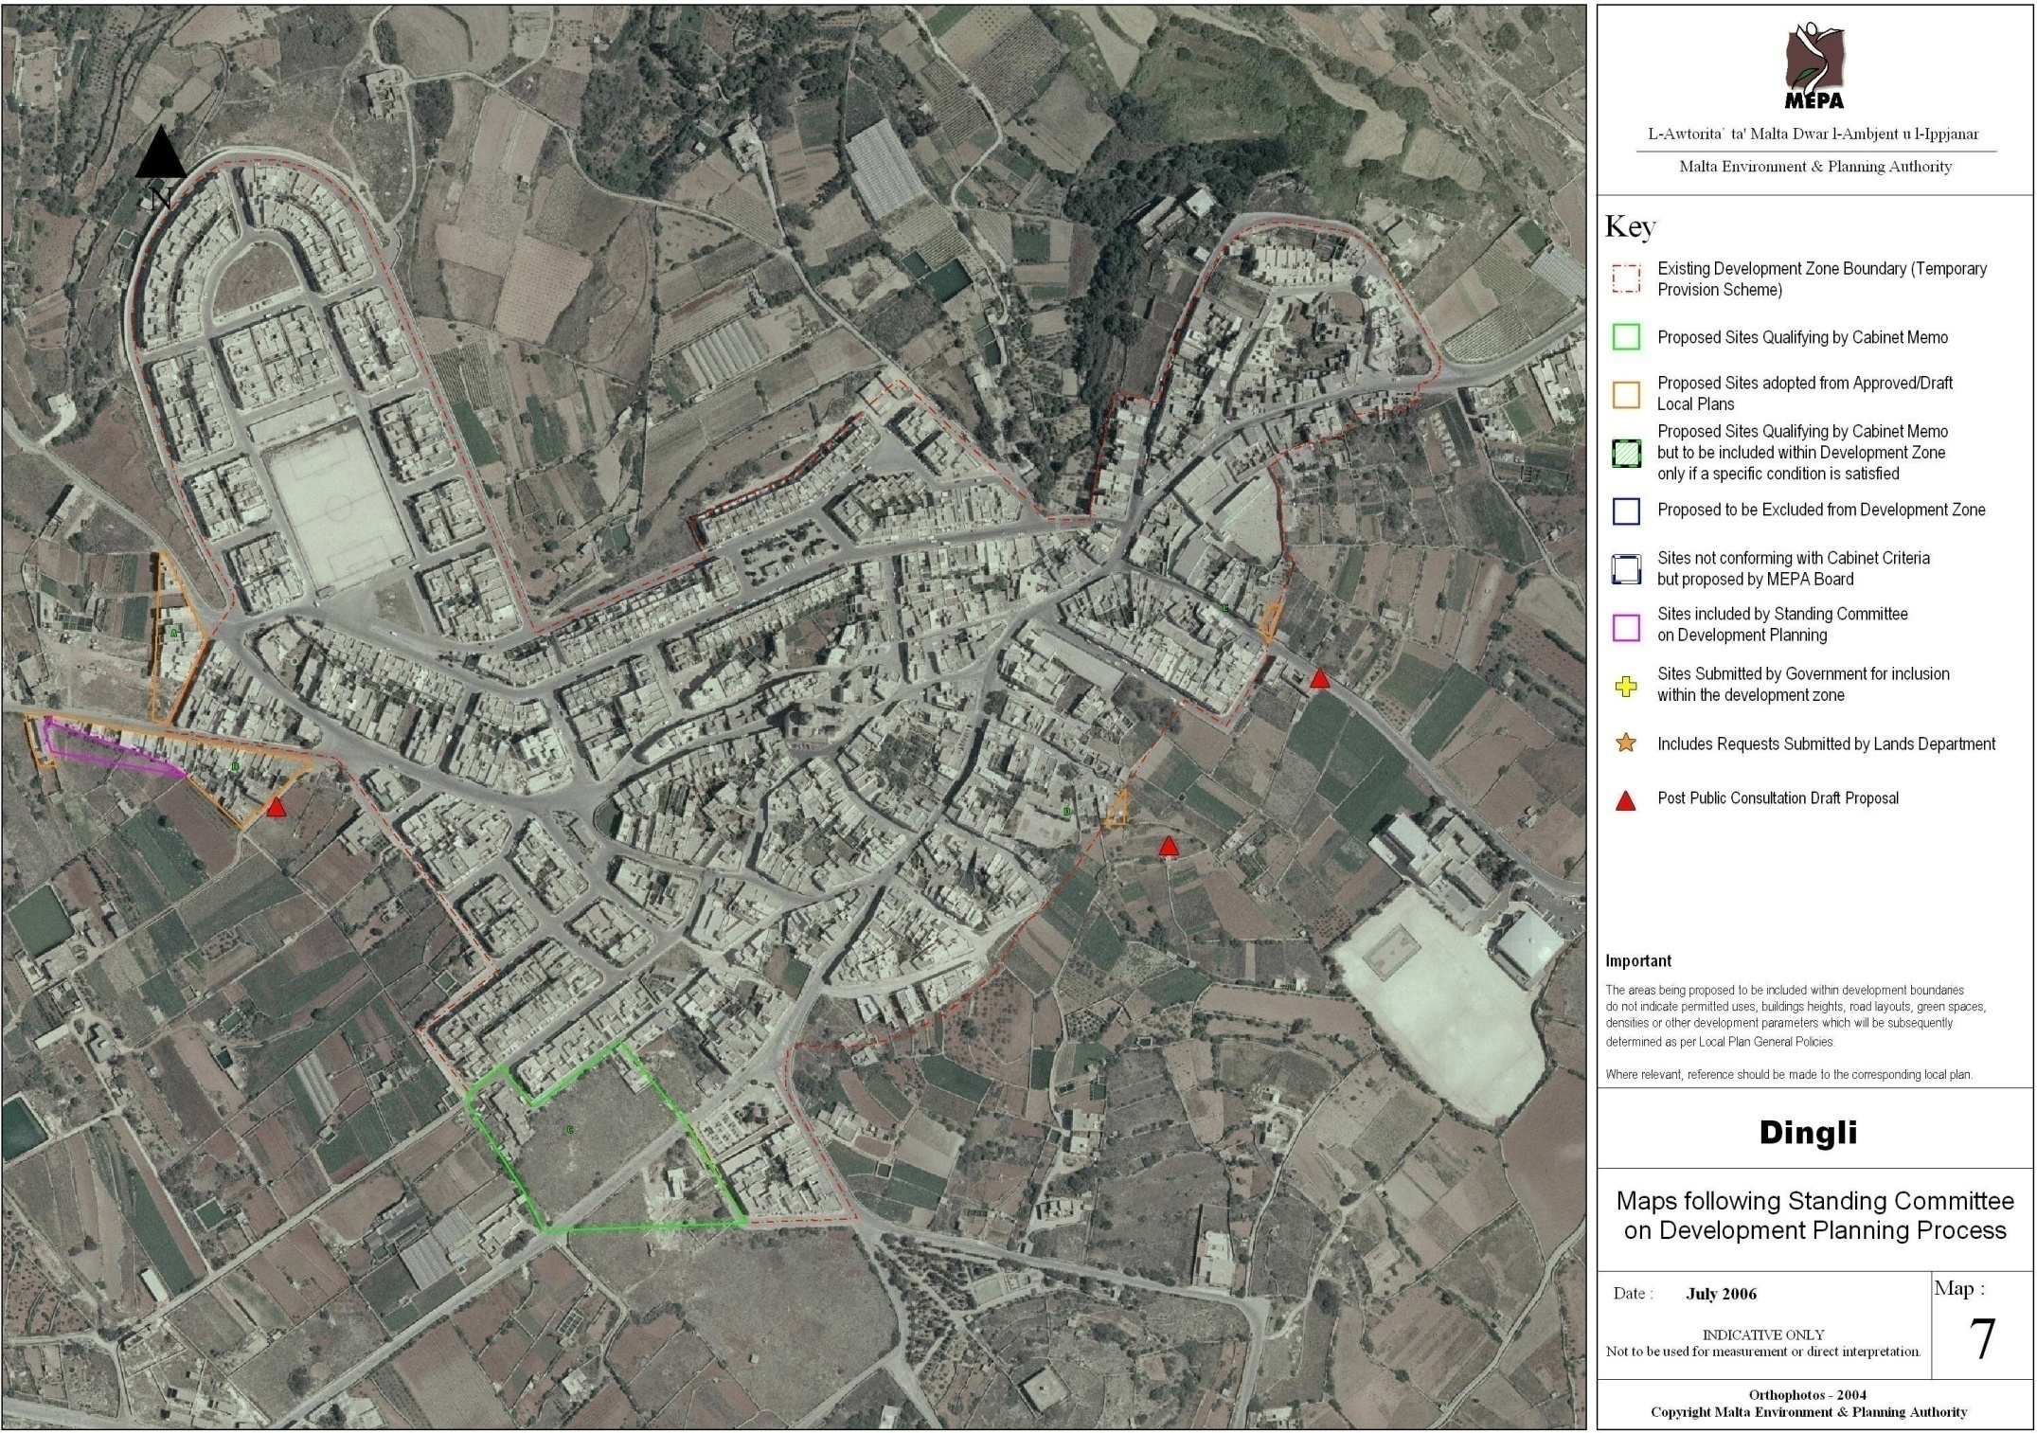
Background
Included in Rationalisation Exercise of 2006
Site adopted from a Draft Local Plan
Extension included by Standing Committee on Development Planning

Slide 4
Background
In the late 2007, MEPA started the planning process of 36 sites, including this site (PC 85/07), that were included in the rationalisation exercise - to establishing the zoning and building height.
PC report was discussed informally at the MEPA board of the 7th May 2009.
MEPA Board approved the PC application on the 26th June 2009. It proposed Maximum height limitation is 3 Floors + 3 courses basement.
Application was referred for Minister’s endorsement on the 22nd July 2009.
On the 3rd August 2009, Minister referred back PC 85/07 for reprocessing.
On the 21st January 2010, MEPA Board approved the PC with maximum height limitation is 2 Floors + 3 courses basement.
Application was endorsed by the Minister on the 8th March 2010.

Slide 5
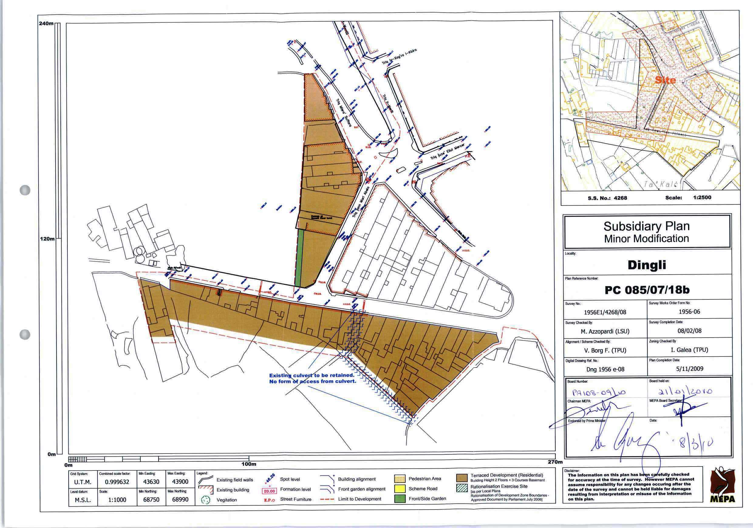

Slide 6
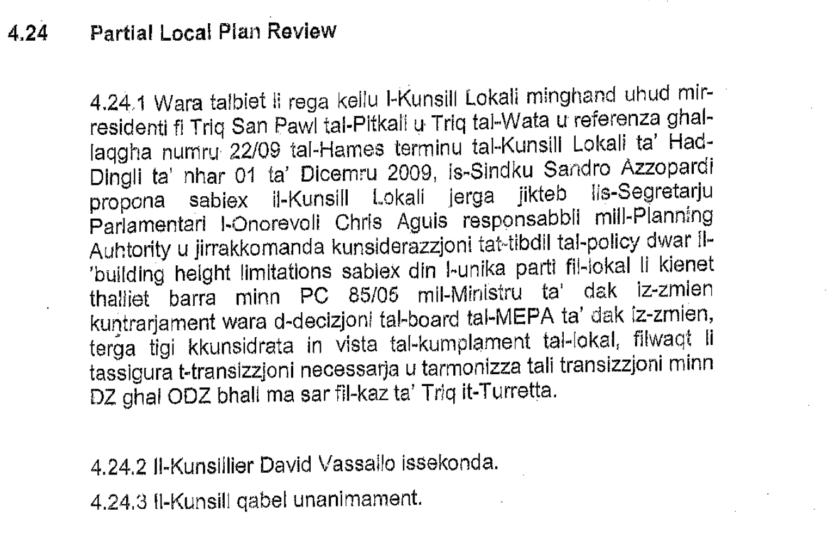
On the 7th September 2018, extract for Dingli LC minutes referred with an instruction to start a local plan review for the site.

Slide 7
Public Consultation on Objectives
The objectives were issued for public consultation between the 7th December 2018 and 9th January 2019.
The published objective was:
To increase the building height for the area whilst at the same time providing a transition with the ODZ.
Two submissions were received from:
Flimkien Ghal Ambjent Ahjar
Environment and Resources Authority (ERA)

Slide 8
Public Submissions
Adequate transition already exists.
At conservative increase of 15.4m (3 floors without basement), the present transition would be lost.
This exercise is a financial reward to private parties and not the general public.
This exercise will allow for further speculation of land.
Cosmetic consultation process is as it was held over the festive period.
Any increase will lead to the creation of 5 storey blank walls
The proposed changes are in breach of several provisions of SPED.

Slide 9
Public Submissions
Part of the site does not constitute enough depth length necessary for adequate transitional change in height. The current height limitations should be retained for these parts.
An increase in building heights should consider the context in order to minimize potential visual impacts on long distance views.
Increase in intensification which may have impacts on the current infrastructure.

Slide 10
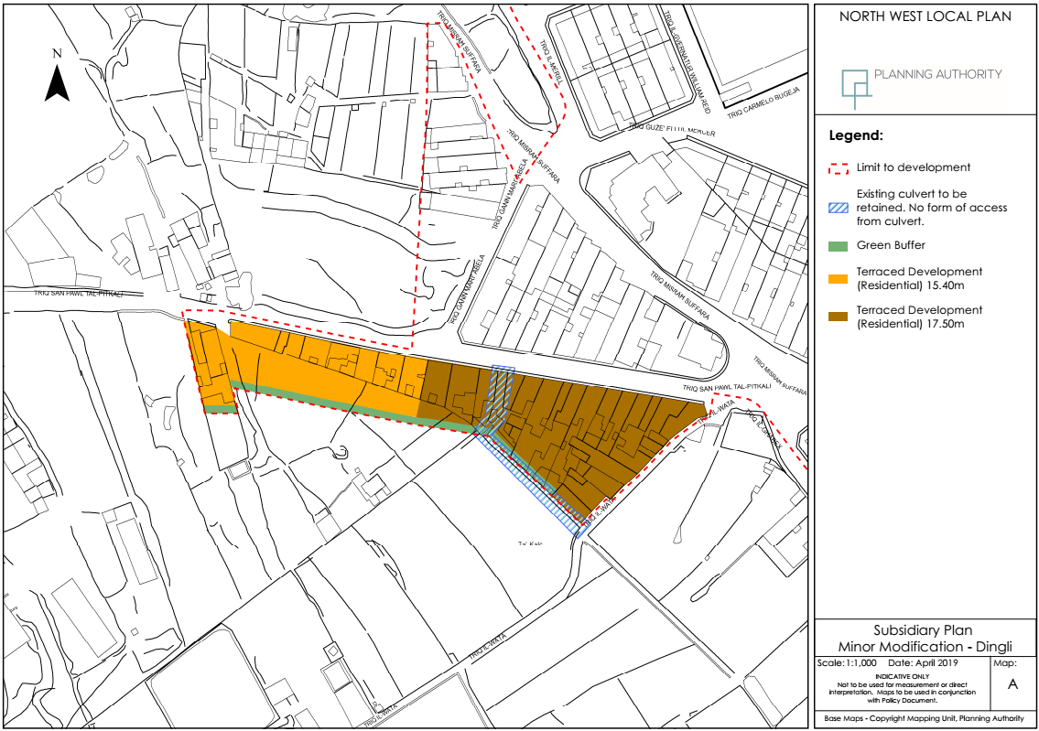
Minor Modification Map

Slide 11
Conditions
Site is zoned for terraced residential development subject to conditions NWUS 3 in the NWLP.
The maximum allowable height of buildings of 17.50m and 15.40m as shown on Map A and shall be interpreted in terms of the applicable policies, guidelines and standards in the Development Control Design Policy, Guidance and Standards, 2015 (DC15). In addition, for heights of the building facades facing the ODZ a height of 12.30m with a setback of not less than 3 m from the alignment is applicable.
Elevations fronting the ODZ should be treated.
A 3m green buffer from the elevation fronting the ODZ is required. Additionally, boundary or dividing wall within the green buffer zone shall not exceed a height of 1.2m and shall be constructed in random rubble wall.
Building with frontage on Triq San Pawl and Triq tal-Watta do not have access from an open culvert at the back of the property.
Site shall not be subject to the provisions in document; A Planning Policy Guide on the Use of the Applicability of the Floor Area Ratio(FAR).
Detailed development proposals shall be subject to third party rights, including those related to access through or to the site.

Slide 12
2nd Stage Public Consultation
Representations: nwlp.takalc@pa.org.mt
16th September 2019

