Slide 1

The Prevalence of Loneliness in the Maltese Population aged 11+
A nationally representative study
June 2019

Slide 2
Research Agenda
Prevalence of loneliness amongst the Maltese population;
Relationships between loneliness, socio-demographic and structural variables
Contribute to empirical research

Slide 3
Methodology
Stratified random sample (gender, age, and district)
11 +
De Jong Gierveld Loneliness Scale (De Jong Gierveld & Kamphuls, 1985)
Socio-demographic questions.
CATI
Final sample: 1,009

Slide 4
Main Findings
43.4% of participants experience some degree of loneliness
41.3% moderately lonely
1.7% severely lonely
0.5% very severely lonely

Slide 5
Significant associations
A number of factors are significantly associated with loneliness amongst the Maltese population.
These are:
  Age,
  level of education,
  employment status (16+),
  marriage status (18+),
  living with parents/guardians, living alone (18+),
  person's mortgage is paid or not,
  perception of how adequate one's income is,
  self-reported general health,
  subjective wellbeing
  disability.

Slide 6
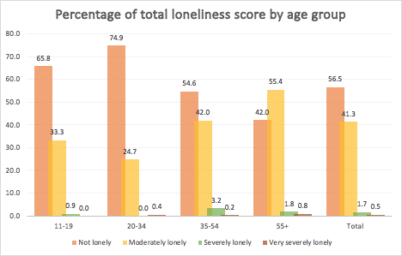
Age
not lonely: 20-34 years - 74.9% classified as not lonely
moderately lonely: 55 years or above - highest proportion (55%)
severely lonely: 35-54 years

Slide 7
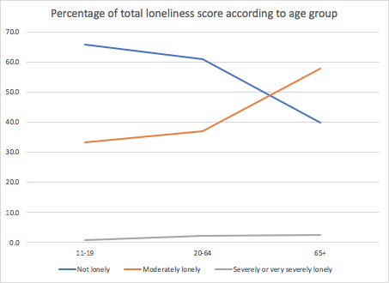
Age – inversely proportional
Not lonely decreases with age
Moderate loneliness lowest in adolescence, increases with age
Rise significantly by 20% once individuals are over the age of 65 years.
Severe or very severe loneliness increase over time, but this does not exceed 2.5% of the population.

Slide 8
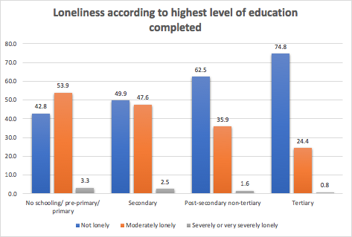
Level of education
Education protects against loneliness.
The higher one’s education level, the less affected they are by loneliness.
People with a tertiary level of education have the lowest rates of both moderate and severe loneliness.

Slide 9
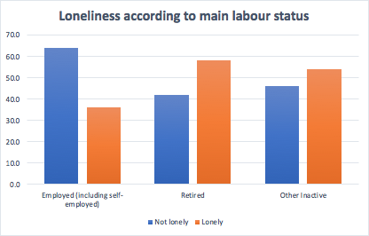
Employment status
Retired: highest rates of loneliness
Individuals not in employment (students, unemployed persons, unable to work due to an illness or disability, or taking care of the house/family) higher rates of loneliness than those in employment

Slide 10
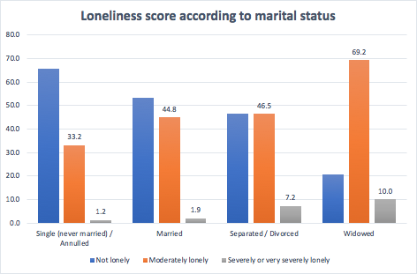
Marital status (18+)
Single people: highest not lonely/ lowest moderately lonely
Widowed persons: highest rates of both moderate and severe loneliness than all other marital statuses.
Separated or divorced: severe loneliness also high

Slide 11
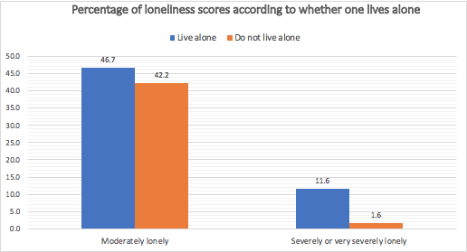
Living alone (18+)

Slide 12
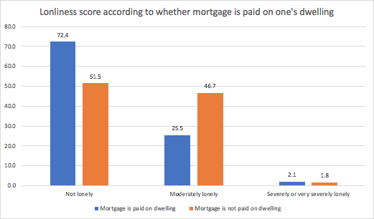
Mortgage & Income
Results show almost double the rate of moderate loneliness for individuals whose mortgage is not paid on their dwelling.

Slide 13
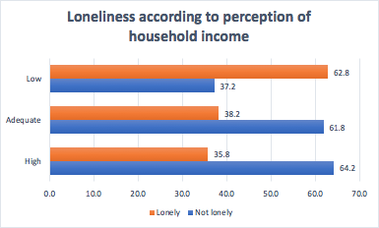
Mortgage & Income
Perception of one’s household income as being high, adequate, or low
Little difference in loneliness amongst those who perceive their household income to be adequate and high
those who perceive their income to be low are the loneliest.

Slide 14
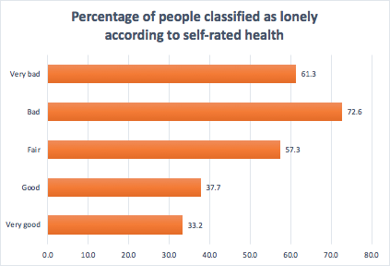
General Health

Slide 15
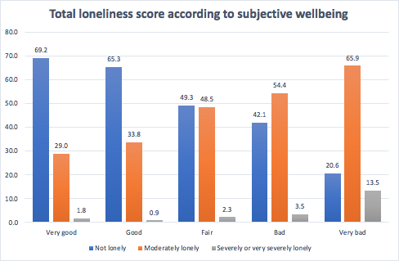
Subjective wellbeing & coping

Slide 16
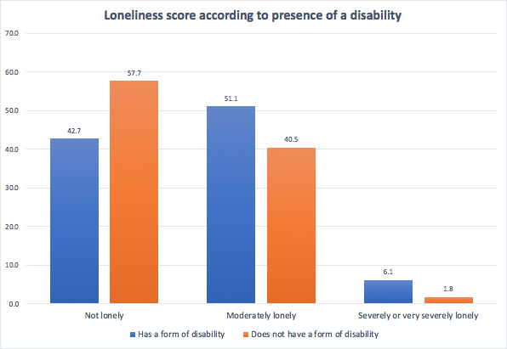
Disability
51.1% of those with a disability are moderately lonely, compared to 40.5% of those who do not have a disability.
Rates of severe or very severe loneliness are over three times higher for those with a disability (6.1%) than those without a disability (1.8%).

Slide 17
Conclusion
Surveys shed light on changing patterns of loneliness
Efforts must continue to monitor the situation
Inform social policy in Malta

