Slide 1
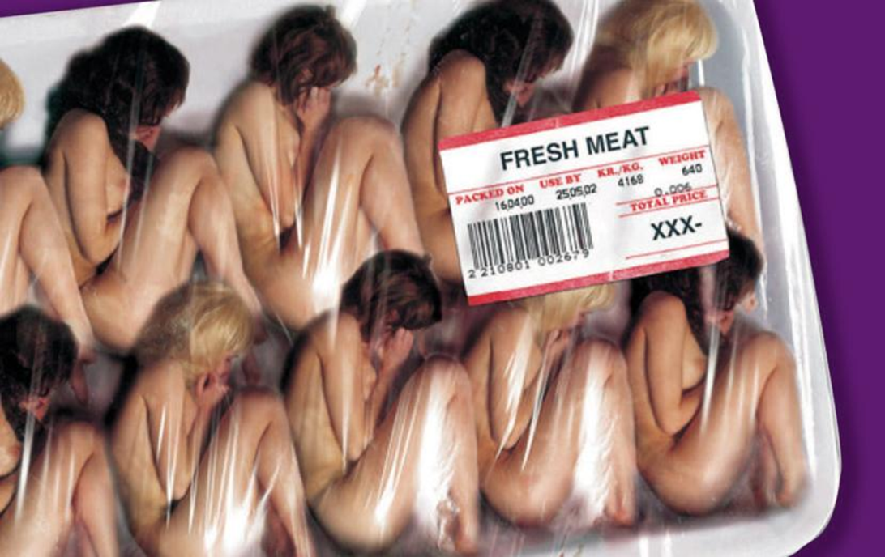
Exploring the Issue of Prostitution through the Gender Lens
Dr Anna Borg
A4E – Association for Equality
June 2019

Slide 2
Introduction
1. Different ways of looking at prostitution
2. Some key facts
3. Can sex work be considered as a normal job?
4. Should we open up prostitution- what are we proposing?

Slide 3
Different ways of looking at prostitution
At present prostitution is not illegal in Malta.
Pimping and soliciting are illegal
The Pro-prostitution lobby argues that prostitution can be valid choice for women (and trans men and gay men) who choose to engage in it, as long as it is a free choice.
They argue that sex workers should be protected from abuses imposed by the sex industry/pimps and by the legal system.
If banned they fear that it may go underground
Regulatory - Harm Reduction approach
The Anti-prostitution lobby view prostitution as a form of violence on women by definition because it involves unwanted sex.
Violence is not acceptable and so it cannot be regulated.
They argue that prostitution is the result of the existing patriarchal social order, that views women (and trans and men) involved as sex objects that can be used and abused by men.
Nordic Model Approach

Slide 4

Before deciding we need to gather some facts!
Who are the people involved in prostitution?
How do they find themselves in these circles?
Are these people really making a free choice?
Are these empowered happy hookers earning good money ?
Or, are they victims of circumstances on which they have little control?

Slide 5

Some key facts – Exploiting Vulnerability
For the vast majority of women in prostitution , the age of entry is below 18 and some girls are groomed from a young age, and as early as 12 – 13 (EU, 2014).
The most vulnerable children coming from the dysfunctional families or youngsters having mental health issues are specifically targeted by pimps to prepare them for prostitution .
Girls are groomed into prostitution by their boyfriends, family members, pseudo work agents.
          (EU, 2016).

Slide 6
Some key facts – Exploiting Vulnerability
The EU claims that between 43% and 69% have been sexually abused and many were homeless at some point in their lives (EU, 2014; Farley et al, 2003).
In the Netherlands it is estimated that 60-70% of the women in prostitution are forced by criminal groups (EU, 2014).
Unaccompanied children are increasingly being trafficked for sexual exploitation and forced criminality (EU, 2016).

Slide 7
Some key facts – Exploiting Vulnerability
As more men are watching pornography, sex with prostituted persons is become more rough and more extreme leading to painful and often damaging moves.
People used in the sex industry often need medical care as a result of the ever-present violence and infectious diseases.
Survivors frequently need mental health care for post-traumatic stress disorder, psychotic episodes and suicide attempts.

Slide 8
Some key facts – Exploiting Vulnerability
Prostitution and the drug trade go hand in hand and many prostituted persons have addiction problems.
In a study over 9 countries , 71% of prostitutes have encountered violence and the mortality rate of prostitutes can be up to 40 times higher than the average population (Lynne, J., Zumbeck, S., Spiwak, F., Reyes, M.E., Alvarez , D., Sezgin, U. 2003)
One study suggested that up to 89% of prostituted persons indicated they wanted to leave but they did not see a way out or another option to survive (Farley et al, 2003).

Slide 9
Some key facts – Exploiting Vulnerability
Results from German Survey (2007) – where everything is legal and regulated!
43% had been sexually abused as children
87% Physical Violence
41% had taken drugs in the last year
25% had contemplated suicide
In Germany which is considered to be the Bordello of Europe, today there are over 400,000 prostitutes, mostly foreigners, serving over 1 million men a day.
EU (2014), p.44.

Slide 10
Some key facts – Exploiting Vulnerability - Malta
Samantha , 36 year old, mother of 6, who was pimped by her boyfriend when she became drug dependent at a young age. Her pimp was also her cousin and from whom she had two children. This is what she had to say:
“Kien jaħqarni ħafna. Kien iniżżilni fit-tmienja ta’ filgħodu u fil-ħamsa joħodni d-dar kemm nieħu toast u ninħasel, u jerga jniżżilni, anke bil-lejl kien iħallini hemm. Kont inġib ħafna flus.....Kien iġelni nħalli l-mobile miftuħ biex jisma’ x’inkun qed nagħmel u x’inkun qed ngħid meta nkun mal-klijenti. U jekk indum aktar milli jridni hu kien jiġi hemm u malli jwaqqfuni bil-karozza kien jaqbad isawwatni.
Minn tiegħu għandi żewġ itfal u anke tqila kien iniżżilni, sa' l-aħħar kien iħallini għax meta nkun tqila l-klijenti kienu jħallsu iktar. U hu kien moħħu fil-flus. Meta kont tqila bit-tifla, kien baqa’ jniżżilni sal-aħħar u kont nibkilu biex itini ċans nistrieħ imma qatt ma ried. Meta nfaqali l-ilma kont ma klijent u ċempiltlu biex jiġi joħodni l-isptar imma ma ħadnix. Ħallieni hemm u riedni nibqa’. Kien qagħad għassa tieghi mill-karozza. Imbagħad ħrabtlu u wassalni klijent l-isptar. U hu ġie hemm isibni. Wara li wellidt ried jerġa’ joħodni ħa jniżżilni l-Gżira imma l-isptar ma batunix. Imbagħad ħariġni mill-isptar l-għada u reġa beda jniżżilni”
(Maria Claire Cauchi,2015)

Slide 11
Some key facts – An intergenerational pattern with no exit route
Women used in prostitution usually have children sooner or later.
In a world of sex, violence and sometimes addiction, the children are often neglected, traumatized, and tend to become merchandise in the sex industry themselves.
So unless the pattern is stopped, this may become an intergenerational pattern with no exit route.

Slide 12
Some key facts – Normalisation of prostitution
In countries like the Netherlands and Germany where all aspects of prostitution are legal, prostitution has become normalised – it has been turned into a tourist attraction (sex tourism).
University guides for student in the Netherlands advertise work in sex lines for poorer students to pay for tuition fees and sex workers visit schools to talk about their profession (EU,2014)
Job offerings in prostitution are placed next to other job openings and women can have their unemployment pay rejected because they refuse a job for which they qualify – prostitution

Slide 13

The pro-prostitution lobby want to turn ‘sex work’ into a normal job
The pro-prostitution lobby use the word ‘sex work’. This is their preferred term.
They argue that people who go into prostitution make a choice and this is like going into any other job – An exchange of service/work for a sum of money.
Can sex work really be considered as a normal job?

Slide 14
Is this a normal job?
There is a “menu” circulating on the Internet , where buyers can choose what they want from a long à la carte list in German Brothels. I will just cite a couple of them:
AFF = Analer Faustfick (die ganze Hand im Hintereingang) – Anal Fist Fucking
AO = alles ohne Gummi – Everything without rubber
Braun-weiß = Spiele mit Scheiße und Sperma – Play with shit and sperm
DP = Doppelpack (Sex mit 2 Frauen) oder (2 Männer in einer Frau) – Sex with 2 women or double penetration (2 men in one woman)
FFT = Faustfick total – Fist Fuck totally
FT = Französisch total doppeldeutig: Blasen ohne Gummi mit Spermaschlucken und seltener: Blasen ohne Gummi bis zum Finale, aber ohne Schlucken – Blow job without condom and with swallowing the sperm.
Kvp = Kaviar Passiv (Frau lässt sich anscheißen) – Man shits on woman
SW = Sandwich, eine Frau zwischen zwei Männern – One woman between 2 men
tbl, = tabulos, ALLES ist erlaubt – Without taboo, everything permitted.
ZA = Zungenanal (am / im Hintereingang lecken) – Licking the anus
In German brothels you can have day-long sexual services for a lump sum of €100 (EU, 2014)
Decent and regularised sex work is a joke!

Slide 15
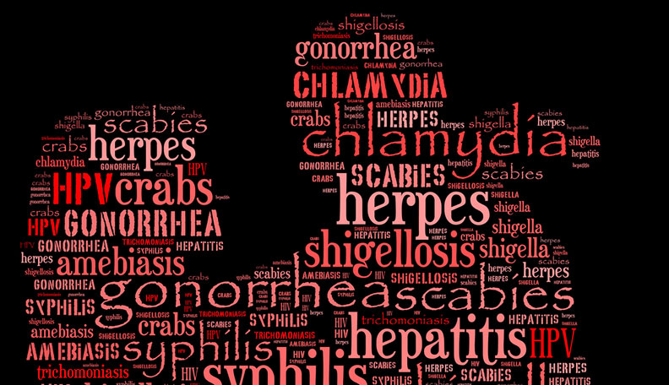
Do you get any of these from a ‘normal job’?
HIV + AIDS
Syphilis
Chlamydia
Hepatitis B + C
Gonorrhoea
HPV leading to cancer
Herpes
Pubic Lice
Genital Warts

Slide 16
What will happen if we legalise prostitution?
Legalising prostitution is a gift to pimps, traffickers and the sex industry.
Legalising prostitution means increased demand for prostitutes (Vulnerable people).
Legalising prostitution to protect the health of the prostituted person is a myth.
The physical and psychological damages inflicted are huge.
The men (johns) are not screened and prostituted persons cannot be forced to go for regular health checks.
Prostitution commodifies women’s bodies and implies that their body can be used and abused for the benefit of men - as long as this is paid.
The vast majority of women who are in prostitution do not want the sex industry to be legalised.

Slide 17
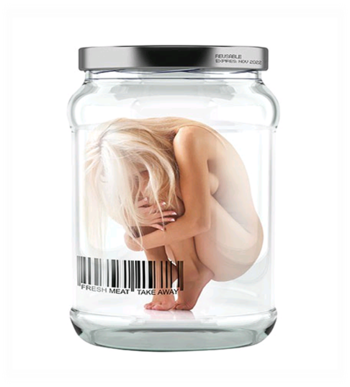
We need to decide and take a stand
What kind of society do we want? Do we want Malta to become a mecca of sex tourism?
Are we after increasing pimping and giving it a respectability veneer to hide its ugly side by legalising it?
Will we be happy if we legalise pimping and soliciting as long as this means more business , more tourists and more taxes? Is this the kind of society of want?
Or do we want to stop trafficking, protect the vulnerable and increase gender equality in line with the most Avant-garde and gender equal countries?

Slide 18

Does Legalized Prostitution Increase Human Trafficking?
Cho, Seo-Young, Axel Dreher and Eric Neumayer. (2013) Does Legalized Prostitution Increase Human Trafficking?. World Development 41: 67-82
This paper investigates the impact of legalized prostitution on human trafficking inflows based on the empirical analysis for a cross-section of up to 150 countries.
On average, countries where prostitution is legal experience larger reported human trafficking inflows (Increase demand-increase supply).
Malta has taken a stand to stop human trafficking – and this unbiased scientific paper should guide us.

Slide 19
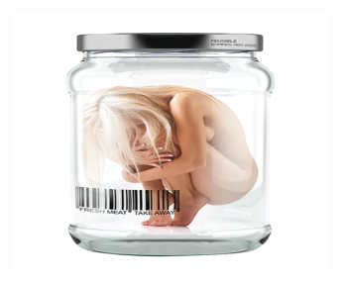
Conclusion
99% of victims in the commercial sex industry are women and girls (ILO, 2017).
Trafficking, like prostitution is demand driven - It is the money of the sex buyers that lines the pocket of traffickers and pimps.
Without demand for sex by the sex buyers, traffickers would not need to groom or deceive or coerce vulnerable persons, into prostitution.
So, if we want to curb the abuse of the vulnerable, and if we really want to control trafficking, we need to adopt the Nordic Model.

Slide 20
The Nordic/Feminist Model
Impact of the Nordic Model
What is the Nordic Model?
Selling of sex is decriminalised – to make sure that those who are prostituted cannot be arrested or blackmailed and do not end with a criminal record that hampers their exit.
The buying of sex is made illegal and is considered a form of violence against women
Exit programmes and job retraining – plus education, housing support, etc especially in the case of migrant women.
Prostitution is considered to be a form of violence against women and is not tolerated because this is harmful to girls and women, (transgendered women) and to boys and men, and to society in general
The customer who has more power must be prevented from violating women - Power inequality between prostitute and john
Sweden, Norway, Iceland, Ireland, France and Canada have adopted the harm elimination/Abolitionist Nordic Model
Model endorsed by the European Women’s Lobby and the European Parliament (EU, 2014) + local women’s organisations

Slide 21

Questions?

