Slide 1

CORINTHIA site regeneration st.George’s bay – st. Julian’s
Land transfer deed
11th December 2018

Slide 2
Tourism in malta
2018 PROJECTIONS
Over 2.6M tourist arrivals (+13%)
18M bed nights (+1.5m)
€2.1Bn tourism expenditure (+10.5%)

Slide 3
Tourism Numbers
*Figures based on NSO Official Data

Slide 4
CONNECTIVITY IN MALTA
Connectivity in Malta has increased from 91 routes to 110 routes during 2018
Malta has now more connections to Europe than Heathrow
Increased presence by both legacy carriers and low-cost carriers
Government’s vision is to attract higher-spending tourists
Target the U.S., South America and Asian markets (China, S. Korea, Japan and India).
Arrivals from the U.S. has increased by 30.9% in 2018 and offers significant protential.

Slide 5
TOURISM STRATEGY
Sustainable growth spread across the year
Repositioning towards a higher end offering over a seven-year period.
Quantum leap in tourism product and experience
Improved infrastructure through transport upgrades, the Paceville Embellishment Programme, Valletta and Three Cities regeneration, and regeneration of niche areas
Longer-haul connectivity
World class events (theatre, culture, music, kids, sports etc)
Private investment in hotels, retail and entertainment venues
Creation of family entertainment venues and attractions all year-round

Slide 6
International Hotel investments
IHI is one of Malta’s foremost international hotel and real-estate investor, developer and operator, which commenced business in Malta, in 1962, and has since continued to develop and operate luxury hotels and commercial real estate across three continents, in Europe, the Middle East and Africa
IHI was listed on the Maltese Stock Exchange in April 2000. The company is the successor to the original Corinthia company established in 1962 as a private company
IHI has since built a strong investor base of around 15,000 Maltese shareholders and bondholders, in addition to its founding family shareholder, the Pisani family, and two international sovereign funds which have been invested in the company since 1974 and 2008 respectively
IHI has an issued capital of €615 million and an asset valuation of €1.6 billion
Corinthia has a global marketing footprint through proprietary websites and social media capabilities, as well as a network of owned international offices and marketing partnerships in London, Beverly Hills, New York, various European capitals and Hong Kong amongst others.
Corinthia is also a shareholder and lead partner in the Global Hotel Alliance, a marketing and distribution platform shared by 26 of the world’s best known hotels and technology brands spanning the globe

Slide 7
Early discussions and mou
Since 2015, the Government has been in discussions with IHI with a view to regenerate the area currently occupied by the Corinthia and Marina Hotels at St. George’s Bay as well as the area occupied by the Radisson Blu Hotel, having been recently acquired by the Corinthia Group.
IHI expressed intention to consolidate the whole of the St. George’s Bay site in order to develop a holistic qualitative project of a six-star hotel.
It is acknowledged that the development of a luxury hotel requires significant investment, including the re-development of the whole area to ensure a suitable and complementary environment.
MOU signed between the GoM and Corinthia Group in 2015.

Slide 8
Existing rights for ihi
IHI, already holds emphyteutical title to the land on which these three hotels are built (circa 70,334 sq m)
Deeds entered into with the Government during the early nineties include the right to develop and construct real estate commercial projects without any limitation on volumes and subject however to the condition that such developments are intended for touristic purposes
Corinthia’s interest in undertaking this project is conditional upon this restriction being waived and the term of the emphyteutical deed be extended
Government is amenable to the waiver of the existing restrictive condition and to the extension of the emphyteutical term, subject to fair compensation being paid by IHI

Slide 9
GOVERNMENT COMMITMENT
The Government, having considered :
  That the project tallies with its vision to head towards a more qualitative level of tourism based on value rather than volume, through the creation of a six-star luxury environment, so necessary for Malta
  The significant investment being undertaken by IHI
  The significantly increased direct and indirect income to the Government arising from the development, which would otherwise remain locked at current levels as per current title deeds
  That there will be multiple tangible benefits to Malta as a direct result of this development and the project will attract a new level of visitor to Malta. Such clients will demand a level of quality
  That the project is comparable to other high-end Mediterranean destinations and resorts
  That in terms of employment figures, the current three hotels collectively have a staff complement of around 380 full-time employees. The two new operations will have a staff-to-bedroom ratio of 1.5:1 to provide the levels of service necessary to achieve the desired room rates. This implies some 600 full-time employment opportunities as well as substantial investment in training and development
Has therefore agreed to the revised terms of IHI’s ownership rights including a revised term of 99 years.

Slide 10
IHI COMMITMENT
Focus the project around the creation of 2 new hotels having not less than 375 bedrooms. These will include:
A 6-star flagship hotel on the site of the current Corinthia Hotel, albeit with an additional two floors and;
A 5-star hotel targeted at business travellers
Project will feature a high degree of external, landscaped areas, covering more than half the site to ensure a luxury environment over the whole of the peninsula
Leisure, entertainment and retail outlets benefitting of and commensurate to a luxury development
IHI is committed to a ceiling of 100,000m² of floor areas to be allocated to residential and commercial areas
Underground parking & beach management
Project to be executed in phases, within timeframes agreed to with Government

Slide 11
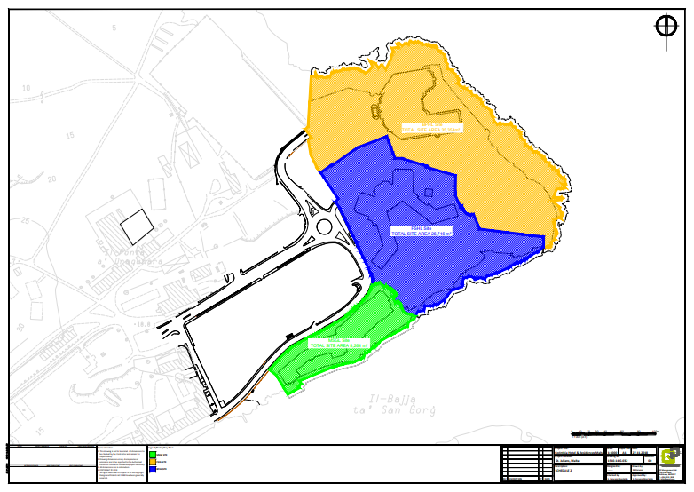

Slide 12
Deloitte’s Valuation of areas
Residential and office areas at the rate of €1,250 per net internal sqm
  Total Gross Value of €121.7M
Deductions from Total Gross value:
  €16.1m for infrastructure costs to be borne by IHI concerning public areas
  €9m as compensation for forgone assets and rights concerning the existing Marina Hotel building which will be demolished as part of the project.
  The acquisition cost of the Radisson Blue Resort of €33.4m. This was acquired by IHI plc in order to fulfil the conditions laid out in the 2015 MOU with Government.
  €12.9m for the potential additional tourist related development that may be undertaken on the site in question. The volume of underdeveloped area was quantified by an architect having reference to building densities allowed in the area.

Slide 13
Total net value
On this basis, the net value due for the waiver by Government of the restriction requiring that all developments are to be undertaken for touristic purposes and for the extension of the emphyteutical term has been calculated at Euro50.3
The parties have agreed to higher total compensation figure to Euro51.4 million, which will be paid as detailed in the next slide
None of this added income would accrue to Government under IHI’s current ownership title conditions
Additional Corporate Social Responsibility payment of €100,000 annually for a period of 10 years to the Pembroke and St. Julian’s Local Councils to be utilised for projects of benefit to the surrounding communities.

Slide 14
Developments since 2015 MOU
Since being tasked with taking this project forward in 2017, the Ministry for Tourism has re-engaged in fresh negotiations with Corinthia. These negotiations brought considerable improvements on agreed conditions of 2015 MOU:
Revised valuation upwards with support of Deloitte
Aligned term of concession in line with recent concessions
Reduced the ceiling on development of residential and commercial facilities to 100,000 sq m.
Increased compensation for waiver of restrictive condition and increase in terms from €38.7 million to €51.4 million
Increased premium from €12 million to €17 million
Increased title conversion payments from €175 per sq m pa to €250 per sq per annum in respect of residential/office space
Obligation to convert temporary title to perpetual and subsequent redemption on residential properties
Introduced a further €1m contribution for Corporate Social Responsibility

Slide 15
Proposed transactions
1. Disposal of land via special resolution of the House of Representatives: Article 31(c) of the Government Lands Act, Chapter 573 of the laws of Malta
2. Administrative Permit – Beach Areas: Grant of management rights over the beach areas (to ensure overall maintenance and security)
3. Deed: conditional termination of existing rights over part of the site and grant of real rights over the said site.
Existing deeds continue to regulate ca. 9,527 sq m of site area (foreshore) but the Government did not extend Corinthia’s rights over public domain property beyond what already exists in the current deeds

Slide 16
Design ideas

Slide 17
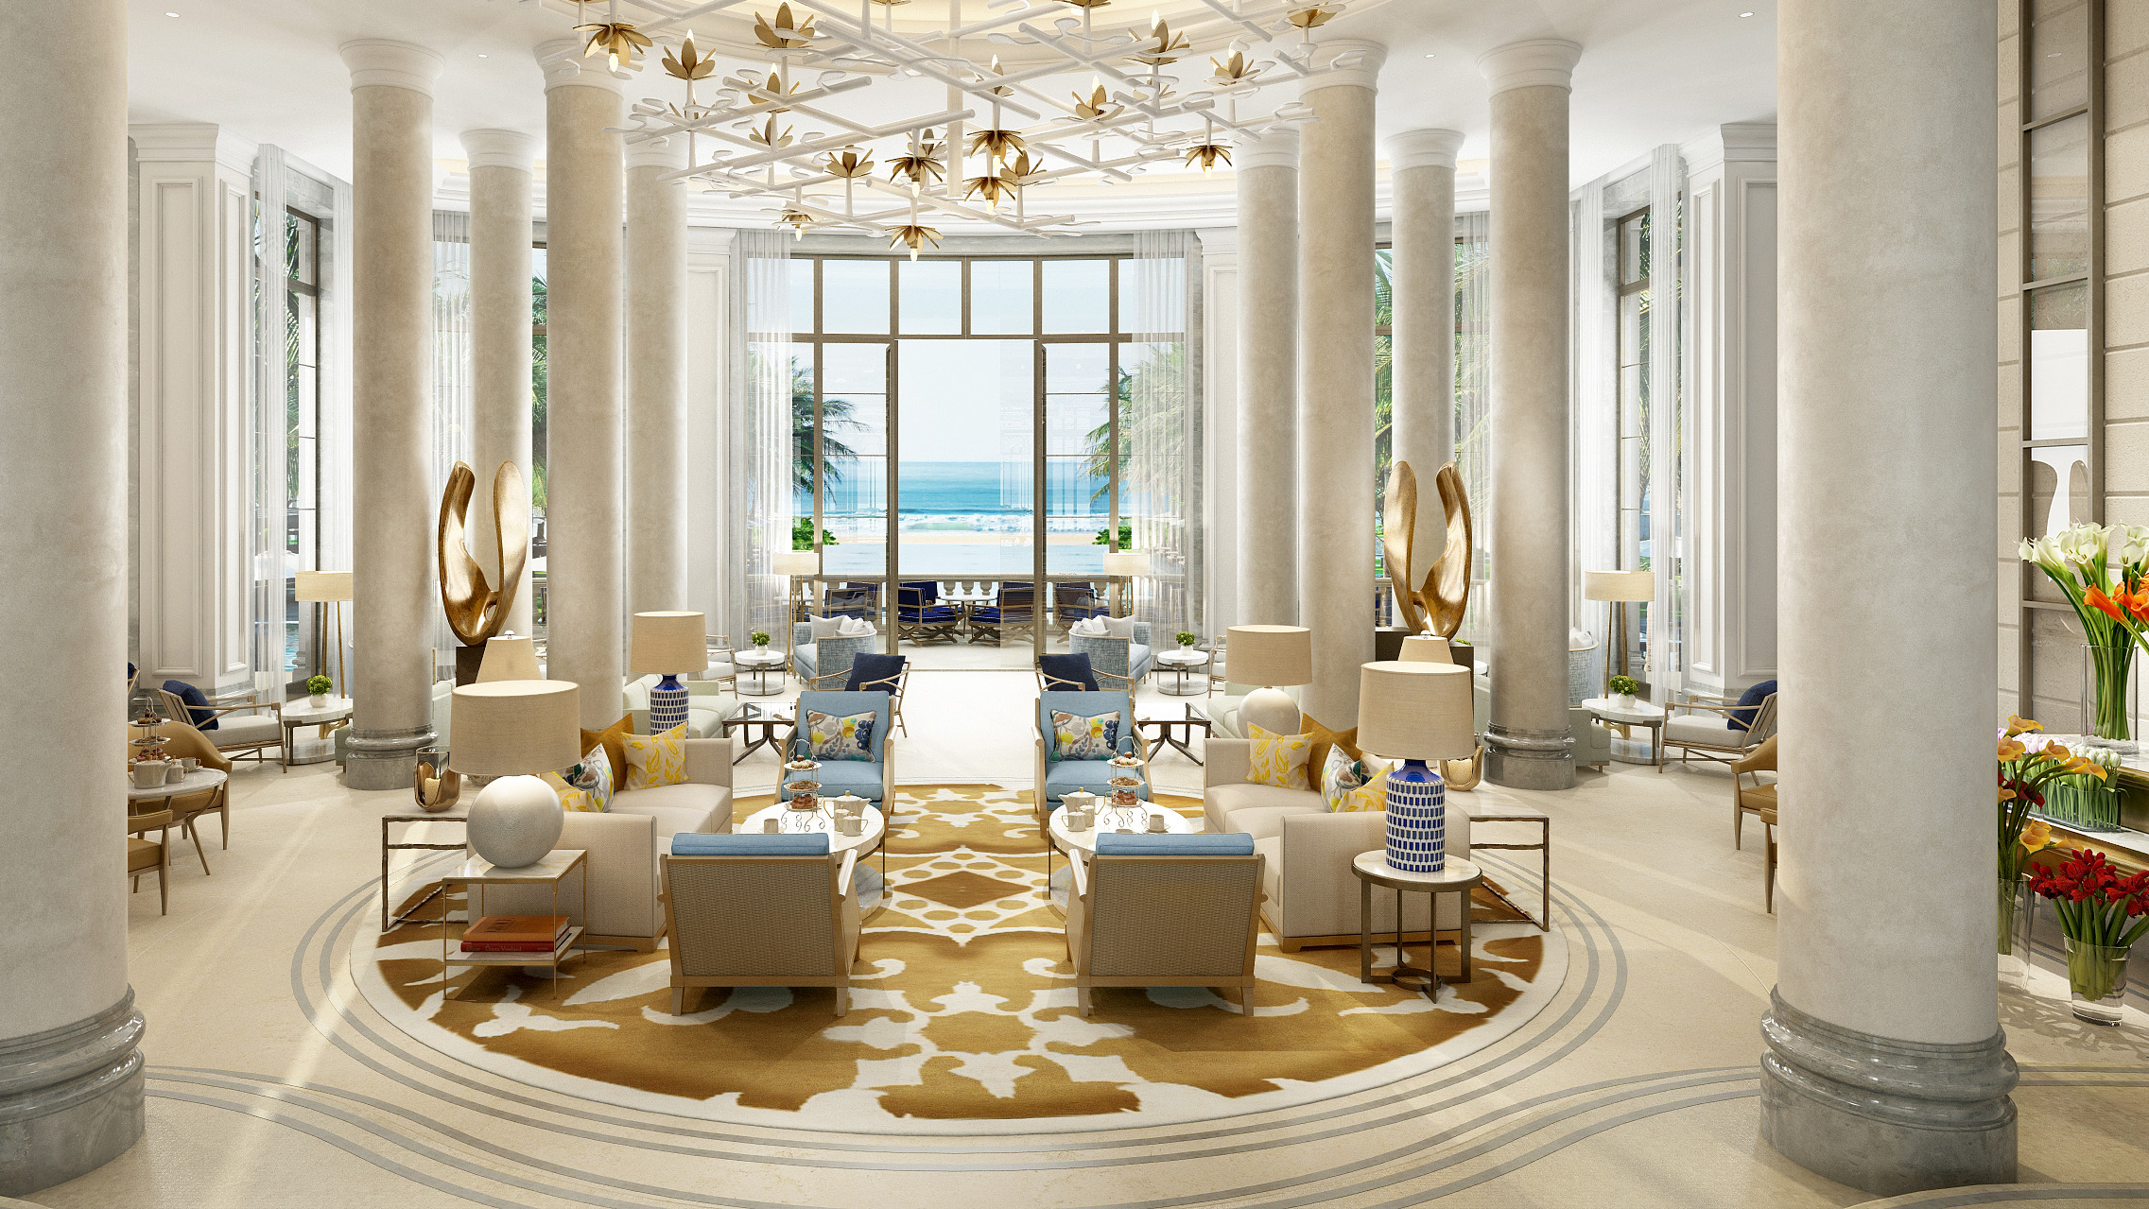
The lobby

Slide 18
The lobby

Slide 19
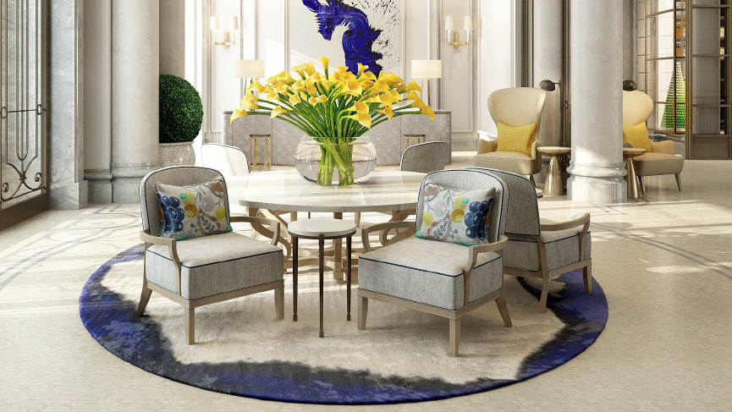
The entrance

Slide 20
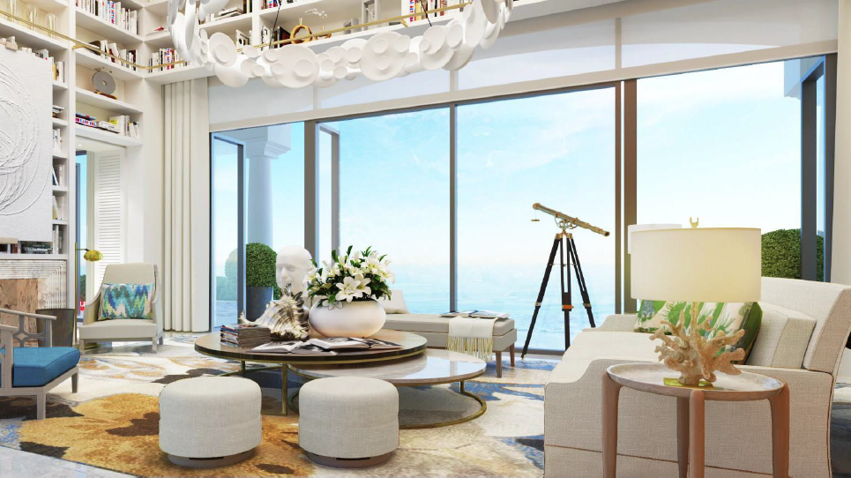
Themed suites

Slide 21
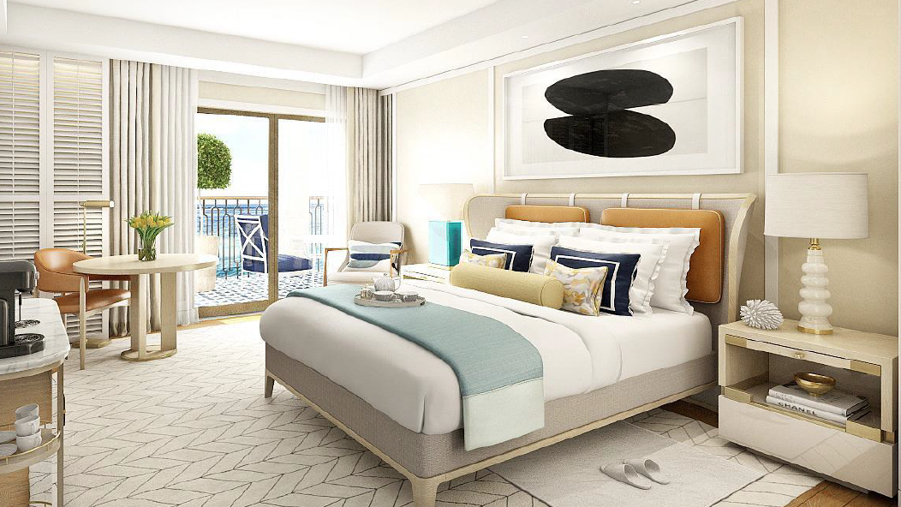
Standard bedrooms

Slide 22
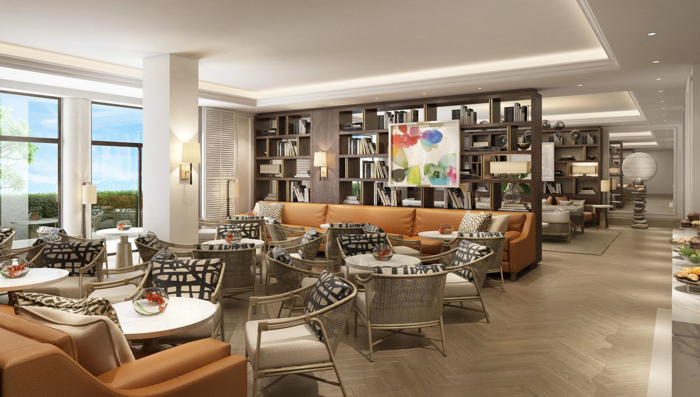
Resort lounge

Slide 24
Salient conditions of the deed
Conditional termination of the existing deeds in respect of part of the site
Existing deeds continue to regulate ca. 9,527 sq m of site area (foreshore) but the Government did not extend Corinthia’s rights over public domain property beyond what already exists in the current deeds
Fresh concession in respect of the terminated part of the site between government and Five Star Hotels Limited granting temporary emphyteutical title in respect of circa 60, 975 sq m of land;
Extension of term to 99 years from date of deed
Annual Base ground rent - €195,120 (€3.20 per sq m pa)
Formula for Increased Ground Rent: (BGR (Base Ground Rent)/(TAD)Total Area of Development Site) x DA (superficial area of that portion of land forming part of the Development Site which is designated by FSHL as being for Residential or Office use) x 2
Both base and increased ground rent are revisable by 5% every 5 years
Payment of premium of €17,000,000
CSR payment of €100,000 annually for a period of 10 years to the Pembroke and St. Julian’s Local Councils to be utilised for projects of benefit to the surrounding communities.

Slide 25
Salient conditions of the deed
Option for third party acquirers of residential and office space to covert and redeem;within 2 years from acquisition;
Obligation for FSHL to convert from temporary to perpetual emphyteusis, within 1 year from lapse of third party option;
Rate payable upon conversion :€250 per net internal saleable area of residential/office space and €37.50 in respect of garages and other external spaces.
Obligation of FSHL to redeem the ground rent iro all converted title;
Redemption at capitalisation rate of 5% of the applicable ground rent.
Project Phase 1: development application to be submitted within 1 year from re-zoning and completed within 5 years from issue of executable permit. Minimum project components of Phase 1 – luxury hotel and 15% of permitted volumes;
Remaining phases: all permits to be applied from within 10 years from date of re-zoning;
Full project completion (85% of permitted volumes and investment of €300,000,000) by not later than 5 years from the issue of the last executable permit.

Slide 26
Contractual obligation | Value
Premium
Definite upfront premium | €1,000,000
Definite premium within 3 years from date of deed | €3,000,000
Additional premium subject to project development | €13,000,000
Total Premium | €17,000,000
Mandatory Payments for conversion of title from temporary to perpetual
€250 per sq m of internal office and residential area | €24, 300,000
€37.50 per sq m of external area (residential and office area) | €1,100,000
€37.50 per sq m of car park area | €1,800,000
Total Conversion Payments | €27,200,000
Ground Rent
Value of annual ground rent on residential and office area (€75K per annum capitalized at 5% | €1,500,000
Value of annual ground rent on hospitality and other areas (€200k per annum capitalized at 3.5%) | €5,700,000
Total | €51,400,000

