Slide 1


Performance Audit
A Review on the Contract for Mount Carmel Hospital’s Clerical Services

Slide 2

Why This Study?
Previous NAO report revealed that some security personnel were being employed through a contract governing clerical services
NAO therefore decided to conduct an in-depth review on the contract for outsourced clerical services

Slide 3

Background
156 outsourced clerks are deployed to assist a directly employed staff complement of 717
Outsourced clerks cost MCH €3million per annum

Slide 4
Scope and Objectives
Determine whether the manner in which the contract for outsourced clerical services is managed by the hospital impinges on the value for money being attained by Government
NAO also came across significant information on the Outsourcing of Cleaning Services and hence conducted a cursory review

Slide 5
Main Finding
Irregular engagements, contractual design flaws and a weak contract management function, dilute value for money in
Mt. Carmel Hospital’s contract for
outsourced clerical services.

Slide 6
The Contract for Clerical Services
Contract expired in July’18
Extended for 12 months only by written communication from MFIN (€2.7 million budget)
New tender was submitted to DoC in March’18 – still not published
Some pre-requisites are too broad and subjective
No clear performance monitoring mechanism in the contract

Slide 7
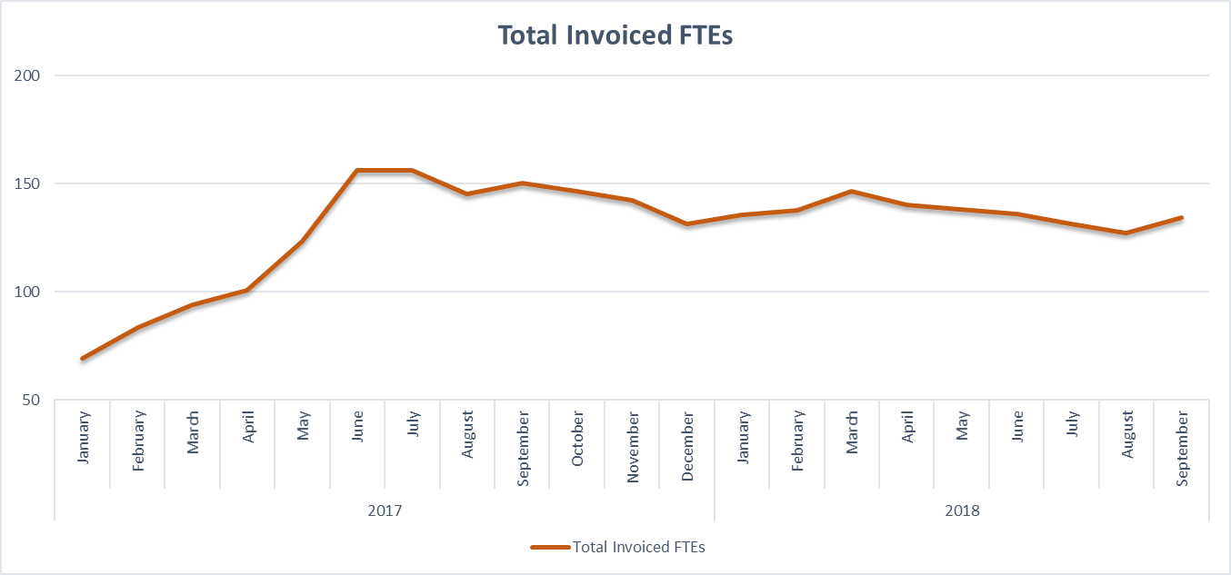
Staff Deployment and Contract Management
No responsible key official is assigned overall ownership of contract
Contract calls for 60 FTEs – 134 procured as at Sep’18

Slide 8
Staff Deployment and Contract Management
No Documentation Justifying the Number of
Engaged Outsourced Clerks was found
Highest increase in FTEs occurred in May and June ’17
Ex-COO informed NAO that this increase was the result of a six-month long exercise
FC and HR were not officially informed of this exercise
No official documentation on this exercise could be traced by NAO

Slide 9
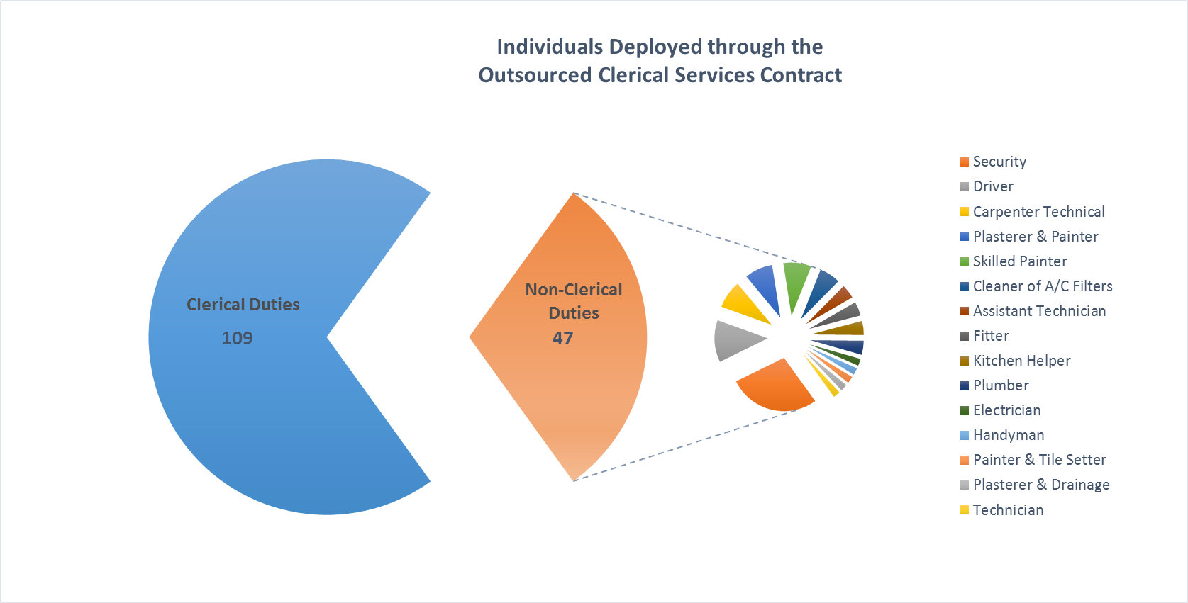
Staff Deployment and Contract Management
MCH does not need the quantities of outsourced clerks deployed –
Significant number of outsourced clerks
do not perform clerical duties

Slide 10
Staff Deployment and Contract Management
Ex-COO stated that MCH did not have any outsourcing contract for maintenance personnel and, in view of the hospital’s many requirements, maintenance personnel were engaged through clerical contract
Current CEO stated this practice is no longer being adopted and all engagements through this contract are assigned clerical duties

Slide 11
Staff Deployment and Contract Management
Quality
Outsourced clerks performing clerical duties : Management generally satisfied with the quality
Outsourced clerks performing non-clerical duties : A number of these personnel were not licensed or qualified to perform tasks related to the department they are assigned to
However, despite not being satisfied with the quality of some individuals, MCH found it difficult to request a replacement since it was the hospital itself who had referred such individuals to the contractor.

Slide 12
Outsourced Cleaning Services
MCH Management not aware of any formal contract governing the cleaning services
€1.6million worth of cleaning services were procured for six months through a call for quotations even if this far exceeded the financial threshold of this procurement method (tender process currently underway)
A number of deployed personnel (44) were not assigned cleaning duties
Quality of some of the outsourced staff and the cleaning products used was questionable; lack targeted training; replacements of employees not always possible

Slide 13
Concluding Remarks
Irregular deployment of non-clerical personnel and the involvement of Government officials shows ongoing misuse as regards the contract for outsourced clerks
Disjointed manner by which MCH manages this contract; apparent miscommunication among management, contract not assigned to a key official; and the shouldering of undue administrative burden which pertains to the contractor
Cursory review of the cleaning services contract showed the existence of identical problems as in the case of the clerical services contract

Slide 14
Thank You

